Slide 1
Batch processing with sh_gamit
M. A. Floyd
Massachusetts Institute of Technology, Cambridge, MA, USA
School of Earth Sciences, University of Bristol United Kingdom
2–5 May 2017
Material from T. A. Herring, R. W. King, M. A. Floyd (MIT) and S. C. McClusky (now ANU)
http://web.mit.edu/mfloyd/www/courses/gg/201705_Bristol/

Slide 2
Outline
Setup, operation and options for GAMIT processing with sh_gamit
Directory structures
Main functions in gamit
Programs called that run the GAMIT processing
Files that are important in processing
Summary files
Residual plots
Problems that can happen and suggestions

Slide 3
Overview of sh_gamit: Getting started
To start sh_setup will create /tables, /rinex, /gsoln directories and then local specifics can be set.
In tables/, process.defaults and sites.default are the two main files that need to be edited; sittbl. may also need editing to ensure some constrained stations in the network to be processed; sestbl. is edited if non-standard processing.
In tables/, apriori coordinate file created (name in process.defaults). Additional coordinates are put into ./tables/lfile.
In rinex/, local RINEX files need to be copied in; rinex data in archives will automatically be downloaded
sh_gamit -expt [expt-name] -s [yr] [start-doy] [stop-doy]
Common options are: -dopt –copt –rx_doy_minus -netext
Notes:
If you want to be sure you know what external cGPS data are available, you may choose to download the external RINEX files in advance (sh_get_rinex).

Slide 4
Directory Structure
Top level: global tables and survey directories
Within each survey directory: /tables /rinex /igs /gfiles /brdc /gsoln /glbf /day1 /day2 (these directories are created as needed)
Generally 50-60 sites is the largest network processed in GAMIT; larger numbers of stations require sub-netting of sites (see netsel, global_sel and sh_network_sel).
Tables are linked from day directories to experiment tables/ and then to ~/gg/tables
GAMIT processing occurs in the day directories
GLOBK processing occurs in gsoln/

Slide 5
Files provided or created automatically
Satellite orbits
IGS sp3-files (tabular) and/or g-files (ICs for GAMIT)
ARC integrates to get t-files (tabular)
Earth orientation parameters (EOPs: ut1.; wob.) — downloaded if needed for current day
Leap-second file — linked to gg/tables (update ~yearly or when leap second)
Satellite clock (j-) files — from RINEX navigation (brdc) file
Rcvr/ant characteristics (rcvant.dat, hi.dat) — linked to gg/tables
Differential code biases (dcb.dat) — update ~monthly
Antenna phase center models (antmod.dat) — linked to gg/tables (also needs to be updated when new antennas added).
Luni-solar ephemerides and nutation (soltab., luntab., nutabl.) linked to gg/tables (need to update yearly)
Ocean tide grid (optional) – linked to gg/tables
Atmospheric loading grid (optional) – need to update yearly
Mapping function grid (optional) – need to update yearly
Notes:
ftp chandler.mit.edu and get files from source/incremental_updates/tables directory.

Slide 6
Files you need to worry about
RINEX files – local plus list in sites.defaults
Control files
process.defaults – minor edits for each survey
sites.defaults – sites to include/omit; source of metadata
sestbl. – unchanged for most processing
sittbl. – sites constrained for ambiguity resolution
globk_comb.cmd – use_site, apr_neu, apr_svs, apr_wob, apr_ut1, sig_neu, mar_neu
glorg_comb.cmd – apr_file, pos_org, stab_site
A priori coordinates ( apr-file, l-file )
Meta-data (station.info)
Differential code biases (dcb.dat) – download current values 1/month
Satellite characteristics (svnav.dat) – download current w/ each new launch
Notes:
Templates for these files are in~/gg/tables, and the individual entries are discussed in Chapter 2 of the Introduction to GAMIT/GLOBK and Chapter 3 of the GAMIT Reference Manual.

Slide 7
Important files
autcln.cmd
process.defaults
sestbl.
sites.defaults
sittbl.
station.info
apr-file

Slide 8
process.defaults
Controls:
data and processing directory structure
some session parameters (e.g. start time, length and data interval, and apr-file name)
peripheral book-keeping (e.g. files to compress, archive or delete, and email address for summary)

Slide 9
sites.defaults
Controls:
Sites to be in included in experiment of given name

Slide 10
autcln.cmd
Controls:
All parts of the phase cleaning algorithm
Defaults generally work well for all experiments
May occasionally wish to change:
elevation mask
criteria to keep more data from sites with bad a priori co-ordinates

Slide 11
apr-file
Controls:
a priori (input) coordinates of sites
Convergence of (non-linear) processing is about 1:1000, i.e. 10 m accuracy for a priori co-ordinate will result in final coordinate accurate to about 10 mm
Important to have good a priori coordinates
Utilities include: sh_rx2apr
apr-file specified in process.defaults is copied to experiment “l-file”

Slide 12
station.info
Controls:
site occupation metadata, e.g.
Site name
Start and stop times of occupation
Reciever and antenna information (types, serial numbers, firmware, heights)
THIS IS A VERY IMPORTANT FILE!
Utilities include: sh_upd_stnfo and mstinf

Slide 13
sestbl.
(“session table”)
Controls
Processing setup
Observables to use (e.g. LC, L1+L2, etc.)
Experiment (orbits and EOPs) type
Models used

Slide 14
sittbl.
(“sites table”)
Controls:
Site-specific information for processing
Constraint (accuracy) of a priori coordinates in apr-file

Slide 15
sh_gamit internal operation
The following programs are run by the script:
makexp and makex prepare the data
fixdrv prepares the batch control files
arc integrates GPS satellite orbits
model calculates theoretical (modeled) phase and partial derivatives of phase with respect to parameters
autcln repairs cycle slips, removes phase outliers, and resolves the wide-lane ambiguities
solve estimates parameters via least-squares, resolving the narrow-lane ambiguities and creating an h-file for GLOBK (user constraints are removed in the h-file to allow reference frame definition)
Notes:
Once fixdrv is complete, the rest of the run is driven from a batch file, b[expt]][y].bat, which invokes a series of batch files, b[expt][y].nnn, one for each execution of arc, model, cfmrg, and solve.

Slide 16
Steps in the standard GAMIT batch sequence
arc, model, autcln, solve for initial solution
5-minute sampling, no ambiguity resolution (GCR only)
update lfile. for coordinates adjusted > 30 cm
look at: autcln.prefit.sum; q<expt>p.ddd
model, autcln, solve for final solution
2-minute sampling, ambiguity resolution
Look at --> autcln.post.sum, q<expt>a.ddd
Final solution repeated if NRMS reduced by > 30% from initial solution, to assure good editing and linear adjustment of parameters (original final-solution files overwritten)

Slide 17
What SOLVE produces:
Print output is the q-file, which records
in detail
a constrained solution without ambiguities resolved (GCR)
a constrained solution with ambiguities resolved (GCX)
These are the solutions you should examine, along with the autcln summary files, to assess the quality of the solution
And in summary only
a loose solution without ambiguities resolved (GLR)
A loose solution with ambiguities resolved (GLX)
Updated l-file for successive iterations or days
Useful output for GLOBK is the h-file (analogous to the IGS-standard SINEX file), which contains the parameters estimates and full covariance matrix.
(There is also an o-file, which is just the q-file but in more machine-readable form, and is seldom used; and, if orbits adjusted, an updated g-file)
Notes:
Although when data run smoothly, you will seldom have need to examine the q-file (only the e-mailed summary), you should be familiar with all of the entries in this file in order to understand problems with your data.

Slide 18
Options for metadata (station.info)
Pre-prepared station.info (make_stnfo, sh_upd_stnfo)
Must set xstinfo in sites.defaults
RINEX headers (sh_gamit default: may change soon)
Update station.info unless an entry already exists for the day being processed or stinf_unique is set to -u in process.defaults and entry has not changed
Can be used with non-standard receiver and antenna names specified in guess_rcvant.dat (ideally your rinex files have the IGS official receiver and antenna names. It is critical that this information is correct.
Notes:
Unless you know that all of the RINEX header information is correct (rarely the case), we recommend using pre-prepared station.info files, using sh_upd_stnfo to get started but then using log sheets to check and edit the files as needed.

Slide 19
A priori coordinates (sh_gamit)
Create l-file in day directory by merging existing lfile. and apr_file from ../tables (apr_file has priority)
If site not found in l-file
Use RINEX header coordinates (use_rxc=Y in process.defaults, good for modern (post SA, in 2000) data.
or
Use pseudorange data in RINEX file to estimate point position or differential position relative to a site in sites.defaults (use_rxc=N, default)
During the sh_gamit run, the coordinates are updated (and copied to ../tables/lfile.) if they are in error by > 30 cm
Notes:
Why do we do have this scheme? Need to maintain get and maintain coordinates < 0.3 m
GAMIT runs from L-file, either the older spherical format or the newer Cartesian (GLOBK apr) format. The L-file is updated after each solve run with the new estimates if the adjustments exceed the ‘Update tolereance’ (usually 0.3 m) in the sestbl. In sh_gamit processing, these values are carried forward to the next day except that at the beginning of each day, the coordinates in the L-file for any site appearing in the ‘apr_file’ (named in process.defaults), which usually includes ITRF sites and any regional sites for which previous processing has achieved precise coordinates.

Slide 20
Ambiguity resolution
(L2-L1) integers resolved by autcln and passed to solve in the n-file (LC_AUTCLN option)
weak dependence on geometry
need current differential code bias file dcb.dat
use LC_HELP for codeless data (before ~1995) or if problems (default max distance is 500 km)
Narrow-lane (L1) resolved by solve
strong dependence on phase noise and models
5-10 cm constraints on a priori coordinates usually sufficient
Notes:
Do resolve LC ambiguities, we need to resolve both L1 and L2, which can be reformulated as L2-L1 (wide-lane, WL) and L1 (narrow lane, NL). This is the form and notation used in autcln and solve. With code-tracking receivers (P2 present), the best strategy is to use the pseudoranges to resolve the WL in autcln (LC_AUTCLN). For codeless receivers, P2 is not available, so we must estimate the WL by constraining the ionosphere (LC_HELP).
Confusing topic without knowing theory. Come back to later in the afternoon if requested.

Slide 21
sh_gamit_ddd.summary (email)
Contents (Purple is output):
Input options -d 2002 30 31 32 33 -expt ncar -pres ELEV -yrext -netext a
Processing 2002 031 GPS week 1151 4 Raw 2
/data51/tah/SENH02/glob02/suomi/2002_031a
Disk Usage: 12678.4 Free 76447.4 Mbyte. Used 15%
Summary Statistics ( from autcln )
Number of stations used 4 Total xfiles 4
Postfit RMS rms, to and by satellite
RMS IT Site All 01 02 03 04 05 06 07 08 09 …
RMS 20 ALL 4.8 4 5 6 5 5 4 5 4 5 …
Best and Worst two sites:
RMS 20 TMGO 3.2 3 3 4 4 4 3 3 3 4 …
RMS 20 SA09 4.6 4 4 5 4 5 4 4 4 5 …
RMS 20 PLTC 5.4 4 5 5 6 5 4 5 5 6 …
RMS 20 SA13 5.5 5 5 6 5 5 5 5 5 6 …
Notes:
At the end of the sh_gamit executioin, it extracts information from final autcln summary (autcln.post.sum) and from the q-file (final, or (“a” solution) and writes this information into a summary file that is email to the user (sh_gamit.summary). Normally, this is all you need to see to assure that the run was successful.
This slide shows the top part of the summary file, giving the number of sites processed and statistics extracted from autcln. The key numbers are the number of stations used is less than what you expect, then check the sh_gamit log file and your directories to see if a RINEX file is missing or mis-named. If the total xfiles is less than the number of stations used, then xfiles have been created but not used, which can occur if they are too short (minxf in process.defaults) or you have intentially excluded then with ‘xsite’ in sites.defaults or the sh_gamit command line. The autcln statistics are the phase noise for the two stations with the lowest (“best”) noise, and the two for the highest (“worse”) noise. All the values in between you’ll need to get by examining autcln.post.sum. “Worse values between 7and 10 mm are common for each station; values between 10 and 15 will sometimes occur due to poor site conditions and should be usually be accepted with no further action. If one or more of the “best” sites has 0. for its rms, it means that autcln has discarded all the data from that station, and you should find out why (see later slides).

Slide 22
sh_gamit_ddd.summary (email)
Solution statistics from solve
Double difference statistics
Prefit nrms: 0.31280E+03 Postfit nrms: 0.21324E+00 Constrained free
Prefit nrms: 0.31185E+03 Postfit nrms: 0.21818E+00 Constrained fixed
Prefit nrms: 0.31272E+03 Postfit nrms: 0.20470E+00 Loose free
Prefit nrms: 0.31185E+03 Postfit nrms: 0.20756E+00 Loose fixed
Number of double differences: 12447
Numbers of WL and NL biases 120 Perscent fixed 95% WL 85% NL
Any large adjustments to positions (>0.3 m)
Things to note:
Number of stations matches expectation
Site postfit RMS values 3-10 mm
No stations with RMS = 0 ( implies no data retained by autcln )
Postfit nrms from solve ~0.2 for constrained and loose solutions
“Most” ambiguities resolved (70-85% for noisy days, > 90% for best)
Notes:
The statistics in the bottom part of the summary have been extracted from the q-file. The four nrms values correspond to the four solutions performed by ‘solve’: the two constrained solutions that you can examine in the q-file, and the two loose solutions that are not in the q-file but are written into the h-file for globk. These nrms values should all be nearly the same, with the ambiguity free values a little lower than the ambiguity fixed values, and the loose solution values a little lower than the constrained solution values. The most common anomaly is if the constrained solution nrms values are much higher, which implies that you have overconstrained the solution. That may be ok, since this solution is not used by globk, but it may be a problem if it compromised ambiguity resolution.
Since narrow lane ambiguities can be resolved only if wide-lane ambiguities are resolved first, the percentage of NL will always be smaller than the percentage for WL. A low WL percentage indicates poor pseudoranges; a low NL percentage compared to WL indicates geometric or atmospheric errors. For data since 2000, the values shown are typical; for data between 1995 and 2000, values in the range of 60-80% may occur, particularly if you have long baselines in the mix.

Slide 23
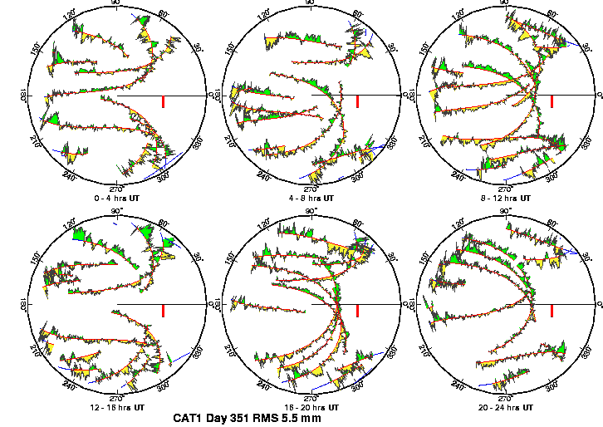
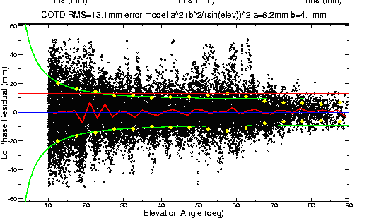
Phase residual plots
Set with -pres elev in sh_gamit command line (requires GMT)
Postscript files in day directory, by default converted to gif in /gifs directory and then erased (needs ImageMagik convert program).
Use to assess multipath, water vapor, and antenna phase center model
“Sky plot” Phase vs elevation angle
Notes:
The sky plots produced using the –pres ELEV command-line option of sh_gamit (or separately with sh_sky_gifs), are the most accessible source of detailed knowledge about conditions of session: multipath, atmosphere, receiver performance. In sky plots, red is the satellite track; yellow and green are positive and negative residuals, colored differently only to aid the eye; red bar is scale (10 mm). In right plot, all satellites are included. Red line is the average, green the envelope representing the constant + elevation-dependent noise model computed by autcln and passed to solve in the n-file for the final solution

Slide 24
Sky plots
High residuals in the same place at different times suggest mulitpath
High residuals appearing in a given place only at one time suggest water vapor

Slide 25
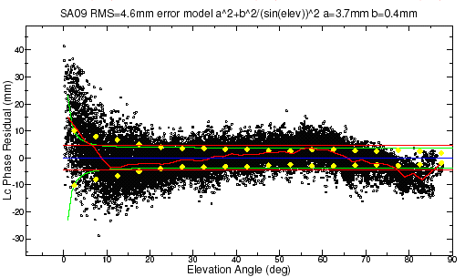
Phase vs elevation angle
Normal pattern: bands are high-frequency multipath; red is smoothing of individual values, showing no strong systematics. Mid-elevation angle noise could be atmospheric delay errors?
Bad pattern: systematic signature of smoothed values indicates a poor model of the antenna phase pattern (perhaps a misidentified antenna in station.info)
(Green lines show the elevation-dependent noise model shown at top and used to reweight the data in solve)
Notes:
Large excursion is below 10 deg but still systematic above 10 deg

Slide 26
What can go wrong?
Site missing (not listed)
no RINEX data within session span: check RINEX file and/or makex.expt.infor
too few data, x-file too small and not used: check RINEX file size, change minxf in process.defaults
Site in solution but no data or adjustment
a priori coordinates > 10 m off: check range rms in autcln.prefit.sum,
run sh_rx2apr differentially for several RINEX files
bad receiver: examine RINEX files or initial c-files with cview
Q-file nrms > 0.2
solution over-constrained: check GCX vs GLX nrms, rerun with only one site constrained
Notes:
Next few slides look at each of these problems.

Slide 27
Problems with a priori coordinates
Need to be good to < 10 m to get through autcln
Safest source is a previous solution or a pseudorange solution using svpos/svdiff (sh_rx2apr)
Range rms and bias flags added from autcln summary file are a useful check
Convergence is 1:100 to 1:1000 (1 m error in apr can lead to 1-10 mm error in adjustment)—hence automatic update of L-file for GAMIT 2nd solution
Watch for repeated updates in email summary as a sign of bad data

Slide 28
Constraining the GAMIT solution
Minimal (single-station) constraint is all that’s needed for ambiguity resolution, but sittbl. can list several to assure one
Orbits can be fixed or tightly constrained (.005 ppm) for IGS orbits since at least 1996. Use of baseline mode (no orbit estimated now recommended for regional processing.
Look for good (~0.2) loose (GLR/GLX) nrms but elevated constrained nrms (GCR/GCX) as indication of an over-constrained solution
Notes:
If using GLOBK for final solution, you can constrain the frame more rigorously there, so for GAMIT, just provide a minimal constraint to assess data quality.: low nrms, small adjustments to all parameters.

Slide 29
More Subtle Problems
Site with high rms in autcln.post.sum
high multipathing or water vapor: check sky plots of phase
bad receiver: examine RINEX files or initial c-files with cview
Phase vs elevation angle plot large and systematic
misidentified antenna (wrong PCV model)
coupling between antenna and mount
GAMIT results within normal range but time series shows outlier
survey-mode: antenna not leveled and centered over mark
change in multipath (water, objects) or water vapor
snow on antenna
incorrect ambiguity resolution (east component except for high latitudes)
Notes:
These are somewhat overlapping, both with the three major problems discussed on the previous slides, and with each other. They provide a conceptual structure with which to look at the plotting tools available for diagnostics.

Slide 30
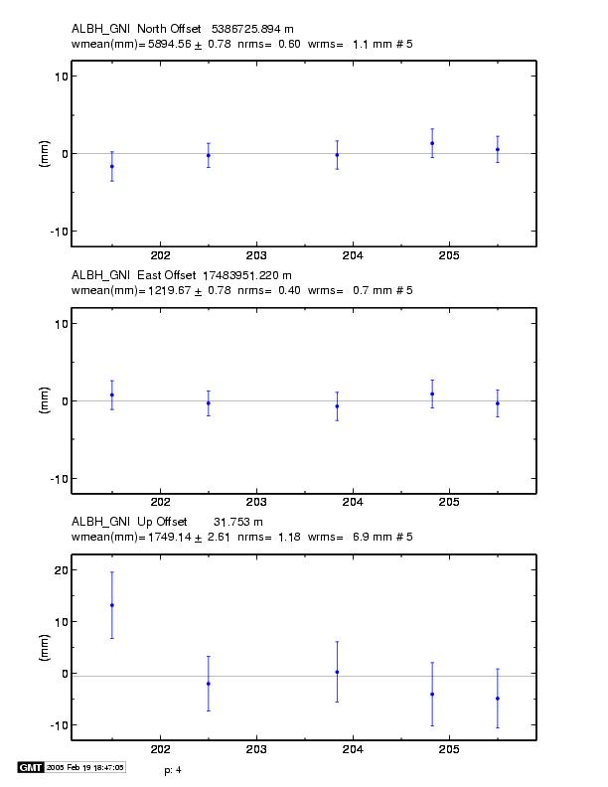
Example of understanding outliers
Autcln RMS:
Day 201 9.6 mm
Day 202 6.0 mm
Notice height outlier on day 201
Notes:
Time series (from sh_glred) showing an outlier on day 201. Why?
Probably troposphere since in height and we don’t expect multipath to change (though it can)
Look at the sky plots.

Slide 31
ALBH 2003 Day 201
ALBH 2003 Day 202
Notes:
In fact, day 201 (the outlier) has significantly higher phase noise than day 202. Since the pattern is different on the two days, the cause must be water vapor rather than multipath.

