Slide 1



Batch processing with sh_gamit
M. A. Floyd T. A. Herring
Massachusetts Institute of Technology, Cambridge, MA, USA
GNSS Data Processing and Analysis with GAMIT/GLOBK and track
UNAVCO Headquarters, Boulder, Colorado, USA
24–28 August 2020
http://geoweb.mit.edu/~floyd/courses/gg/202008_UNAVCO/
Material from R. W. King, T. A. Herring, M. A. Floyd (MIT) and S. C. McClusky (now at ANU)

Slide 2
Outline
Setup, operation and options for GAMIT processing with sh_gamit
  Directory structures
  Main functions in GAMIT
    Programs called that run the GAMIT processing
  Files that are important in processing
  Summary files
  Residual plots
  Problems that can happen and suggestions

Slide 3
Overview of sh_gamit: Getting started
sh_setup will create tables/ directory, then local specifics can be set
  In tables/, process.defaults and sites.defaults are the two main files that need to be edited; sittbl. may also need editing to ensure some constrained stations in the network to be processed; sestbl. is edited if non-standard processing.
  In tables/, a priori coordinate (.apr) file created (name in process.defaults); additional coordinates are put into tables/lfile.
Create rinex/ directory (e.g. mkdir rinex) in which to store local RINEX files to be processed; RINEX data in public archives will automatically be downloaded
sh_gamit -expt <expt-name> -s <yr> <start-doy> <stop-doy>
  Common options are: -orbit, -eops, -gnss, -netext
Notes:
If you want to be sure you know what external cGNSS data are available, you may choose to download the external RINEX files in advance (sh_get_rinex).

Slide 4
Directory structure
Top level: global tables and survey directories
Within each top-level directory:
brdc/ gfiles/ glbf/ gsoln/ igs/ rinex/ tables/
001/ 002/ … (these directories are created as needed)
Generally 50-60 sites is the largest network processed in GAMIT; networks larger than 99 stations require sub-netting of sites (see netsel, global_sel and sh_network_sel)
Tables are linked from day directories to experiment tables/ and then to ~/gg/tables/
GAMIT processing occurs in the day (<DDD>) directories
GLOBK processing occurs in gsoln/

Slide 5
Files provided or created automatically
Satellite orbits
  IGS SP3-files (tabular) and/or g-files (initial conditions (ICs) for GAMIT)
  arc integrates to get t-files (tabular)
Earth orientation parameters (EOPs: ut1.; wob.): downloaded if needed for current day
Leap second file; linked to gg/tables/ (update approximately yearly or with leap second announcements)
Satellite clock (j-) files; from RINEX navigation (brdc) or SP3 file
Receiver and antenna characteristics (rcvant.dat, hi.dat); linked to gg/tables
Differential code biases (dcb.dat); updated monthly
Antenna phase center models (antmod.dat); linked to gg/tables/ (also needs to be updated when new antennas added)
Lunar, solar and planetary ephemerides (nbody); linked to gg/tables/
  Formerly tables (soltab., luntab., nutabl.) linked to gg/tables/, which needed to be updated yearly; no longer necessary
Ocean tide grid (optional); linked to gg/tables/ from gg/GRIDS/
Atmospheric loading grid (optional); linked to gg/tables/ from gg/GRIDS/; need to update yearly
Mapping function grid (optional); linked to gg/tables/ from gg/GRIDS/; need to update yearly
Notes:
ftp chandler.mit.edu and get files from source/incremental_updates/tables directory.
Although you generally don’t need to inspect these files, understanding their purpose and origin is important for sorting out problems.

Slide 6
Files you need to worry about
RINEX files: local plus list in sites.defaults
Control files
  process.defaults : minor edits for each survey
  sestbl. : experiment and models setup (unchanged for most processing)
  sites.defaults : sites to include or omit and source of metadata
  sittbl. : sites constrained for ambiguity resolution
  globk.cmd : use_site, apr_neu, apr_svs, apr_wob, apr_ut1, sig_neu and mar_neu commands
  glorg.cmd : apr_file, pos_org, stab_site commands
a priori coordinates (.apr-file, l-file)
Metadata (station.info)
Differential code biases (dcb.dat); download current values once per month
Satellite characteristics (svnav.dat); download current with each new launch
  Now linked to igs_metadata.snx, which is maintained by the IGS
Notes:
Templates for these files are in~/gg/tables, and the individual entries are discussed in Chapter 2 of the Introduction to GAMIT/GLOBK and Chapter 3 of the GAMIT Reference Manual. See the doc file Using_global_h-files for suggested strategies for choosing IGS sites to include in your processing.

Slide 7
Important files
autcln.cmd
process.defaults
sestbl.
sites.defaults
sittbl.
station.info
.apr-file

Slide 8
process.defaults
Controls:
  Data and processing directory structure
  Some session parameters (e.g. start time, length and data interval, and apr-file name)
  Peripheral book-keeping (e.g. files to compress, archive or delete, and email address for summary)
Notes:
You need to understand all of the entries in this file.

Slide 9
sites.defaults
Controls sites to be in included in experiment of given name
  Whether or not these sites should be downloaded from a public data server (use “ftprnx” flag)
  Whether or not these sites should have their metadata updated from the RINEX file header (not recommended, particularly for continuous sites; use “xstinfo” flag)
May use one sites.defaults file with multiple experiment names and use “-expt” option in sh_gamit to process only certain sites
May use a different experiment setup for different days
  sh_gamit will look first for “sites.defaults.YYYYDDD”, then a generic “sites.defaults” file
Notes:
The [expt] token accompanying each entry allows you to use this file to establish sub-netting, as will be described in the lecture on large continuous networks.

Slide 10
autcln.cmd
Controls all parts of the phase cleaning algorithm
Defaults generally work well for all experiments
  May occasionally wish to change:
    elevation mask
    criteria to keep more data from sites with bad a priori co-ordinates

Slide 11
.apr-file
Controls a priori (input) coordinates of sites
Convergence of (non-linear) processing is about 1:1000, i.e. 10 m accuracy for a priori co-ordinate will result in final coordinate accurate to about 10 mm
  Important to have good a priori coordinates
Utilities include: sh_rx2apr
.The experiment l-file is initialized each day with the coordinates in the .apr-file specified in process.defaults (while retaining any entries added during prior processing for sites not in the .apr_file

Slide 12
station.info
Controls site occupation metadata
  Site name
  Start and stop times of occupation
  Receiver and antenna information (types, serial numbers, firmware, heights)
Utilities include sh_upd_stnfo which invokes program mstinf
Options for metadata include
  Pre-prepared station.info (sh_upd_stnfo, make_stnfo)
    Must set “xstinfo” in sites.defaults
  RINEX headers (sh_gamit default but may change soon)
    Update station.info unless an entry already exists for the day being processed or “stinf_unique” is set to “-u” in process.defaults and entry has not changed
    Can be used with non-standard receiver and antenna names specified in guess_rcvant.dat (ideally your RINEX files have the IGS official receiver and antenna names. It is critical that this information is correct
THIS IS A VERY IMPORTANT FILE!
  If you do not get this file correct (and verified) before processing, you may lose a lot of time reprocessing phase data at the GAMIT (slowest) stage

Slide 13
sestbl. (“session table”)
Controls processing setup
  Observables to use (e.g. LC, L1+L2, etc.)
  Experiment (orbits and EOPs) type
    “BASELINE” solves for site coordinates only using fixed orbital parameters [default]
    “ORBIT” solves for orbital parameters only using fixed site coordinates (from .apr-file)
    “RELAX.” solves for both site and orbital parameters
  Models used

Slide 14
sittbl. (“sites table”)
Controls:
  Site-specific information for processing
    Constraint (accuracy) of a priori coordinates in .apr-file
Notes:
Modest contraints (5-10 cm) on one or two sites are sufficient to effect good ambiguity resolution. In many cases you can simply use the template in gg/tables, which includes a large number of IGS sites, some of which are likely to be in your network.

Slide 15
sh_gamit internal operation
The following programs are run by the script:
makexp and makex prepare the data
fixdrv prepares the batch control files
arc integrates GNSS satellite orbits
model calculates theoretical (modeled) phase and partial derivatives of phase with respect to parameters
autcln repairs cycle slips, removes phase outliers, and resolves the wide-lane ambiguities
solve estimates parameters via least-squares, resolving the narrow-lane ambiguities and creating an h-file for GLOBK (user constraints are removed in the h-file to allow reference frame definition)
Notes:
Once fixdrv is complete, the rest of the run is driven from a batch file, b[expt]][y].bat, which invokes a series of batch files, b[expt][y].nnn, one for each execution of arc, model, cfmrg, and solve. It behooves you to read the documentation for each of these programs so that you can understand problems when they occur.

Slide 16
Steps in the standard GAMIT batch sequence
arc, model, autcln, solve for initial solution
  5-minute sampling, no ambiguity resolution (GCR only)
  update lfile. for coordinates adjusted > 30 cm
  look at: autcln.prefit.sum; q<expt>p.ddd
model, autcln, solve for final solution
  2-minute sampling, ambiguity resolution
  Look at: autcln.post.sum, q<expt>a.ddd
Final solution repeated if NRMS reduced by > 30% from initial solution, to assure good editing and linear adjustment of parameters (original final solution files overwritten)

Slide 17
What solve produces
Print output is the q-file, which records
  in detail
  A constrained solution without ambiguities resolved (“GCR”)
  A constrained solution with ambiguities resolved (“GCX”)
  These are the solutions you should examine, along with the autcln summary files, to assess the quality of the solution
  and in summary only
  A loose solution without ambiguities resolved (“GLR”)
  A loose solution with ambiguities resolved (“GLX”)
Updated l-file for successive iterations or days
Useful output for GLOBK is the h-file (analogous to the IGS standard SINEX file), which contains the parameters estimates and full covariance matrix.
(There is also an o-file, which is just the q-file but in more machine-readable form, and is seldom used; and, if orbits adjusted, an updated g-file)
Notes:
Although when data run smoothly, you will seldom have need to examine the q-file (only the e-mailed summary), you should be familiar with all of the entries in this file in order to understand problems with your data.

Slide 18
A priori coordinates (sh_gamit)
Create l-file in day directory by merging existing lfile. and apr_file from ../tables/ (apr_file has priority)
If site not found in l-file
  Use RINEX header coordinates (“set use_rxc = Y” in process.defaults, good for modern (post selective availability, in 2000) data
  or
  Use pseudorange data in RINEX file to estimate point position or differential position relative to a site in sites.defaults (“set use_rxc = N”, default)
During the sh_gamit run, the coordinates are updated (and copied to ../tables/lfile.) if they are in error by > 30 cm
Notes:
Why do we do have this scheme? Need to maintain get and maintain coordinates < 0.3 m
GAMIT runs from L-file, either the older spherical format or the newer Cartesian (GLOBK apr) format. The L-file is updated after each solve run with the new estimates if the adjustments exceed the ‘Update tolereance’ (usually 0.3 m) in the sestbl. In sh_gamit processing, these values are carried forward to the next day except that at the beginning of each day, the coordinates in the L-file for any site appearing in the ‘apr_file’ (named in process.defaults), which usually includes ITRF sites and any regional sites for which previous processing has achieved precise coordinates.

Slide 19
Ambiguity resolution
(L2 − L1) integers resolved by autcln and passed to solve in the n-file (“LC_AUTCLN” option in sestbl.)
  Weak dependence on geometry
  Need current differential code bias file dcb.dat
  Use “LC_HELP” for codeless data (before ~ 1995) or if problems (default max distance is 500 km)
Narrow-lane (L1) resolved by solve
  Strong dependence on phase noise and models
  5–10 cm constraints on a priori coordinates usually sufficient
Notes:
To resolve LC ambiguities, we need to resolve both L1 and L2, which can be reformulated as L2-L1 (wide-lane, WL) and L1 (narrow lane, NL). This is the form and notation used in autcln and solve. With code-tracking receivers (P2 present), the best strategy is to use the pseudoranges to resolve the WL in autcln (LC_AUTCLN). For codeless receivers, P2 is not available, so we must estimate the WL by constraining the ionosphere (LC_HELP).
Confusing topic without knowing theory. Come back to later in the afternoon if requested.

Slide 20
sh_gamit_<DDD>.summary (also email)
Preamble
Input options -d 2002 30 31 32 33 -expt ncar -pres ELEV -yrext -netext a
Processing 2002 031 GPS week 1151 4 Raw 2
/data51/tah/SENH02/glob02/suomi/2002_031a
Disk Usage: 12678.4 Free 76447.4 Mbyte. Used 15%
Summary Statistics (from autcln)
Number of stations used 4 Total xfiles 4
Postfit RMS rms, to and by satellite
RMS IT Site All 01 02 03 04 05 06 07 08 09 ...
RMS 20 ALL 4.8 4 5 6 5 5 4 5 4 5 ...
Best and Worst two sites:
RMS 20 TMGO 3.2 3 3 4 4 4 3 3 3 4 ...
RMS 20 SA09 4.6 4 4 5 4 5 4 4 4 5 ...
RMS 20 PLTC 5.4 4 5 5 6 5 4 5 5 6 ...
RMS 20 SA13 5.5 5 5 6 5 5 5 5 5 6 ...
Notes:
At the end of the sh_gamit executioin, it extracts information from final autcln summary (autcln.post.sum) and from the q-file (final, or (“a” solution) and writes this information into a summary file that is email to the user (sh_gamit.summary). Normally, this is all you need to see to assure that the run was successful.
This slide shows the top part of the summary file, giving the number of sites processed and statistics extracted from autcln. The key numbers are the number of stations used is less than what you expect, then check the sh_gamit log file and your directories to see if a RINEX file is missing or mis-named. If the total xfiles is less than the number of stations used, then xfiles have been created but not used, which can occur if they are too short (minxf in process.defaults) or you have intentially excluded then with ‘xsite’ in sites.defaults or the sh_gamit command line. The autcln statistics are the phase noise for the two stations with the lowest (“best”) noise, and the two for the highest (“worse”) noise. All the values in between you’ll need to get by examining autcln.post.sum. “Worse values between 7and 10 mm are common for each station; values between 10 and 15 will sometimes occur due to poor site conditions and should be usually be accepted with no further action. If one or more of the “best” sites has 0. for its rms, it means that autcln has discarded all the data from that station, and you should find out why (see later slides).

Slide 21
sh_gamit_<DDD>.summary (also email)
Solution statistics from solve
Double difference statistics
Prefit nrms: 0.31280E+03 Postfit nrms: 0.21324E+00 (Constrained free)
Prefit nrms: 0.31185E+03 Postfit nrms: 0.21818E+00 (Constrained fixed)
Prefit nrms: 0.31272E+03 Postfit nrms: 0.20470E+00 (Loose free)
Prefit nrms: 0.31185E+03 Postfit nrms: 0.20756E+00 (Loose fixed)
Number of double differences: 12447
Numbers of WL and NL biases 120 Percent fixed 95% WL 85% NL
Any large adjustments to positions (> 0.3 m) ...
Things to note:
  Number of stations matches expectation
  Site postfit RMS values 3–10 mm
  No stations with RMS = 0 ( implies no data retained by autcln )
  Postfit nrms from solve ~ 0.2 for constrained and loose solutions
  “Most” ambiguities resolved (70–85% for noisy days, > 90% for best)
Notes:
The statistics in the bottom part of the summary have been extracted from the q-file. The four nrms values correspond to the four solutions performed by ‘solve’: the two constrained solutions that you can examine in the q-file, and the two loose solutions that are not in the q-file but are written into the h-file for globk. These nrms values should all be nearly the same, with the ambiguity free values a little lower than the ambiguity fixed values, and the loose solution values a little lower than the constrained solution values. The most common anomaly is if the constrained solution nrms values are much higher, which implies that you have overconstrained the solution. That may be ok, since this solution is not used by globk, but it may be a problem if it compromised ambiguity resolution.
Since narrow lane ambiguities can be resolved only if wide-lane ambiguities are resolved first, the percentage of NL will always be smaller than the percentage for WL. A low WL percentage indicates poor pseudoranges; a low NL percentage compared to WL indicates geometric or atmospheric errors. For data since 2000, the values shown are typical; for data between 1995 and 2000, values in the range of 60-80% may occur, particularly if you have long baselines in the mix.

Slide 22
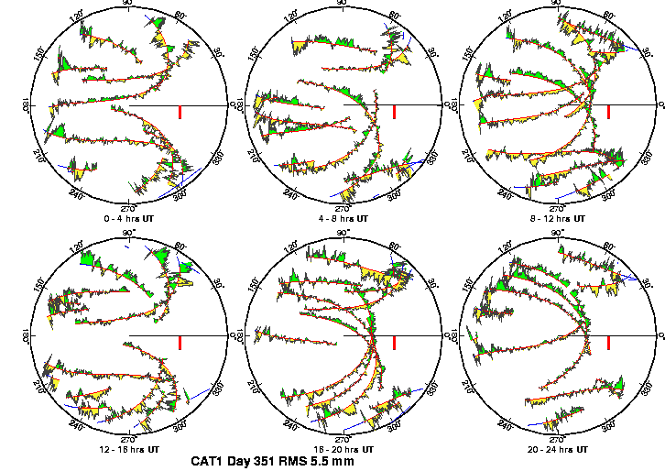
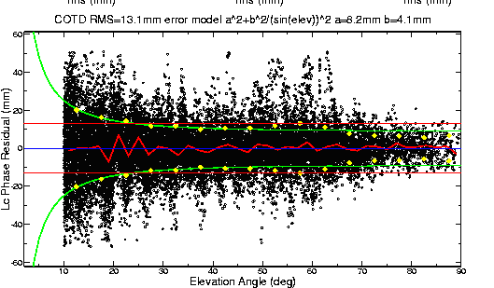
Phase residual plots
Set with “-pres elev” in sh_gamit command (requires GMT)
Postscript files in day directory, by default converted to PNG in figs/ directory and then erased (requires GMT’s psconvert or ps2raster)
Use to assess multipath, water vapor, and antenna phase center model
“Sky plot” Phase vs elevation angle
Notes:
The sky plots produced using the –pres ELEV command-line option of sh_gamit (or separately with sh_sky_gifs), are the most accessible source of detailed knowledge about conditions of session: multipath, atmosphere, receiver performance. In sky plots, red is the satellite track; yellow and green are positive and negative residuals, colored differently only to aid the eye; red bar is scale (10 mm). In right plot, all satellites are included. Red line is the average, green the envelope representing the constant + elevation-dependent noise model computed by autcln and passed to solve in the n-file for the final solution

Slide 23
Sky plots
High residuals in the same place at different times suggest multipath
High residuals appearing in a given place only at one time suggest water vapor

Slide 24
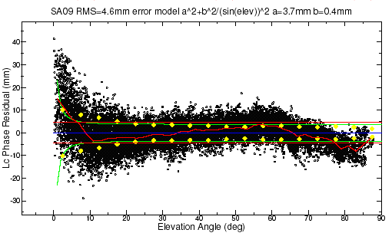
Phase vs elevation angle
Normal pattern: bands are high-frequency multipath; red is smoothing of individual values, showing no strong systematics. Mid-elevation angle noise could be atmospheric delay errors?
Bad pattern: systematic signature of smoothed values indicates a poor model of the antenna phase pattern (perhaps a misidentified antenna in station.info)
(Green lines show the elevation-dependent noise model shown at top and used to reweight the data in solve)
Notes:
Large excursion is below 10 deg but still systematic above 10 deg

Slide 25
What can go wrong?
Site missing (not listed)
  No RINEX data within session span: check RINEX file and/or makex.expt.infor
  Too few data, x-file too small and not used: check RINEX file size, change “minxf” in process.defaults
Site in solution but no data or adjustment
  a priori coordinates > 10 m off: check range rms in autcln.prefit.sum,
    run sh_rx2apr differentially for several RINEX files
  bad receiver: examine RINEX files or initial c-files with cview
q-file nrms > 0.2
  solution over-constrained: check GCX vs GLX nrms, rerun with only one site constrained in the sittbl.
Notes:
Next few slides look at each of these problems.

Slide 26
Problems with a priori coordinates
Need to be good to < 10 m to get through autcln
Safest source is a previous solution or a pseudorange solution using svpos/svdiff (sh_rx2apr)
Range rms and bias flags added from autcln summary file are a useful check
Convergence is 1:100 to 1:1000 (1 m error in .apr-file can lead to 1–10 mm error in adjustment), hence automatic update of l-file for iteration of second GAMIT solution
Watch for repeated updates in email summary as a sign of bad data

Slide 27
Constraining the GAMIT solution
Minimal (single-station) constraint is all that’s needed for ambiguity resolution, but sittbl. can list several to assure one
Orbits can be fixed or tightly constrained (.005 ppm) for IGS orbits since at least 1996
  Use of “BASELINE” mode with “igsf” orbits fixed now recommended for processing regions up to at least 6000 km
Look for good (~0.2) loose (GLR/GLX) nrms but elevated constrained nrms (GCR/GCX) as indication of an over-constrained solution
Notes:
If using GLOBK for final solution, you can constrain the frame more rigorously there, so for GAMIT, just provide a minimal constraint to assess data quality.: low nrms, small adjustments to all parameters.

Slide 28
More subtle problems
Site with high rms in autcln.post.sum
  High multipath or water vapor: check sky plots of phase
  Bad receiver: examine RINEX files or initial c-files with cview
Phase vs elevation angle plot large and systematic
  Misidentified antenna (wrong PCV model)
  Coupling between antenna and mount
GAMIT results within normal range but time series shows outlier
  Survey-mode: antenna not leveled and centered over mark
  Change in multipath (water, objects) or water vapor
  Snow on antenna
  Incorrect ambiguity resolution (east component except for high latitudes)
Notes:
These are somewhat overlapping, both with the three major problems discussed on the previous slides, and with each other. They provide a conceptual structure with which to look at the plotting tools available for diagnostics.

Slide 29
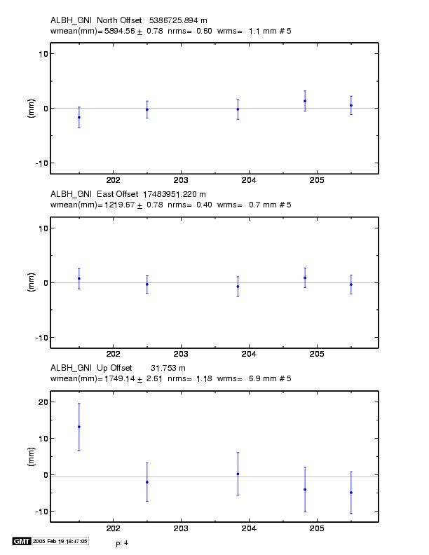
Example of understanding outliers
autcln RMS:
Day 201 9.6 mm
Day 202 6.0 mm
Notice height outlier on day 201
Notes:
Time series (from sh_glred) showing an outlier on day 201. Why?
Probably troposphere since in height and we don’t expect multipath to change (though it can)
Look at the sky plots.

Slide 30
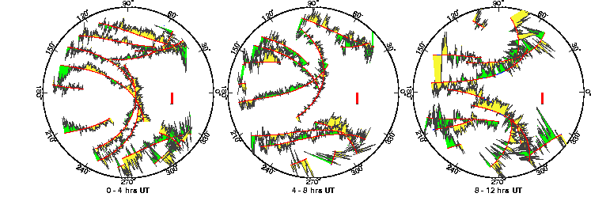
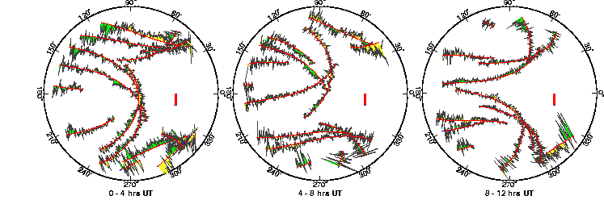
ALBH 2003 Day 201
ALBH 2003 Day 202
Notes:
In fact, day 201 (the outlier) has significantly higher phase noise than day 202. Since the pattern is different on the two days, the cause must be water vapor rather than multipath.

