Slide 1
Izmir GAMIT/GLOBK Workshop
Introduction
Thomas Herring, MIT
tah@mit.edu

Slide 2
Workshop Overview
Lectures and Tutorials: Day 1:
  Introduction to GPS data processing and how processing is treated in gamit/globk
  GAMIT Lecture: Overview of standard processing in GAMIT; daily session processing
  GLOBK Lecture: Overview of the way GLOBK is used to analyze and combine results from GAMIT processing
  Tutorial session: Salton Sea data analysis around time of Magnitude 5.8 aftershock to El Major Cucapah April 4, 2010 Mw 7.2 earthquake

Slide 3
Workshop Overview
Lectures and Tutorials Day 2
  Modeling details, atmospheric delays, loading
  Treatment of earthquakes, equipment changes and other effects
  Statistics of time series and determination of error models for velocity estimates
  Analysis of Salton Sea data over a longer period of time using time series.

Slide 4
GPS overview
For GPS processing, the critical information needed is range and phase data from a receiver collecting data from multiple GPS satellites and information about the orbits of the satellites (earth-fixed frame) and some information about clocks in satellites.
In GAMIT, only crude clock information needed due to double-differencing.
To integrate GPS orbits, information needed about rotation between earth-fixed and inertial space.
For the most accurate GPS results, other ancillary information needed (e.g., atmospheric models, ocean tides, antenna and receiver biases).
Program track (kinematic processing) can use just RINEX data files and SP3 GPS orbit files but GAMIT needs a full suite of additional files (track also can use some of these file). The main GAMIT processing script sh_gamit handles getting all these files.

Slide 5
GPS overview
GAMIT processes GPS phase and range data files (RINEX format) usually for 24-hour sessions of data. For newer data collection (post 1996), orbits do not need to be estimated.
GLOBK combines together results from daily GPS processing and is used to generate velocity estimates and time-series products.
After discussing some general GPS processing issues in the rest of this lecture, we then discuss GAMIT and GLOBK operations.

Slide 6
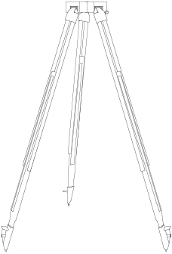
Instantaneous Positioning with GPS Pseudoranges
Receiver solution or sh_rx2apr
Point position ( svpos ) 5-100 m
Differential ( svdiff ) 1-10 m
Your location is:
37º 23.323’ N
122º 02.162’ W
Notes:
Since each satellite maintains time very accurately (~1 nanosecond = 30 cm), it can tag its signal with the time of transmission. This information, together with the location of the satellite, also transmitted to the receiver, is sufficient to allow the receiver to calculate the range to each satellite provided that the receiver also knows also knows the time. Equipping receivers with atomic clocks would be very expensive, so the receiver tags the signal with the time of its internal clock to create a “pseudorange” (range plus an unknown clock correction). The software in the receiver than uses the pseudoranges from four satellites to solve for the four unknowns: three coordinates and the receiver clock correction.

Slide 7
Observables in Data Processing
Fundamental observations
L1 phase = f1 x range (19 cm) L2 phase = f2 x range (24 cm)
C1 or P1 pseudorange used separately to get receiver clock offset (time)
To estimate parameters use doubly differenced
LC = 2.5 L1 - 2.0 L2 “Ionosphere-free combination”
Double differencing (DD) removes clock fluctuations; LC removes almost all of ionosphere. Both DD and LC amplify noise (use L1, L2 directly for baselines < 1 km)
Auxiliary combinations for data editing and ambiguity resolution
“Geometry-free combination (LG)” or “Extra wide-lane” (EX-WL)
LG = L2 - f2/f1 L1
Removes all frequency-independent effects (geometric & atmosphere) but not multipath or ionosphere
Melbourne-Wubbena wide-Lane (MW-WL): phase/pseudorange combination that removes geometry and ionosphere; dominated by pseudorange noise
Notes:
MW-WL needs Data-Code bias (DCB) corrections that are receiver type and satellite dependent.

Slide 8
Modeling the observations
I. Conceptual/Quantitative
Motion of the satellites
  Earth’s gravity field ( flattening 10 km; higher harmonics 100 m )
  Attraction of Moon and Sun ( 100 m )
  Solar radiation pressure ( 20 m )
Motion of the Earth
  Irregular rotation of the Earth ( 5 m )
  Luni-solar solid-Earth tides ( 30 cm )
  Loading due to the oceans, atmosphere, and surface water and ice ( 10 mm)
Propagation of the signal
  Neutral atmosphere ( dry 6 m; wet 1 m )
  Ionosphere ( 10 m but LC corrects to a few mm most of the time )
  Variations in the phase centers of the ground and satellite antennas ( 10 cm)
  * incompletely modeled

Slide 9
Modeling the observations
II. Software structure
Satellite orbit
  IGS tabulated ephemeris (Earth-fixed SP3 file) [ track ]
  GAMIT tabulated ephemeris ( t-file ): numerical integration by arc in inertial space, fit to SP3 file, may be represented by its initial conditions (ICs) and radiation-pressure parameters; requires tabulated positions of Sun and Moon
Motion of the Earth in inertial space [model or track ]
  Analytical models for precession and nutation (tabulated); IERS observed values for pole position (wobble), and axial rotation (UT1)
  Analytical model of solid-Earth tides; global grids of ocean and atmospheric tidal loading
Propagation of the signal [model or track ]
  Zenith hydrostatic (dry) delay (ZHD) from pressure ( met-file, VMF1, or GPT )
  Zenith wet delay (ZWD) [crudely modeled and estimated in solve or track ]
  ZHD and ZWD mapped to line-of-sight with mapping functions (VMF1 grid or GMT)
  Variations in the phase centers of the ground and satellite antennas (ANTEX file)

Slide 10
Parameter Estimation
Phase observations [ solve or track ]
  Form double difference LC combination of L1 and L2 to cancel clocks & ionosphere
  Apply a priori constraints
  Estimate the coordinates, ZTD, and real-valued ambiguities
  Form M-W WL and/or phase WL with ionospheric constraints to estimate and resolve the WL (L2-L1) integer ambiguities [ autcln, solve, track ]
  Estimate and resolve the narrow-lane (NL) ambiguities
  Estimate the coordinates and ZTD with WL and NL ambiguities fixed
  --- Estimation can be batch least squares [ solve ] or sequential (Kalman filter [ track ]
Quasi-observations from phase solution (h-file) [ globk ]
  Sequential (Kalman filter)
  Epoch-by-epoch test of compatibility (chi2 increment) but batch output

Slide 11
Limits of GPS Accuracy
Signal propagation effects
  Signal scattering ( antenna phase center / multipath )
  Atmospheric delay (mainly water vapor)
  Ionospheric effects
  Receiver noise
Unmodeled motions of the station
  Monument instability
  Loading of the crust by atmosphere, oceans, and surface water
Unmodeled motions of the satellites
Reference frame
Notes:
The four catagories I’ve listed here is a useful way to think about errors in GPS measurements. For studying global phenomena they are all potentially important, but I’m going to concentrate today on measurements on continental scale. For these intersite distances, we now know the orbits of the satellites well enough that their contribution is usually small. So we’ll look at effects in signal propagation and uninteresting motions of the receiving antenna. In signal propagation, first order ionospheric effects are removed in all high precision work by combining signals at the two GPS frequencies. And for modern observations, receiver noise is nearly negligible. So we’re left with scattering effects and the atmosphere.

Slide 12
Limits of GPS Accuracy
Signal propagation effects
  Signal scattering ( antenna phase center / multipath )
  Atmospheric delay (mainly water vapor)
  Ionospheric effects
  Receiver noise
Unmodeled motions of the station
  Monument instability
  Loading of the crust by atmosphere, oceans, and surface water
Unmodeled motions of the satellites
Reference frame
Notes:
The four catagories I’ve listed here is a useful way to think about errors in GPS measurements. For studying global phenomena they are all potentially important, but I’m going to concentrate today on measurements on continental scale. For these intersite distances, we now know the orbits of the satellites well enough that their contribution is usually small. So we’ll look at effects in signal propagation and uninteresting motions of the receiving antenna. In signal propagation, first order ionospheric effects are removed in all high precision work by combining signals at the two GPS frequencies. And for modern observations, receiver noise is nearly negligible. So we’re left with scattering effects and the atmosphere.

Slide 13
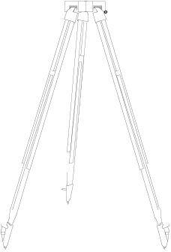
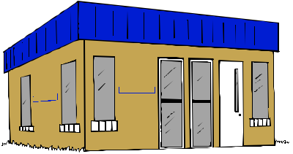
Multipath is interference between the direct and a far-field reflected signal (geometric optics apply)
To mitigate the effects:
Avoid Reflective Surfaces
Use a Ground Plane Antenna
Use Multipath Rejection Receiver
Observe for many hours
Remove with average from many days
Reflected Signal
Direct Signal
Reflected Signal

Slide 14
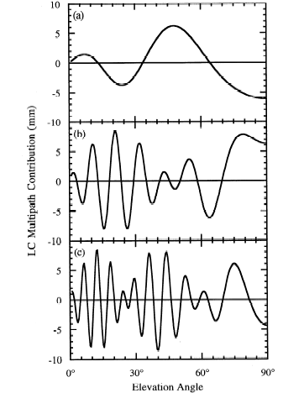
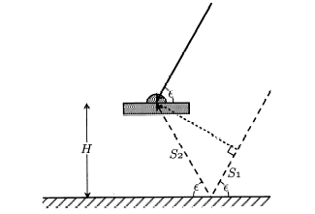
Antenna Ht
0.15 m
0.6 m
Simple geometry for incidence of a direct and reflected signal
1 m
Multipath contributions to observed phase for three different antenna heights [From Elosegui et al, 1995]
Notes:
RIGHT SIDE is predicted variations for three heights.
The most common and dominant source of high-frequency multipath is reflection from the horizontal surface beneath the antenna. If this surface is far enough away from the antenna (1-2 m) to be outside the fresnel zone (no interaction with the antenna itself), then geometric optics allows us to model the signal well enough to predict the frequency. For an antenna mounted 1-2 m above the surface, the variations will be of the order of minutes, and tend to have low, though still significant correlatations with the signature of the station’s coordinates and the atmospheric delay. Once you get within a half-meter, though, the longer period variations are a real problem. And this is even without taking into account the interaction with the antenna structure.

Slide 15
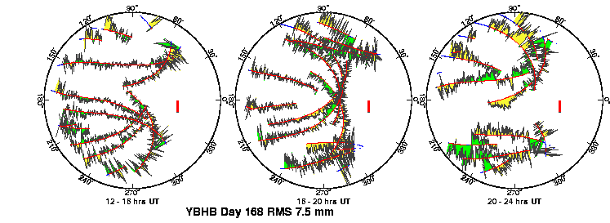
Multipath and Water Vapor Effects in the Observations
One-way (undifferenced) LC phase residuals projected onto the sky in 4-hr snapshots. Spatially repeatable noise is multipath; time-varying noise is water vapor.
Red is satellite track. Yellow and green positive and negative residuals purely for visual effect.
Red bar is scale (10 mm).
Notes:
Now we’ve taken the phase vs time residuals and projected them onto the sky. Same 12-hr period for the same stations on two successive days. North to the right!! This is the pattern you see on the sky at mid-latitudes and shows a mixture of N-S and E-W motion, with N-S dominating. At the equator, all the satellites move nearly N-S on the sky, and at the poles more E-W. The dominant motion determines whether the N-S or E-W component of the station position is better determined. You see again the largest fluctuations at low elevation angles, and much of this noise repeats from day to day—signal multipathing. Where you see differences, as near 90 degrees between 20-24 hours, the likely cause is water vapor.

Slide 16
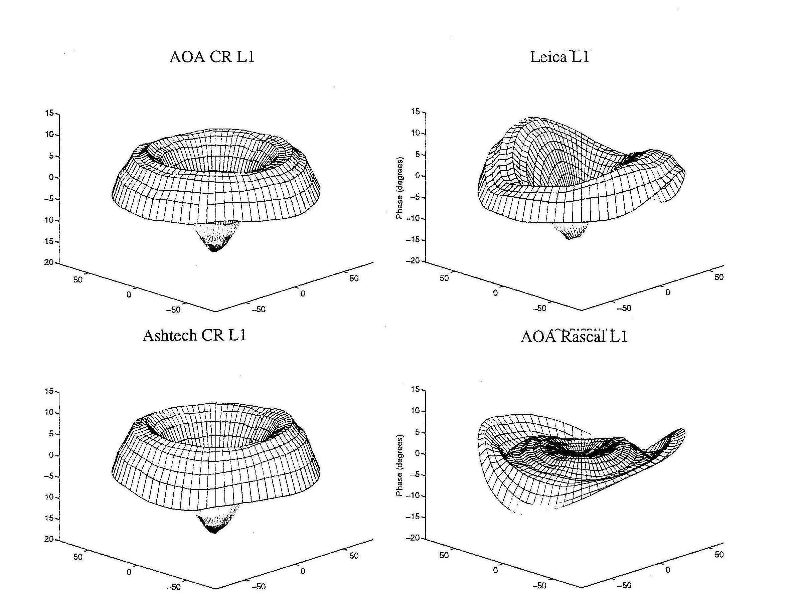
More dangerous are near-field signal interactions that change the effective antenna phase center with the elevation and azimuth of the incoming signal
Left: Examples of the antenna phase patterns determined in an anechoic chamber…BUT the actual pattern in the field is affected by the antenna mount
To avoid height and ZTD errors of centimeters, we must use at least a nominal model for the phase-center variations (PCVs) for each antenna type
Figures courtesy of UNAVCO
Antenna Phase Patterns
Notes:
The first problem we have is that the phase-response pattern of any physical antenna is not spherical. So the effective phase center ---the point to which you want to refer the location of the ground monument---varies as a function of elevation angle, and hence changes if you use a different minimum cutoff—which can happen when you change receivers or cables because of the change in SNR. Sometimes, the patterns also vary with azimuth, as with the Leica and Rascal antennas here, but most of the antennas used for high precision work have symmetric patterns. L1 phase variations for antennas tested by UNAVCO. Zenith values at the center and values for 10 degrees elevation at the edges. 10 deg L1 phase = 5 mm.

Slide 17
Limits of GPS Accuracy
Signal propagation effects
  Signal scattering ( antenna phase center / multipath )
  Atmospheric delay (mainly water vapor)
  Ionospheric effects
  Receiver noise
Unmodeled motions of the station
  Monument instability
  Loading of the crust by atmosphere, oceans, and surface water
Unmodeled motions of the satellites
Reference frame
Notes:
The four catagories I’ve listed here is a useful way to think about errors in GPS measurements. For studying global phenomena they are all potentially important, but I’m going to concentrate today on measurements on continental scale. For these intersite distances, we now know the orbits of the satellites well enough that their contribution is usually small. So we’ll look at effects in signal propagation and uninteresting motions of the receiving antenna. In signal propagation, first order ionospheric effects are removed in all high precision work by combining signals at the two GPS frequencies. And for modern observations, receiver noise is nearly negligible. So we’re left with scattering effects and the atmosphere.

Slide 18
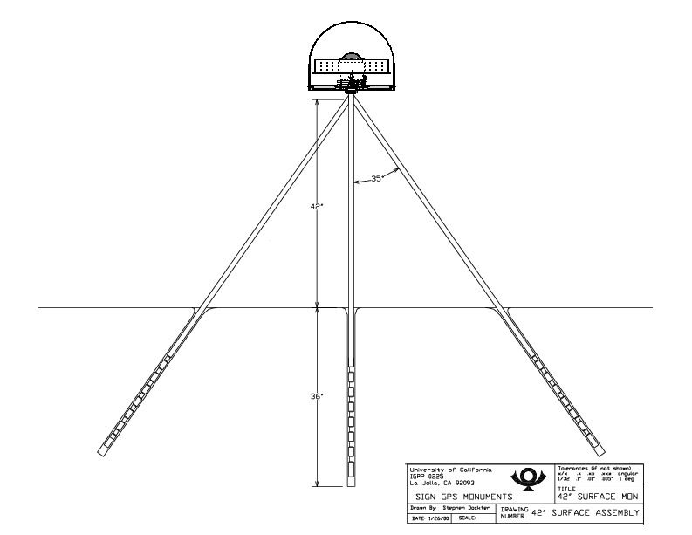
Monuments Anchored to Bedrock are Critical for Tectonic Studies
(not so much for atmospheric studies)
Good anchoring:
Pin in solid rock
Drill-braced (left) in fractured rock
Low building with deep foundation
Not-so-good anchoring:
Vertical rods
Buildings with shallow foundation
Towers or tall building (thermal effects)

Slide 19
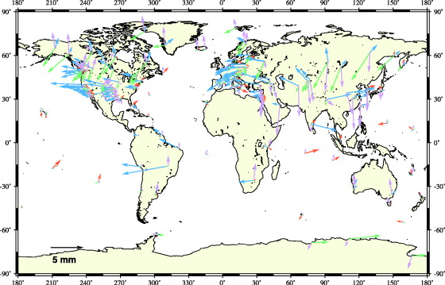
Annual Component of Vertical Loading
Atmosphere (purple)
2-5 mm
Water/snow (blue/green)
2-10 mm
Nontidal ocean (red)
2-3 mm
From Dong et al. J. Geophys. Res., 107, 2075, 2002
Notes:
The only loading effect we currently account for in our processing are those from ocean tides. For these the current models are quite good for most parts of the world, but probably inadequate for high latitudes (above the TOPEX altimeter coverage) and around some complicated shorelines. (High local tides do not mean large errors, however, because it’s the total mass of the water that matters.)
This map is taken from a paper by Danan Dong (former MIT student) and his colleagues at JPL, Scripps, and GSI in Japan. They estimated annual and semi-annual terms in vertical GPS station position and attempted to match these with predicted motions derived from a variety of sources. They could not obtain sufficient correlation overall to validate the models, but they’ve given us rough estimates of the amplitudes and geographical distribution of the induced displacements.
Tom Herring, with Tonie VanDam first detected atmospheric loading effects in VLBI data 10 years ago but neither the global pressure fields nor the data coverage were sufficient to develop and test good models. There’s now an operational program to use the NCEP and European Center analyses to compute loading corrections on a global grid and we’re planning to test these in our GPS analyses over the next few months.

Slide 20
Limits of GPS Accuracy
Signal propagation effects
  Signal scattering ( antenna phase center / multipath )
  Atmospheric delay (mainly water vapor)
  Ionospheric effects
  Receiver noise
Unmodeled motions of the station
  Monument instability
  Loading of the crust by atmosphere, oceans, and surface water
Unmodeled motions of the satellites
Reference frame
Notes:
The four catagories I’ve listed here is a useful way to think about errors in GPS measurements. For studying global phenomena they are all potentially important, but I’m going to concentrate today on measurements on continental scale. For these intersite distances, we now know the orbits of the satellites well enough that their contribution is usually small. So we’ll look at effects in signal propagation and uninteresting motions of the receiving antenna. In signal propagation, first order ionospheric effects are removed in all high precision work by combining signals at the two GPS frequencies. And for modern observations, receiver noise is nearly negligible. So we’re left with scattering effects and the atmosphere.

Slide 21
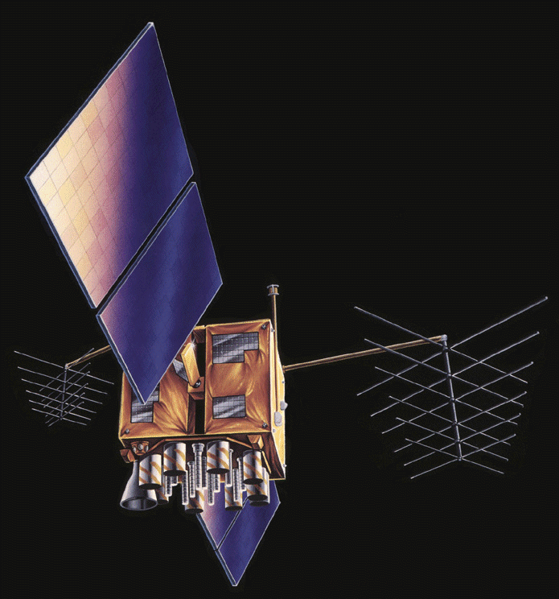
GPS Satellite
Limits to model are non-gravitational accelerations due to solar and albedo radiation, unbalanced thrusts, and outgassing; and non-spherical antenna pattern
Modeling of these effects has improved, but for global analyses remain a problem

Slide 22
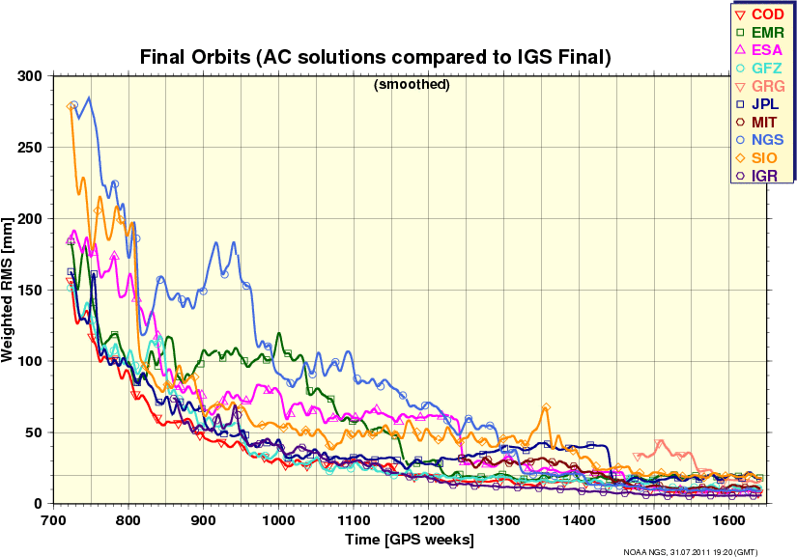
Quality of IGS Final Orbits 1994-2011/07
20 mm = 1 ppb Source: http://acc.igs.org

Slide 23
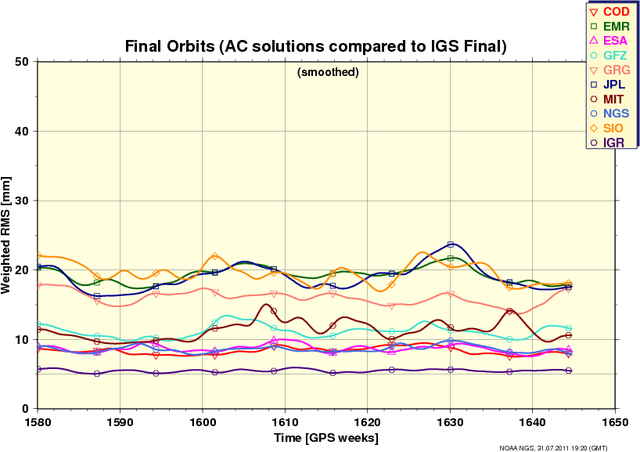
Quality of IGS Final Orbits Last Year 2010/07-2011/07
20 mm = 1 ppb Source: http://acc.igs.org

Slide 24
Limits of GPS Accuracy
Signal propagation effects
  Signal scattering ( antenna phase center / multipath )
  Atmospheric delay (mainly water vapor)
  Ionospheric effects
  Receiver noise
Unmodeled motions of the station
  Monument instability
  Loading of the crust by atmosphere, oceans, and surface water
Unmodeled motions of the satellites
Reference frame

Slide 25
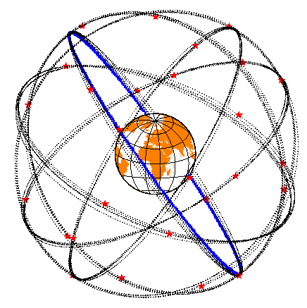
Reference Frames
Global Reference Frame quality:
Center of Mass <10 mm
ITRF ~ 2 mm, < 1 mm/yr
Continental scale networks (e.g. PBO)
< 1 mm/yr horiz., 2 mm/yr vert.
Local scale (100-200 km) depends on how “realized” and available stable sites (IGS sites in region)

Slide 26
Effect of Orbital and Geocentric Position Error/Uncertainty
High-precision GPS is essentially relative !
Baseline error/uncertainty ~ Baseline distance x geocentric SV or position error
SV altitude
SV errors reduced by averaging:
Baseline errors are ~ 0.2 • orbital error / 20,000 km
e.g. 20 mm orbital error = 1 ppb or 1 mm on 1000 km baseline
Network (“absolute”) position errors less important for small networks
e.g. 5 mm position error ~ 1 ppb or 1 mm on 1000 km baseline
10 cm position error ~ 20 ppb or 1 mm on 50 km baseline
* But SV and position errors are magnified for short sessions

Slide 27
Summary
High precision GPS (mm and better positioning) requires external information in additional to just the data and orbit information.
Larger site separations and mixed equipment types require more care in the data analysis than short baseline, homogeneous system data collection.
All of the external information needed is available and the GAMIT processing system gathers most of this information automatically. There is some information that users need to keep up to date (discussed later).
The next two lectures examine running GAMIT and GLOBK. The final session today will be tutorial looking at an earthquake effected data set.

