Slide 1
Reference Frame Realization
Lecture 05
Thomas Herring
tah@mit.edu

Slide 2
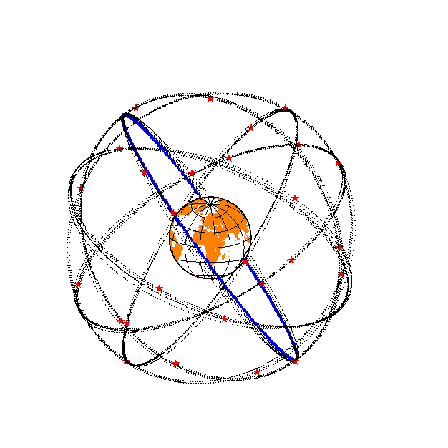
Reference Frames
Global
Center of Mass ~ 30 mm
ITRF ~ 2 mm, < 1 mm/yr
Continental
< 1 mm/yr horiz., 2 mm/yr vert.
Local -- may be self-defined

Slide 3
Reference frames in Geodetic Analyses
Output from GAMIT
  Loosely constrained solutions
  Relative position well determined, “Absolute position” weakly defined
  Need a procedure to expressed coordinates in a well defined reference frame
Two aspects
  Theoretical (e.g., rigid block, mantle-fixed, no-net-rotation of plates)
  Realization through a set of coordinates and velocities
    “finite constraints” : a priori sigmas on site coordinates
    “generalized constraints” : minimize coordinate residuals while adjusting translation, rotation, and scale parameters
Three considerations in data processing and analysis
  Consistent with GPS orbits and EOP (NNR)
    not an issue if network small or if orbits and EOP estimated
  Physically meaningful frame in which to visualize site motions
  Robust realization for velocities and/or time series

Slide 4
Basics of reference frame realization

Slide 5
GLOBK frame realization methods
In GLOBK analyses, normally all stations and orbit initial conditions are loosely constrained, the reference frame is defined in a module called glorg (global origin). The methods used are similar to other programs but there are some subtle differences. Specifically, the frame transformation is implement with a Kalman filter constraint equation, not by direct application of the rotations, translations and scale.
Details are discussed in Dong, Herring and King, J. Geodesy, 1998.
Notes:
Dong D., T. A. Herring, and R. W. King, Estimating Regional Deformation from a Combination of Space and Terrestrial Geodetic Data, J. Geodesy, 72, 200–214, 1998.

Slide 6
Specific implementation
Glorg computes a set of condition equations using weighted least squares. The weights are settable to be dependent on site uncertainty (iteratively) and with weight between horizontal and vertical site positions and rates.
The condition equations are then applied through a Kalman filter formulation to the loose solution covariance matrix and solution vector. The KF formulation allows zero variance for the condition (LSQ approach would need a small but finite variance). The condition can also be given finite variance (avoids zero eigenvalues).
If the original loose solution is free to translate, rotate and scale, the application of the condition solution generate the same answer explicit application of transformation (SDET option).
  For VLBI, translation is rank deficient and rotation is explicitly estimated (scale needs to be explicitly estimated if included in the constraints)
  For GPS, translation is not rank deficient and so condition modifies solution if translation not explicitly estimated. It is not clear whether translation should be estimated explicitly.

Slide 7
Formulation
Condition application, T are estimates of transformation parameters, W is weight matrix, and superscript – and + denote values before and after the conditions are applied. R is the variance of the condition and can be set to zero. (MIT weekly IGS sinex submission, sets 1 m² on translation so not forced to zero)

Slide 8
Coordinate Weight effect
Next set of slides show the effects of height weight on the means of site position residuals after transformation:
  when uniform weight (i.e., height is weighted same as horizontal) is used with no scale estimated (mean height residual is scale)
  when scale estimated with
    Uniform height weight
    Heights down weighted by 10 (consistent with sigmas, default)
    Height so down weighted so much that effectively not used.

Slide 9
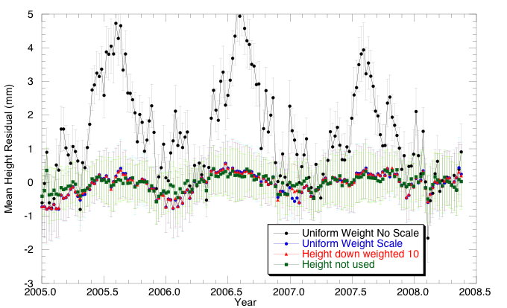
Mean Heights

Slide 10
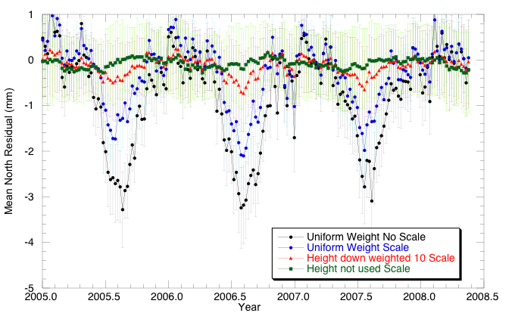
Mean North Residual

Slide 11
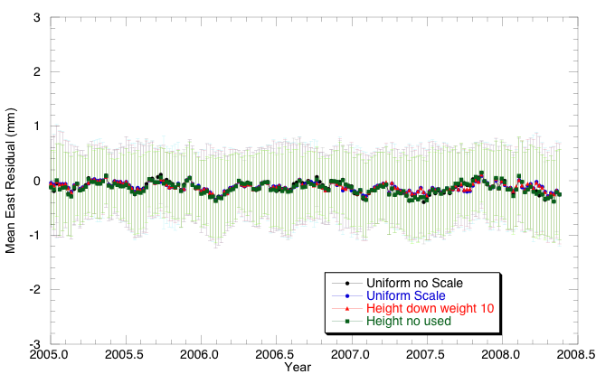
East mean residual

Slide 12
Local Frame Realization
When dealing with a local region (100-3000 km in size), there are a number of choices of approach:
  Sometime motion relative to a stable plate (e.g., Eurasia) is needed
  Often since local strains are important, a local reference frame provides a more useful way of viewing results.
  In the GLORG, translation/rotation method only the rotational part of the strain tensor is effected by how the reference frame is realized. (This is not the case when tight constraints are applied).

Slide 13
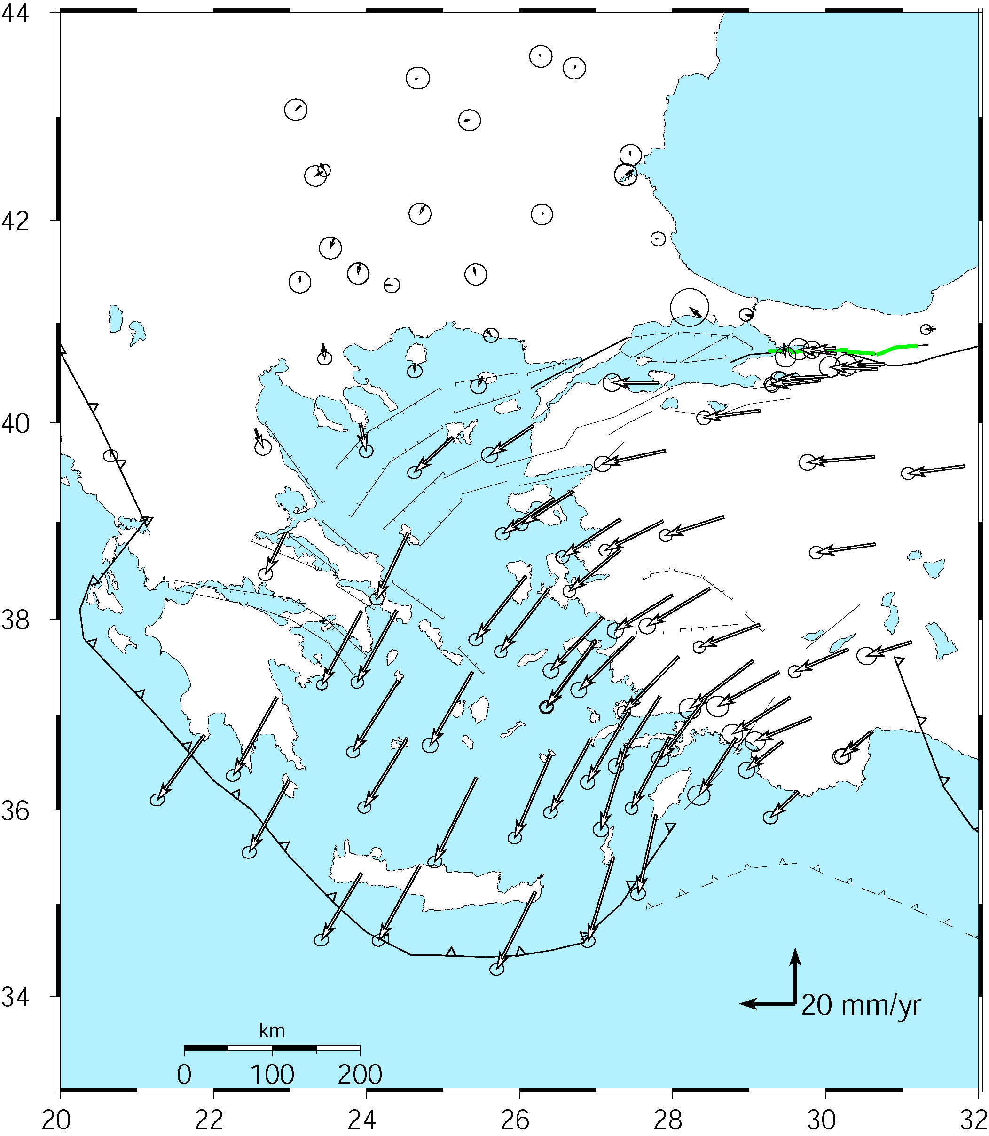
Velocities of Anatolia and the Aegean in a Eurasian frame
Realized by minimizing the velocities of 12 sites over the whole of Eurasia
McClusky et al. [2000]

Slide 14
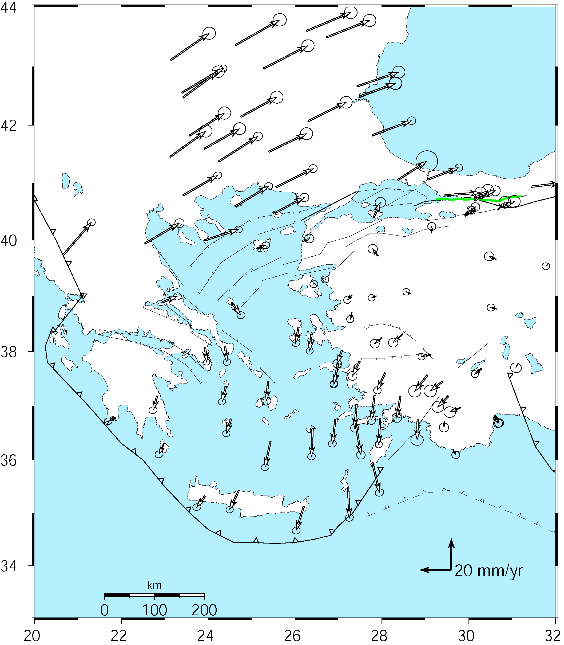
Velocities in an Anatolian frame
Better visualization of Anatolian and Aegean deformation
Here stations in Western/Central are used to align the reference frame (apriori velocity set to zero).
McClusky et al. [2000

Slide 15
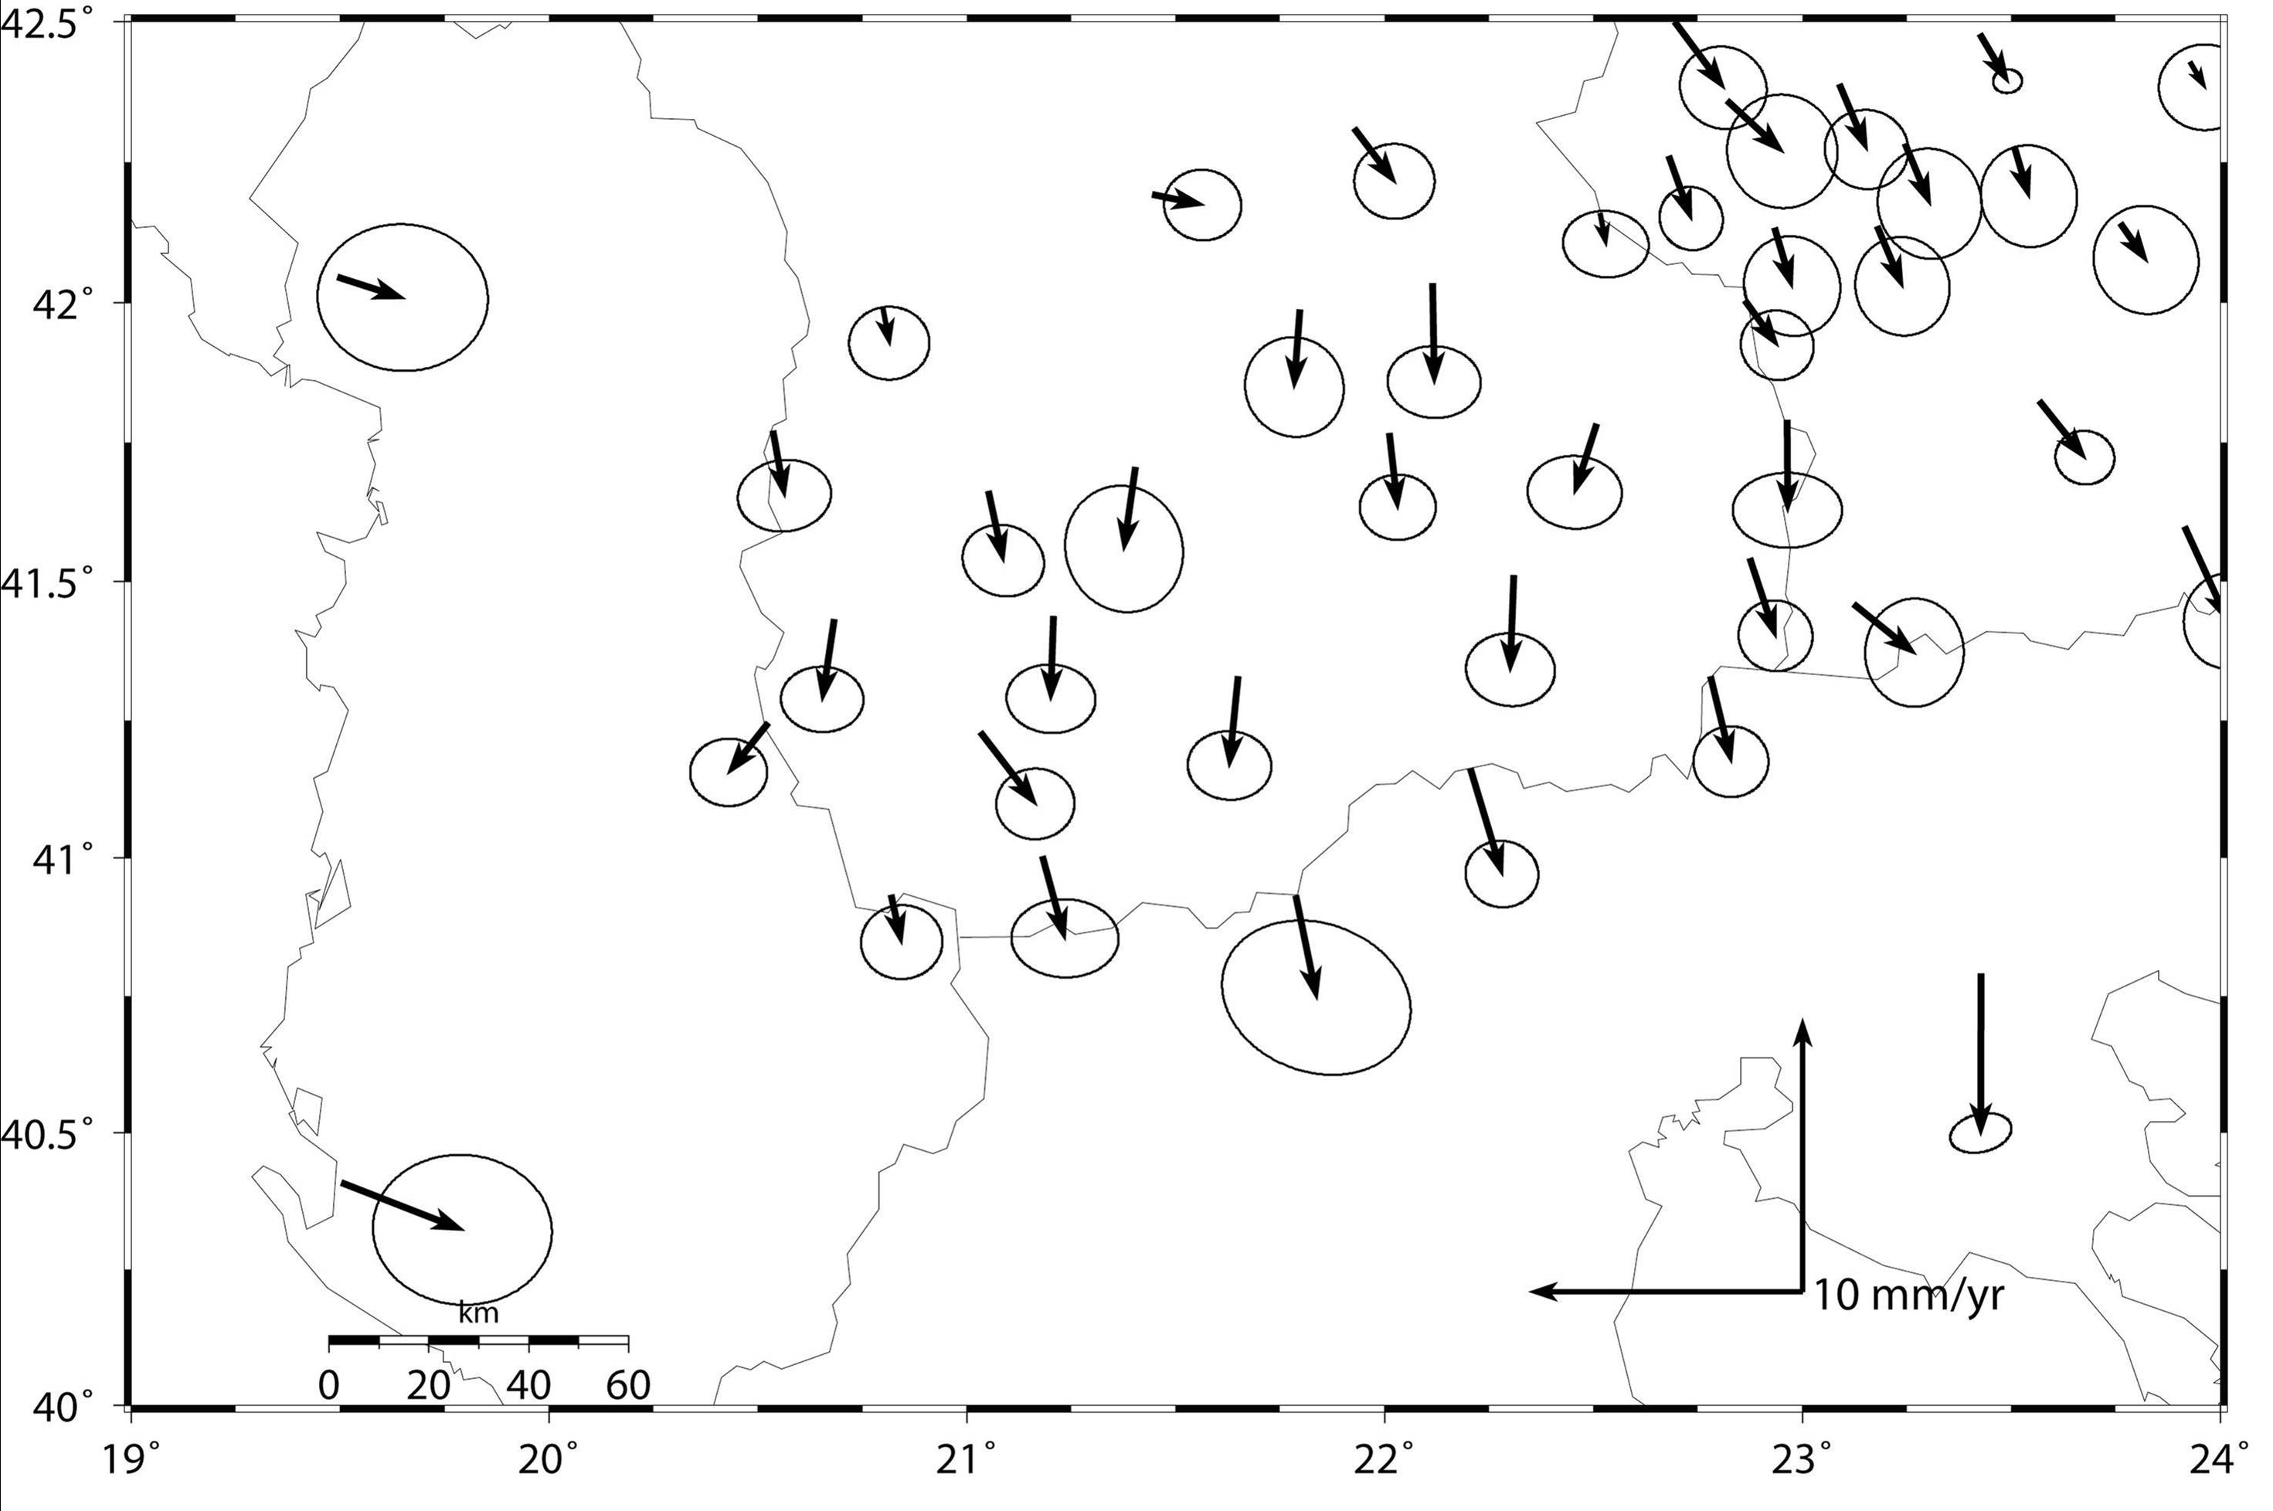
Another example: southern Balkans
Pan-Eurasian realization (as in last example)
Note uniformity in error ellipses, dominated by frame uncertainty

Slide 16
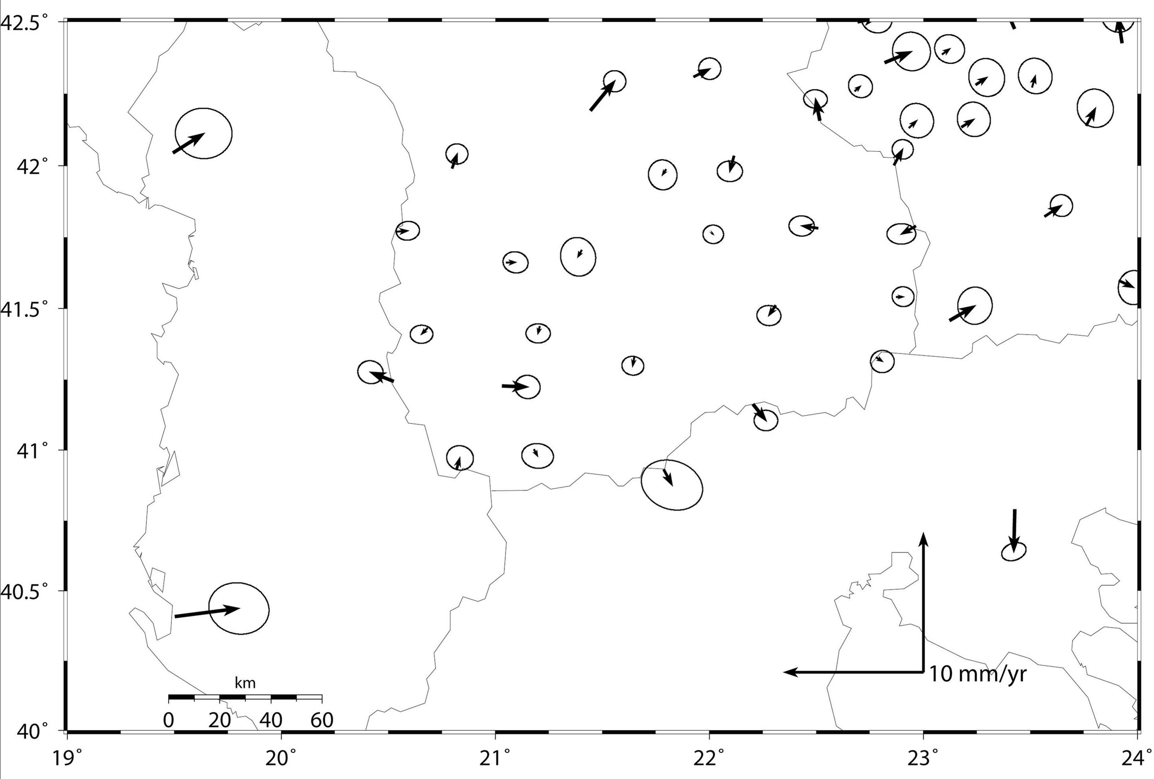
Local Frame Realization
Frame realization using 8 stations in central Macedonia
Note smaller error ellipses within stabilization region and larger ellipses at edges
Notes:
Note how the error bars change as well.

Slide 17
Defining Reference Frames in GLOBK
Three approaches to reference frame definition in GLOBK
  Finite constraints ( in globk, same as GAMIT )
  Generalized constraints in 3-D ( in glorg )
  Generalized constraints for horizontal blocks (‘plate’ feature of glorg)
Reference frame for time series
  More sensitive than velocity solution to changes in sites
  Initially use same reference sites as velocity solution
  Final time series should use (almost) all sites for stabilization

Slide 18
Frame definition with finite constraints
Applied in globk (glorg not called): We do not recommend this approach since it is sensitive to over-constraints that can distort velocities and positions
Example:
  apr_file itrf08.apr
  apr_neu all 10 10 10 1 1 1
  apr_neu algo .005 005 .010 .001 .001 .003
  apr_neu pie1 .002 005 .010 .001 .001 .003
  apr_neu drao .005 005 .010 .002 .002 .005
  …
Most useful when only one or two reference sites or very local area.
Disadvantage for large networks is that bad a priori coordinates or bad data from a reference site can distort the network

Slide 19
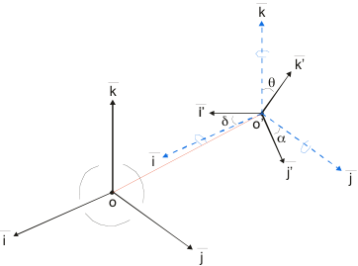
Frame definition with generalized constraints
Applied in glorg: minimize residuals of reference sites while estimating translation, rotation, and/or scale (3 -7 parameters)
  apr_file itrf05.apr
  pos_org xtran ytran ztran xrot yrot zrot
  stab_site algo pie1 drao …
  cnd_hgtv 10 10 0.8 3.
All reference coordinates free to adjust (anomalies more apparent); outliers are iteratively removed by glorg
Network can translate and rotate but not distort
Works best with strong redundancy (number and [if rotation] geometry of coordinates exceeds number of parameters estimated)
Can downweight heights if suspect or to minimuze loading effects
Notes:
This is the preferred method

Slide 20
Referencing to a horizontal block (‘plate’)
Applied in glorg: first stabilize in the usual way with respect to a reference set of coordinates and velocities (e.g. ITRF-NNR), then define one or more ‘rigid’ blocks
apr_file itrf05.apr
pos_org xtran ytran ztran xrot yrot zrot
stab_site algo pie1 nlib drao gold sni1 mkea chat
cnd_hgtv 10 10 0.8 3.
plate noam algo pie1 nlib
assign_p noam drao fair
plate pcfc sni1 mkea chat
After stabilization, glorg will estimate a rotation
vector (‘Euler pole’) for each plate with respect
to the frame of the full stabilization set and print
the relative poles between each set of plates
Use sh_org2vel to extract the velocities of all sites with respect to each plate
Notes:
Assign_plate assigns sites to plate but they are not used in estimation.

Slide 21
Rules for Stabilization of Time Series
Small-extent network: translation-only in glorg, must constrain EOP in globk
Large-extent network: translation+rotation, must keep EOP loose in globk;
if scale estimated in glorg, it must estimate scale in globk
1st pass for editing:
  “Adequate” stab_site list of stations with accurate a priori coordinates and velocities and available most days
  Keep in mind deficiencies in the list
Final pass for presentation / assessment / statistics
  Robust stab_site list of all/most stations in network, with coordinates and velocities determined from the final velocity solution
System is often iterated (velocity field solution, generate time series, editing and statistics of time series; re-generate velocity field).

Slide 22
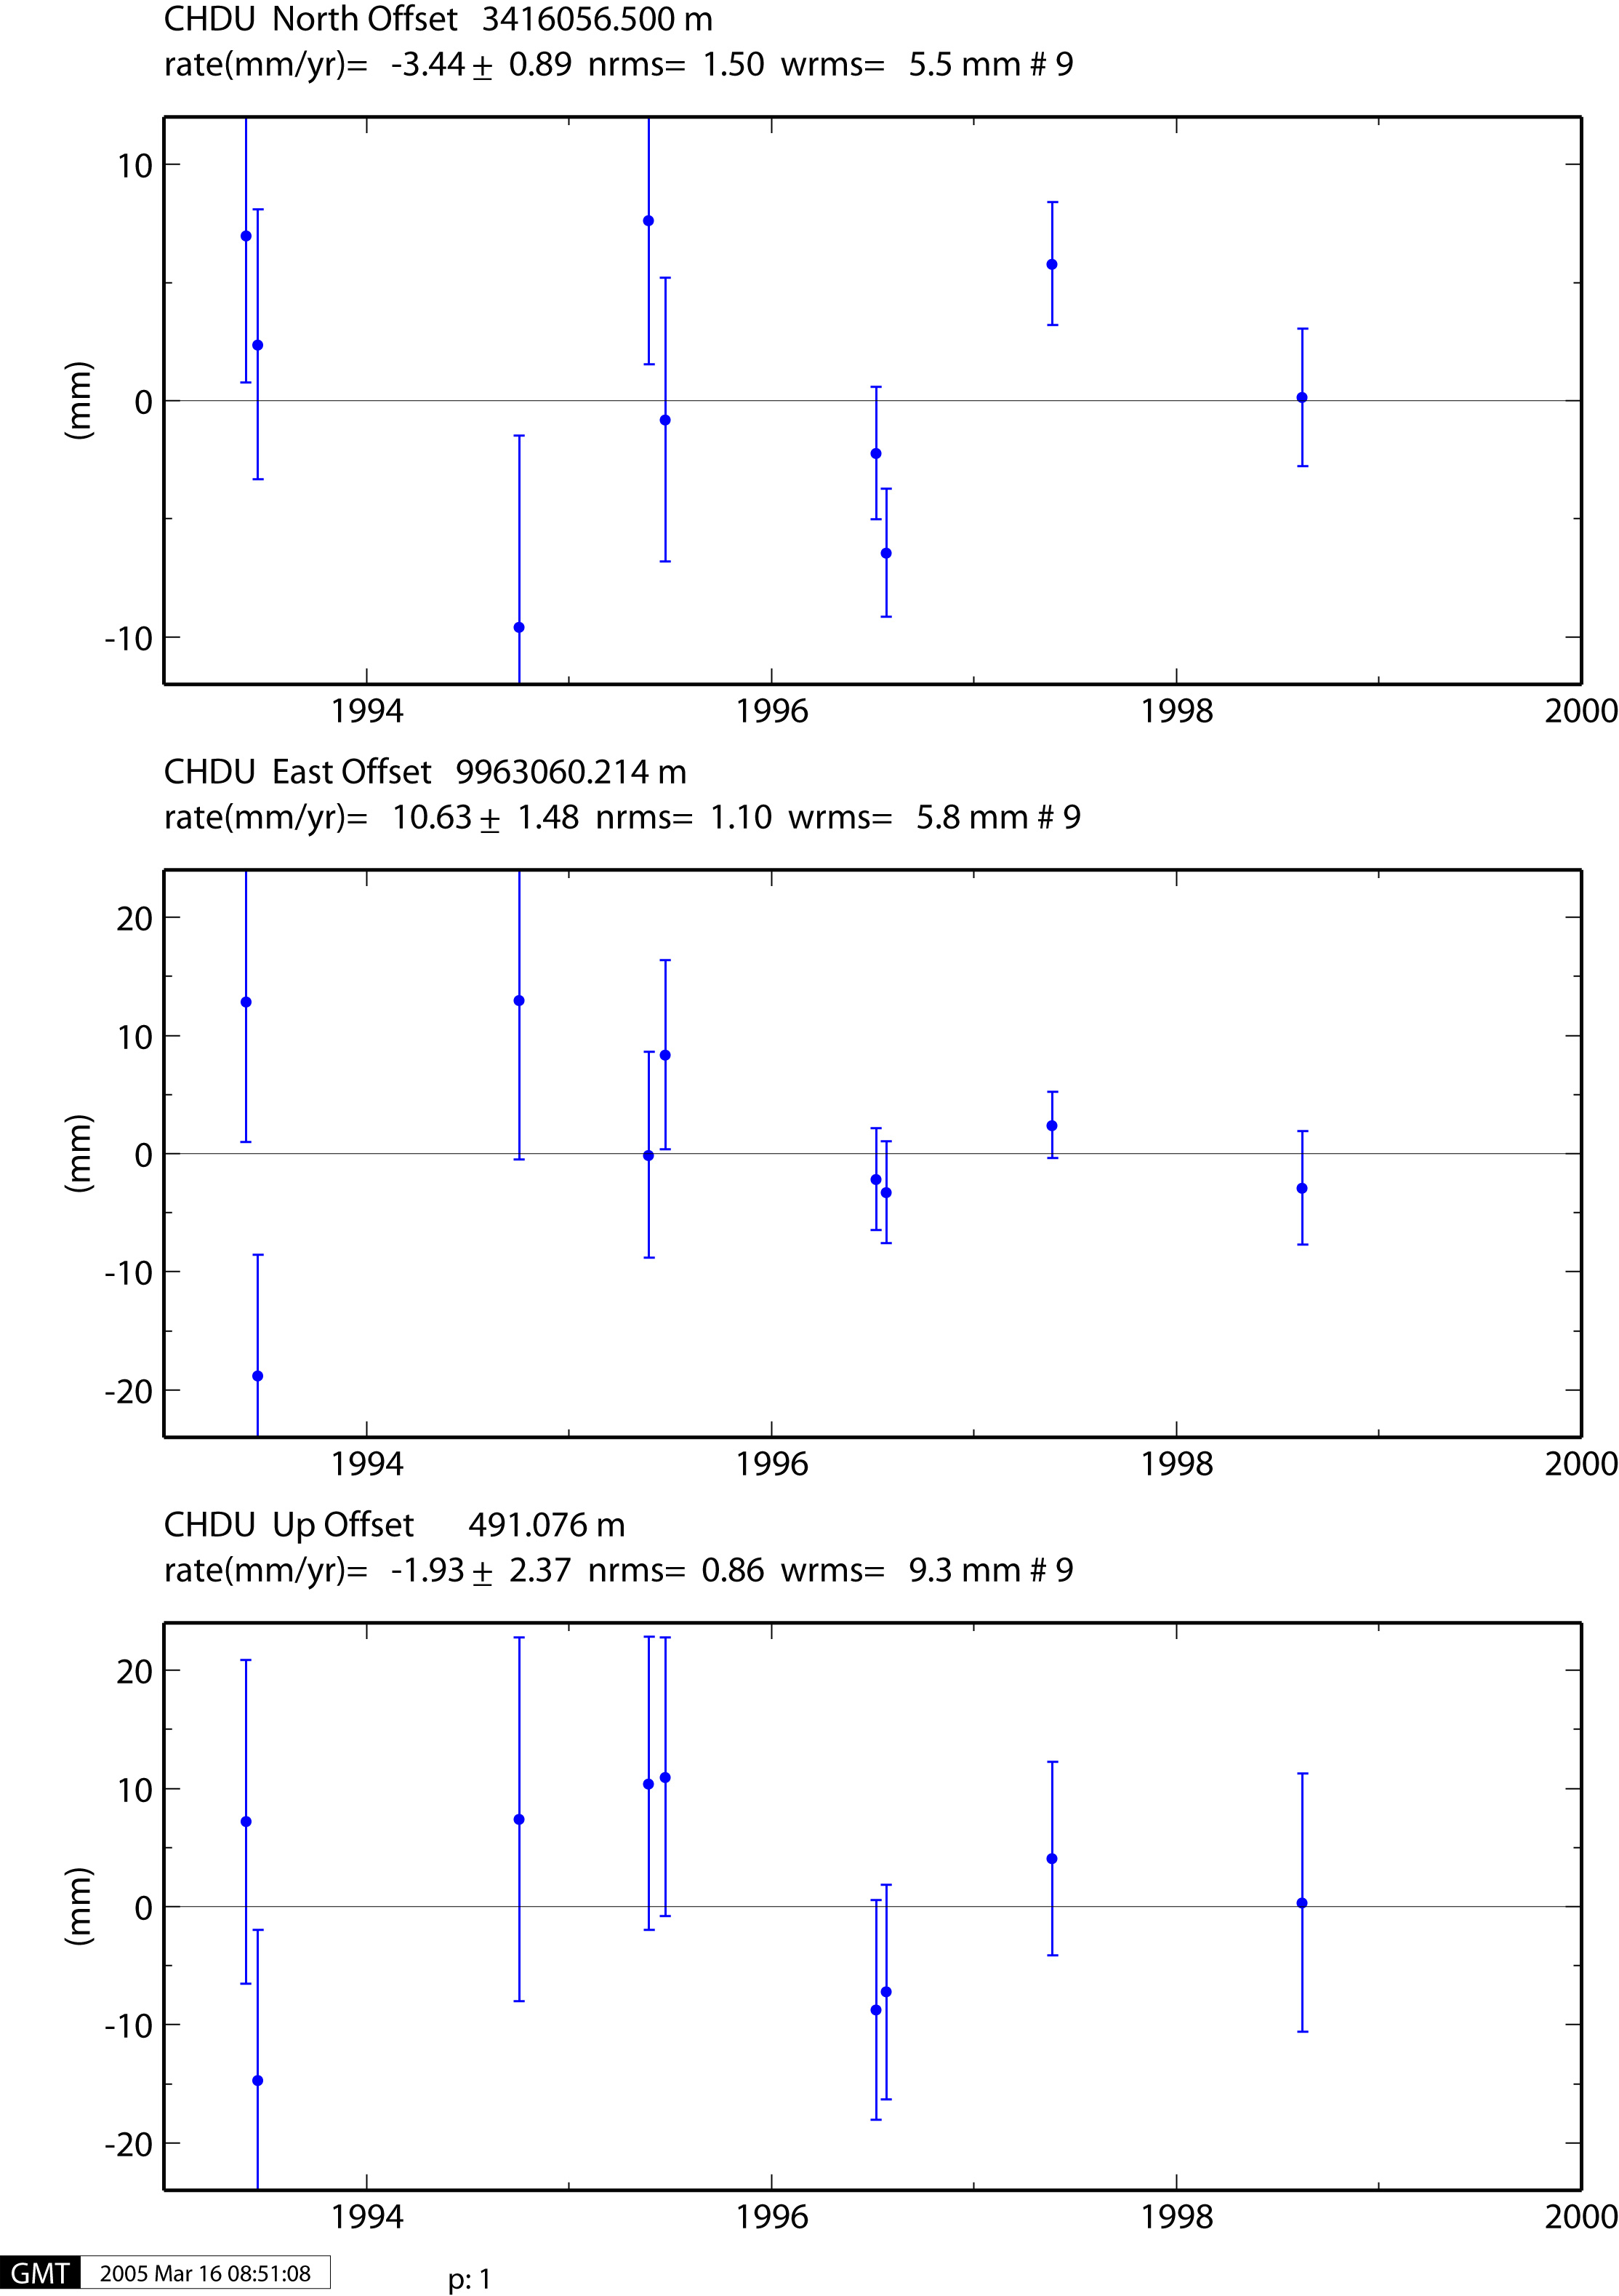
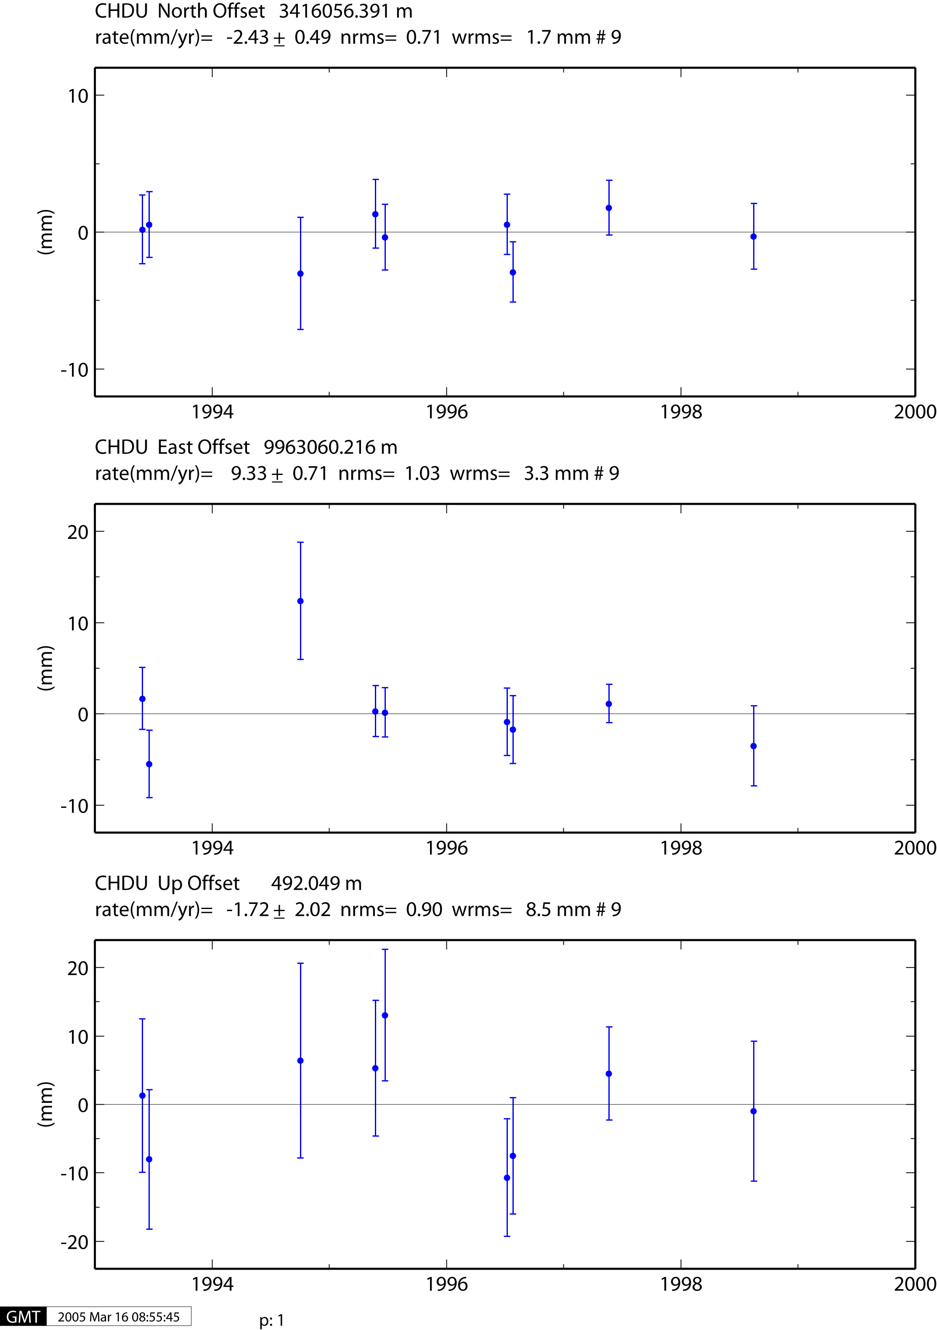
Reference Frames in Time Series
Spatial filtering of Time Series
Example from southwest China
Stabilization with respect to a pan-Eurasia station set
Stabilization with respect to a SW-China station set: spatially correlated noise reduced; this time series best represents the uncertainties in the velocity solution

Slide 23
.. Same two solutions, East component
Eurasia stabilization
SW-China stabilization

Slide 24
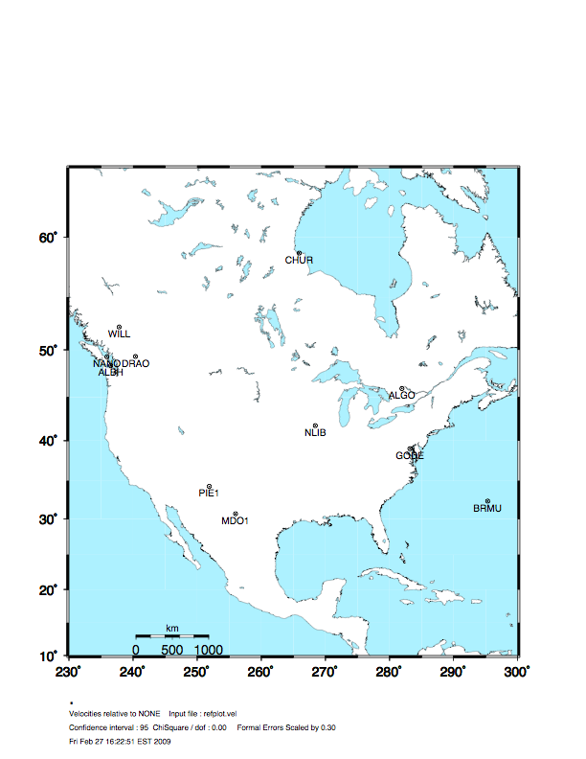
Stabilization Challenges for Time Series
Network too wide to estimate translation-only
(but reference sites too few or poorly distributed to estimate rotation robustly )

Slide 25
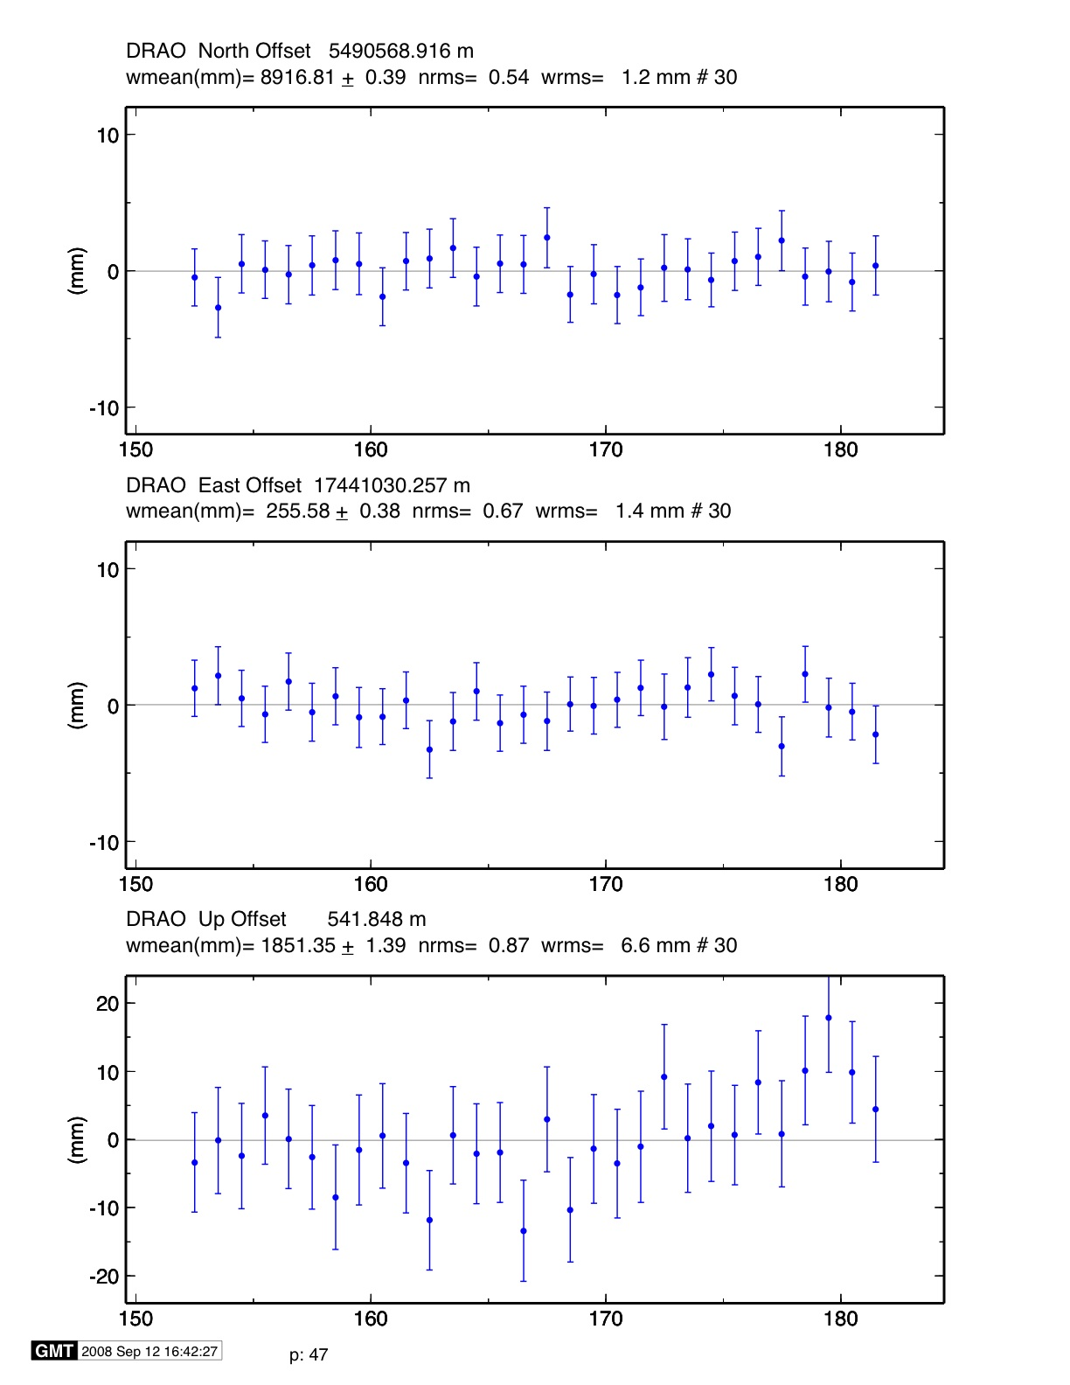
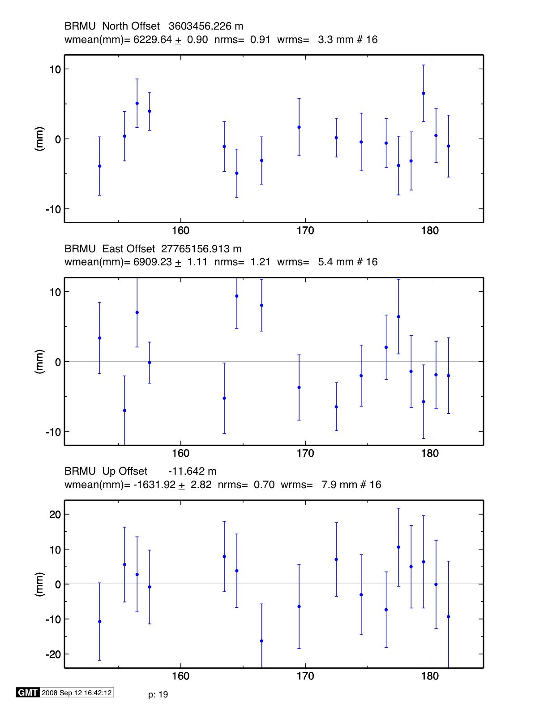
Stable reference frame
Stabilization Challenges for Time Series
*
Example of time series for which the available reference sites changes day-to-day but is robust (6 or more sites, well distributed, with translation and rotation estimated)
Day 176 ALGO PIE1 DRAO WILL ALBH NANO rms 1.5 mm
Day 177 ALGO NLIB CHUR PIE1 YELL DRAO WILL ALBH NANO
rms 2.3 mm
*
**
**
**
**
**
*
**
^ ^
^ ^

Slide 26
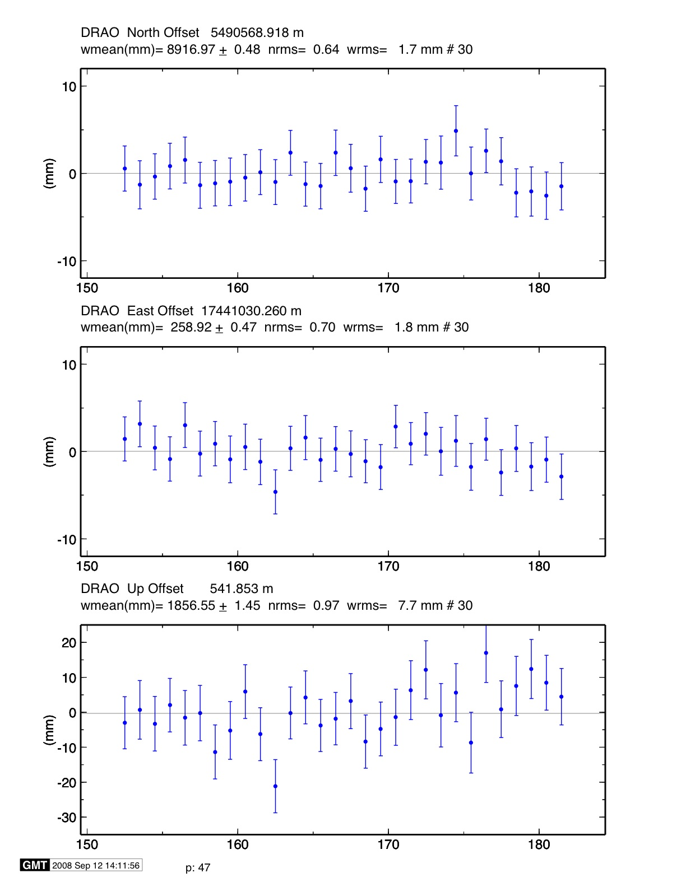
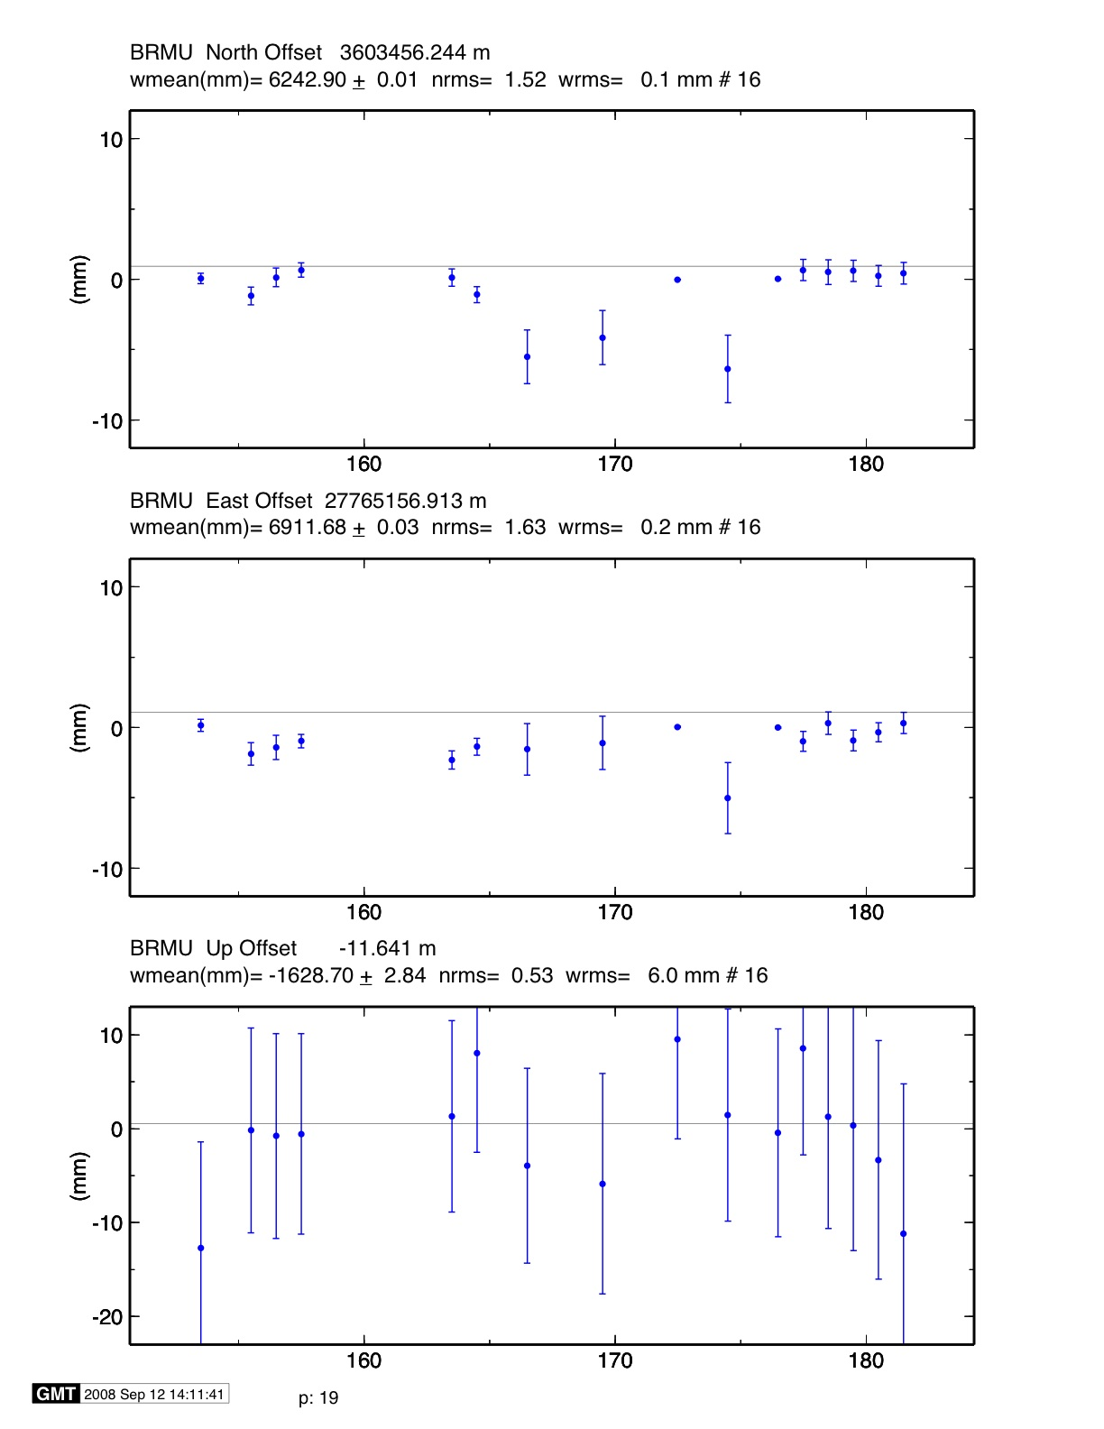
Unstable case
Stabilization Challenges for Time Series
*
Example of time series for which the available reference sites changes day-to-day and is not robust (only 3 sites on one day)
NOTE: Distant frame definition sites can have very small error bars when used and large error bars when not used.
Day 176 BRMU PIE1 WILL
rms 0.4 mm
Day 177 BRMU ALGO NLIB PIE1
YELL WILL
rms 2.0 mm
**
*
*
**
**
^ ^
^ ^
^ ^
^ ^

Slide 27
Use of Global binary H-files
Include global h-files … or not ? For post-2000 data not needed for orbits
Advantages
  Access to a large number of sites for frame definition
  Can (should) allow adjustment to orbits and EOP
  Eases computational burden
Disadvantages
  Must use (mostly) the same models as the global processing
  Orbits implied by the global data worse than IGSF
  Some bad data may be included in global h-files (can remove)
  Greater data storage burden

Slide 28
Regional versus Global stabilization
If not using external h-files, use 8 or more well distributed sites reference sites
If combining with MIT or SOPAC* global h-files, use 4-6 well-performing common sites (not necessarily with well-known coordinates),
MIT hfiles available at ftp://everest.mit.edu/pub/MIT_GLL/HYY
When using MIT files, add apr_svant all F F F to globk command file to fix the satellite antenna offsets
If SOPAC, use all “igs’ h-files to get orbits well-determined

Slide 29
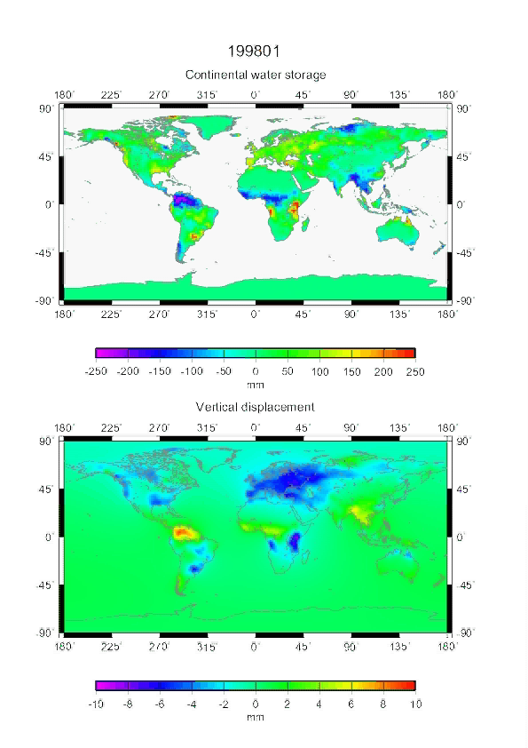
Seasonal Effects
Large seasonal signals due to hydrological loading in many regions of the world
May generates spurious signals in time series
Courtesy J. P. Boy

Slide 30
GRACE Results
There are number of web sites where GRACE results are available. For large-scale loading an approximate rule is 0.5 mm of vertical per mbar or cm of water
Interactive site with graphics
http://geoid.colorado.edu/grace/grace.php
Also see site (select region and click on map):
http://grace.sgt-inc.com/

Slide 31
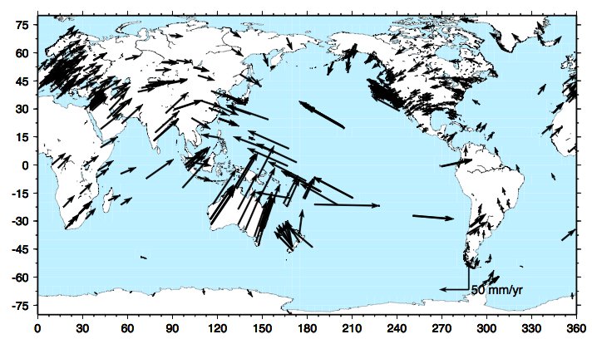
Global site motions
Examine the fast motion between Vanuatu and Tonga
Tonga and
Vanuatu
Alice Springs

Slide 32
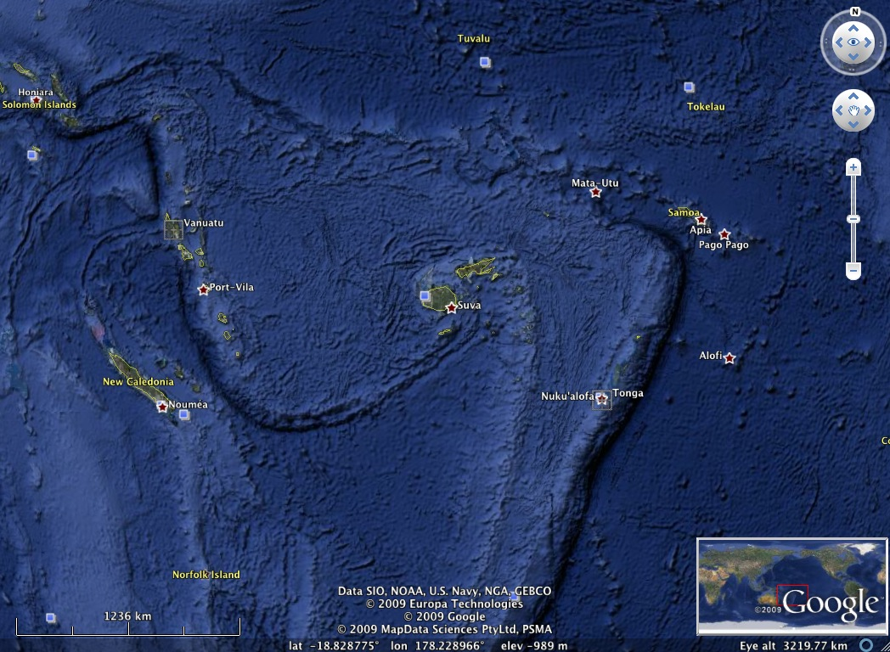
Fastest separating GPS sites in the world 150 mm/yr
The seafloor topography here are spreading ridges and subduction zones. This one of the most seismically active regions in the world.
Notes:
Large earthquakes slip 5-10 meter so every 30-60 years

Slide 33
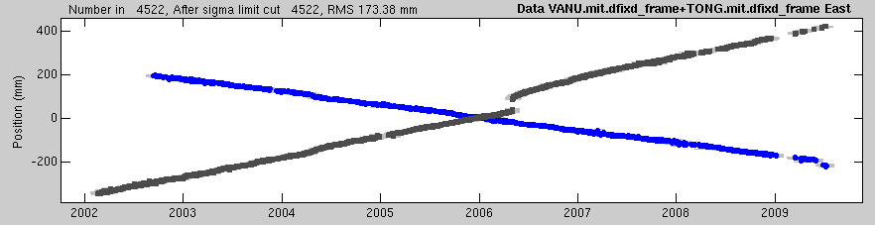
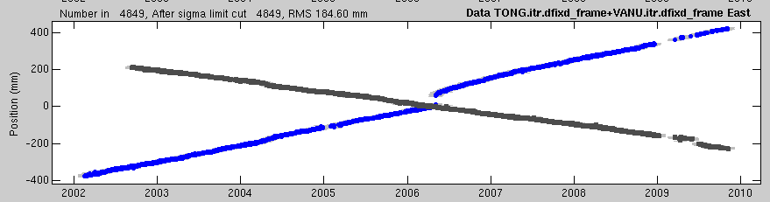
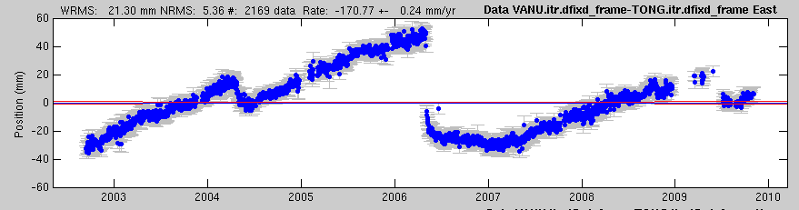
East motions at Vanuatu and Tonga
Figure below show east motions are Vanuatu (blue) and Tonga (black)
Bottom figure is difference with linear trend of 170 mm/yr removed. A fast earthquake on May 3, 2006, Magnitude 7.9, 150 km away from Tonga can see seen. A slow earthquake event in 2004 can also be seen.
Fast Earthquake
Slow Earthquake
Another Earthquake

Slide 34
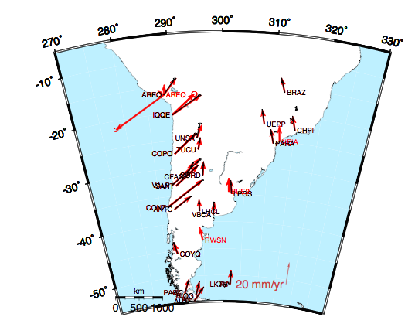
South America
Black vectors are MIT estimates, Red ITRF 2009
Earthquake effects at AREQ

Slide 35
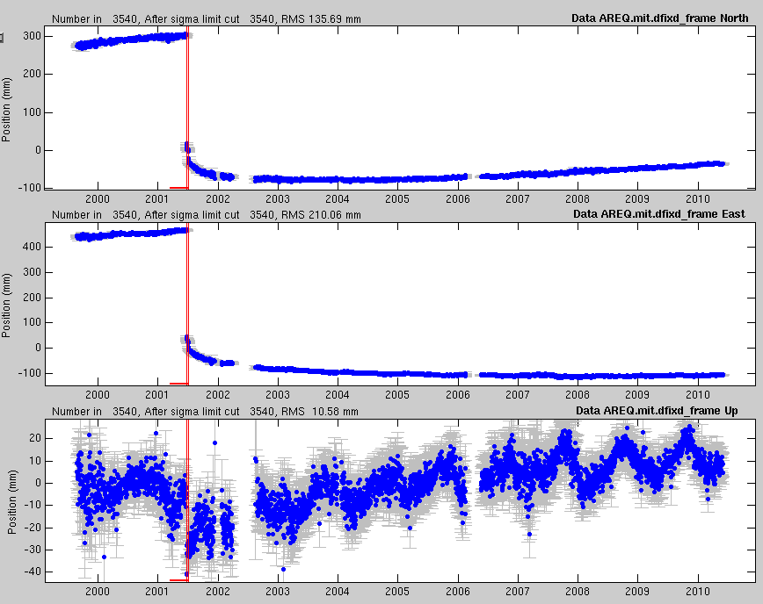
Arequipa, Peru

Slide 36
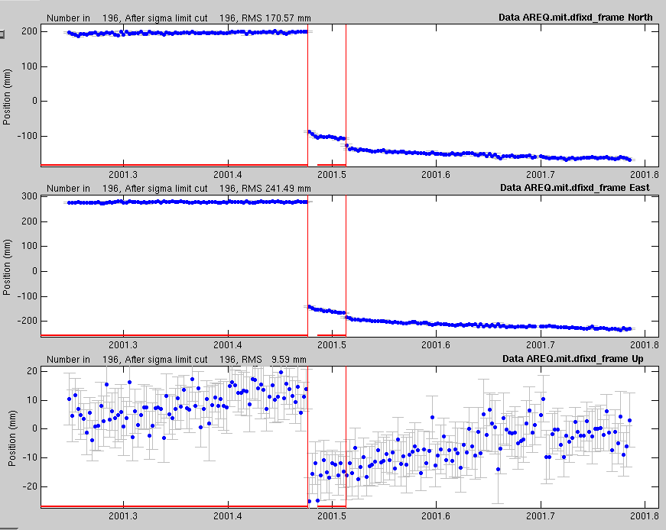

Slide 37
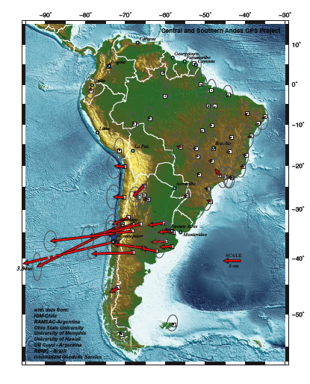
Feb 27, 2010 Chile earthquake
CONZ (GPS/VLBI/SLR)
http://www.unavco.org/research_science/science_highlights/2010/M8.8-Chile_EQ_SAM.pdf

Slide 38
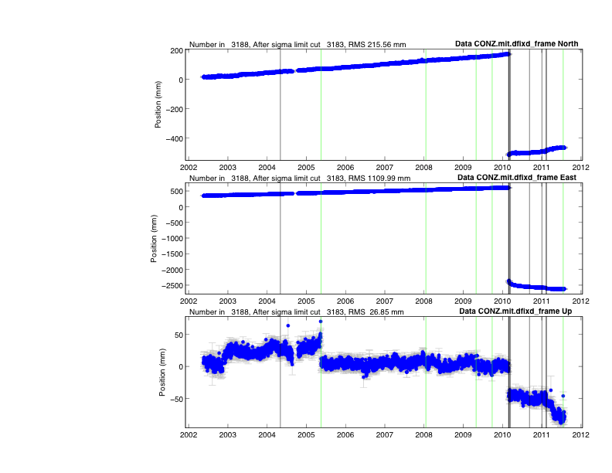
CONZ in Chile
Green lines are equipment changes; black are earthquakes
Antenna change

Slide 39
CONZ detrended
Large amount of post-seismic deformation clear evident here when simple offsets removed.

Slide 40
CONZ: Log
Adding a 10-day log post-seismic decay for the main shock makes the residuals much flatter.

Slide 41
CONZ: East parameter fit
Computing Realistic Sigmas
RealSigma white dchi 0.662946
NRMS Realistic 6.81; Correlation time 64.00 days
Detrend of CONZ.mit.dfixd_frame East
WRMS: 2.00 mm NRMS: 6.81 #: 3183 data
Mean 460.66 +- 1.70 mm
Rate 32.34 +- 0.45 mm/yr
EQBrk 2004 5 3 4 36 -0.00 +- 1.15 mm
OffLn 2010 2 27 6 34 dOf 10.0 -2950.92 +- 6.55 mm
Log 2010 2 27 6 34 dOf 10.0 -58.86 +- 1.56 mm
EQBrk 2010 3 3 17 44 -10.16 +- 13.38 mm
EQBrk 2010 3 5 9 19 -32.88 +- 12.21 mm
EQBrk 2010 3 16 2 21 -7.33 +- 4.28 mm
EQBrk 2010 9 9 7 28 -3.04 +- 2.10 mm
EQBrk 2011 1 2 20 20 -6.17 +- 2.50 mm
EQBrk 2011 2 11 20 4 -19.14 +- 16.55 mm
EQBrk 2011 2 13 8 51 -8.64 +- 16.45 mm
Break 2005 5 17 14 30 1.79 +- 1.23 mm
Break 2008 1 18 13 59 3.93 +- 1.11 mm
Break 2009 4 30 13 30 2.74 +- 1.14 mm
Break 2009 9 26 13 0 -0.76 +- 1.28 mm
Break 2011 7 19 20 30 0.36 +- 4.58 mm
Velocity effect of log term: 1/time; so in 50 yrs velocity will still be 1.1 mm/yr from inter-seismic value

Slide 42
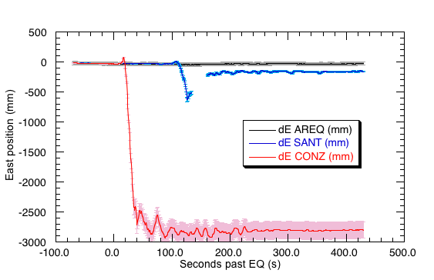
Coseismic East Offsets

Slide 43
Summary
Reference frame realization needs to treated carefully in order to extract the most information from your GPS data analysis.
The caution here is to carefully select and to process data from well distributed “stable” sites that can be used for the reference definition:
  When we say a site or group of sites is moving, the reference frame defines what we consider to be the non-moving system to which the movement is referenced.

