Slide 1
Error Models
Lecture 06
Thomas Herring
tah@mit.edu

Slide 2
Issues in GPS Error Analysis
What are the sources of the errors ?
How much of the error can we remove by better modeling ?
Do we have enough information to infer the uncertainties from the data ?
What mathematical tools can we use to represent the errors and uncertainties ?
Notes:
Sources tell us: maximum sizes, frequency content and correlation times.
Modeling: always want to remove or whiten if possible: add parameters
Data span long enough and density great enough to “see” the behavior of the time series
Tools: spectral analysis to infer characteristics; program models and controls to implement

Slide 3
Determining the Uncertainties of GPS Parameter Estimates
Rigorous estimate of uncertainties requires full knowledge of the error spectrum—both temporal and spatial correlations (never possible)
Sufficient approximations are often available by examining time series (phase and/or position) and reweighting data
Whatever the assumed error model and tools used to implement it, external validation is important
Notes:
Implication of Points 1 and 2 may be that we shouldn’t try to be rigorous; rather, we need to understand and account for the dominant errors at the frequencies we’re most interested in.

Slide 4
Sources of Error
Signal propagation effects
  Receiver noise
  Ionospheric effects
  Signal scattering ( antenna phase center / multipath )
  Atmospheric delay (mainly water vapor)
Unmodeled motions of the station
  Monument instability
  Loading of the crust by atmosphere, oceans, and surface water
Unmodeled motions of the satellites
Notes:
The three catagories I’ve listed here is a useful way to think about errors in GPS measurements. For studying global phenomena they are all potentially important, but I’m going to concentrate today on measurements on continental and regional scale. For these intersite distances, we now know the orbits of the satellites well enough that their contribution is usually small. So we’ll look at effects in signal propagation and uninteresting motions of the receiving antenna. In signal propagation, first order ionospheric effects are removed in all high precision work by combining signals at the two GPS frequencies. And for modern observations, receiver noise is nearly negligible. So we’re left with scattering effects and the atmosphere.

Slide 5
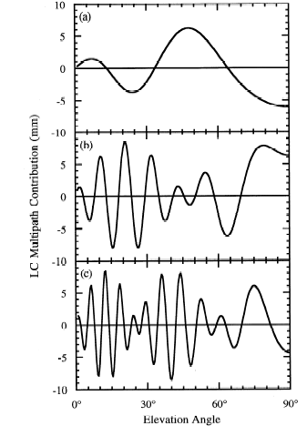
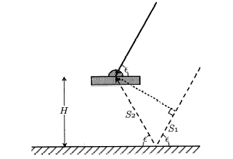
Simple geometry for incidence of a direct and reflected signal
Multipath contributions to observed phase for an antenna at heights (a) 0.15 m, (b) 0.6 m, and (c ) 1 m. [From Elosegui et al, 1995]
Notes:
The most common and dominant source of high-frequency multipath is reflection from the horizontal surface beneath the antenna. If this surface is far enough away from the antenna (1-2 m) to be outside the fresnel zone (no interaction with the antenna itself), then geometric optics allows us to model the signal well enough to predict the frequency. For an antenna mounted 1-2 m above the surface, the variations will be of the order of minutes, and tend to have low, though still significant correlations with the signature of the station’s coordinates and the atmospheric delay. Once you get within a half-meter, though, the longer period variations are a real problem. And this is even without taking into account the interaction with the antenna structure.

Slide 6
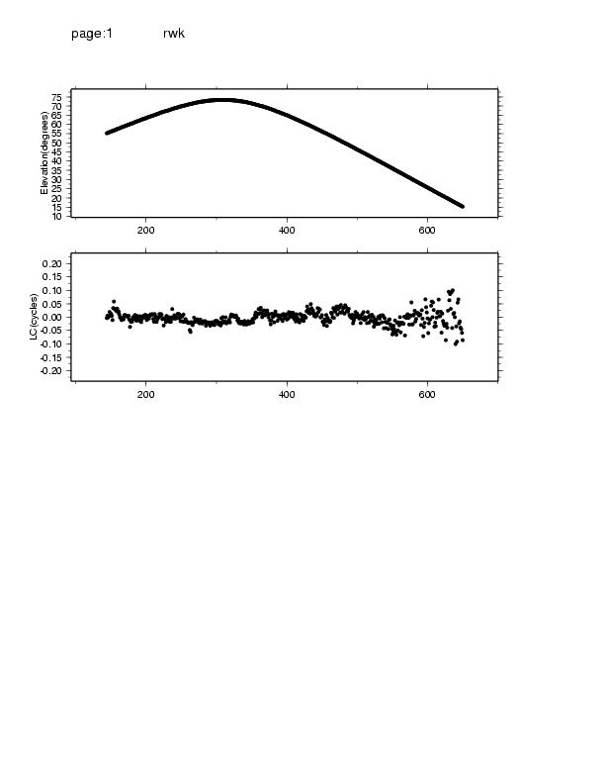
Characterizing Phase Noise
Epochs
20
0 mm
-20
1 2 3 4 5 Hours
Elevation angle and phase residuals for single satellite
Notes:
This slide, produced from a cview display, will give us a feel for the phase noise of a “typically good” antenna environment.
Shows 30s samples of the one-way LC phase residuals after removing clock drift and the best-fit geometric model and clock. Also shown is the elevation angle of the observations. The overall rms is 8 mm (0.04 cycles), but the scatter increases from 2 mm at the zenith to 15 mm at low elevations. NB: Phase errors are not uniform but depend on elevation angle (and also multipath environment and possible receiver behavior). GAMIT weights the phases by an elevation-dependent model derived (by AUTCLN) for each station.
At high elevations the dominant errors have correlation times of about 25 minutes. If we use the default sampling of SOLVE (2 minutes) and scale by the nrms, these “formal” uncertainties will be too small by a factor of sqrt(12), or about 3-4. Since the GAMIT nrms (q-file) is typically 0.2 (based on an arbitrarily assigned phase error—see Chap 2 of the manual) and we do not rescale, the uncertainty estimated by SOLVE would be pessimistic by ~30% if our eye-ball estimate of temporal correlations is representative of the full error spectrum. As we shall see, the median value of short-term scatter in daily positions is typically ~0.7, confirming our “eyeball” estimate of correlation times.
Note that the formal solve sigma (but not the real sigma!) depends on the sampling. These values apply with 2-minute sampling and elevation-dependent weighting. (Note how we got to this, and 1.7 re-scaling factor between autcln and N-file.)

Slide 7
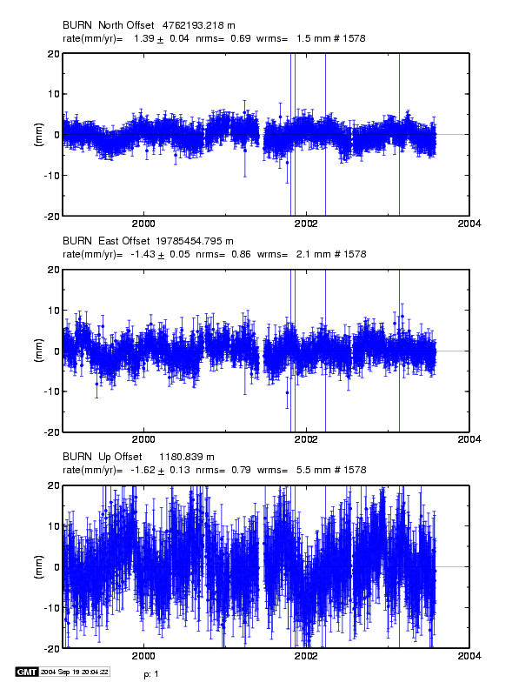
Characterizing the Noise in Daily Position Estimates
Note temporal correlations of 30-100 days and seasonal terms
Notes:
Now let’s move to time series of daily observations. 4-yr from CGPS station in eastern Oregon (dry climate).
Note wrms ~2 mm horizontal 6 mm vertical. Nrms ~0.7. Formal error for white noise assumption after scaling by nrms is .03 mm/yr horizontal .1 mm/yr vertical. But correlation time for independent observations is ~100 days, so to apply our rule-of-thumb, we would scale the velocity uncertainties by a factor of 10, to 0.3 mm/yr horizontal and 1 mm/yr vertical to get realistic estimates.
This eye-balling of correlation times will usually get you within a factor of two of the true uncertainty of a velocity estimate. Let’s look at two ways of doing this a bit more rigorously. One uses spectral analysis and an assumption about how the high-frequency noise is related to the low-frequency noise; the other simply applies more precisely our eyeballing of correlation times.
Best paper for a through description of spectral analysis applied to GPS time series is Williams [2003] (has complete references to earlier work); I’ve given you Mao et al. [1998] because it’s a little more accessible, discusses a broader range of issues,, and introduces an idea used by Mazzotti et al., which provides a good practical approach to assigning velocity errors.

Slide 8
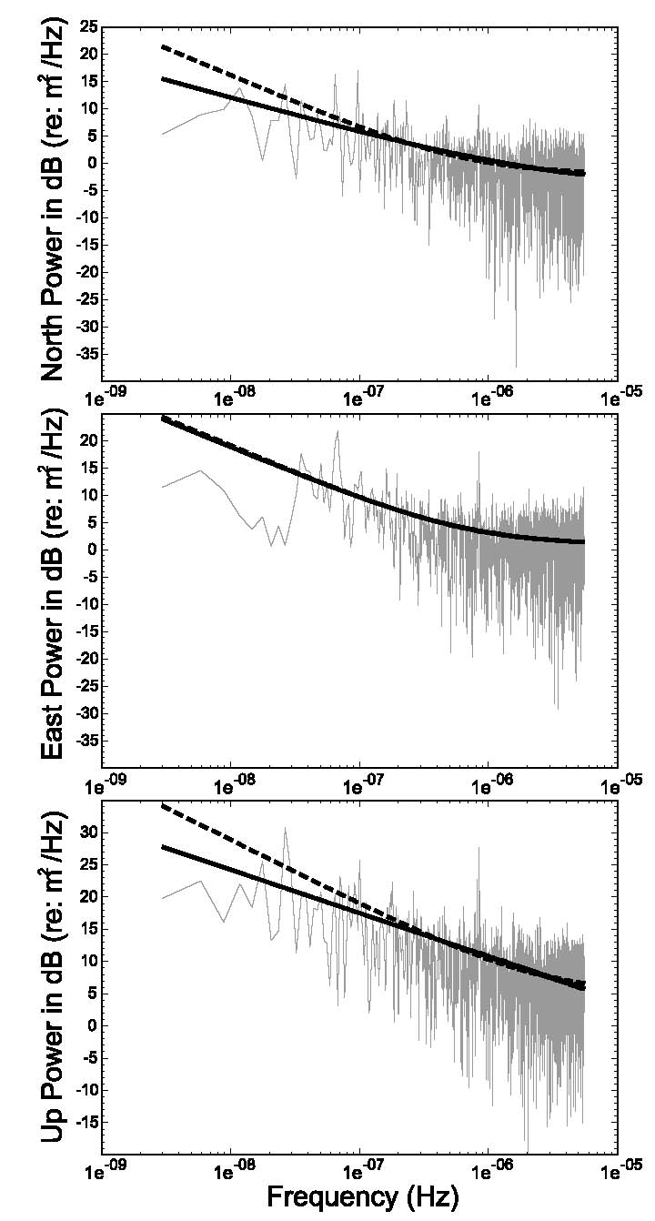
Spectral Analysis of the Time Series to Estimate an Error Model
Figure 5 from Williams et al [2004]: Power spectrum for common-mode error in the SOPAC regional SCIGN analysis. Lines are best-fit WN + FN models (solid=mean ampl; dashed=MLE)
Note lack of taper and misfit for periods > 1 yr
Notes:
Length of span: 1991-2001.
Introduction to spectra: power as a function frequency (inverse of period); with a finite length series, you can take many samples at high frequencies but not many at low frequencies; limit is 1 over half the period (Nyquist frequency) ; max here is 5 yrs.
“Flat” portion at right suggests white noise—with a lot of uncertainty at high frequencies.
Above 10 d (e-6) noise begins to rise with increasing period.
Common approach (Williams, Mao, etc) is to fit this spectrum to a power law; ie. P = f^{n} where n typically 0 to -2; on a log-log plot, the slope of the line; 0 = WN, -1 = FN -2 = RW (imagine these from your own experience) [spectral index]
Above 100 d (e-7) quite variable, and note the difference in the two lines, obtained from different approaches to estimating the power-law fit, making it difficult to infer the true noise level for infinite period (velocity), therefore can a power-law fit be a very reliable estimate of velocity error?

Slide 9
. . . spectral analysis approach
Power law: slope of line fit to spectrum
  0 = white noise
  -1 = flicker noise
  -2 = random walk
Non-integer spectral index (e.g. “fraction white noise” → 1 > k > -1 )
Good discussion in Williams [2003]
Problems:
  Computationally intensive
  No model captures reliably the lowest-frequency part of the spectrum
Notes:
Summary of spectral characterization of noise.
Note possibility of non-stationary noise.

Slide 10
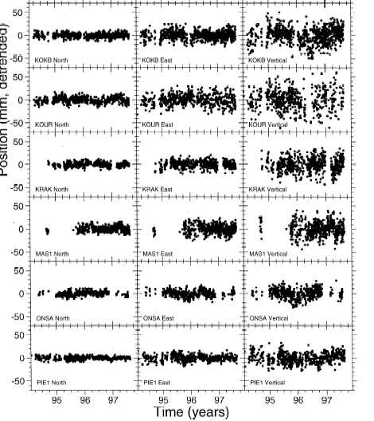
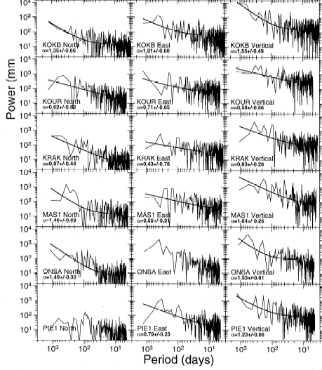
Examples of times series and spectra for global stations
From Mao et al., 1999
Notes:
Here is a sample of power spectra from Mao et al. (old and short IGS analysis), and you have a complete set in your notes. Note the range of spectral indices and also the large uncertainty in extrapolating from high to low frequencies. Most are between 0.7 and 1.5, spanning the exponent (1) indicative of flicker noise. It’s the result of this type of analysis that led Zhang et al., Mao et al., and Williams to use “flicker noise” as the characterization of GPS time series.
I would argue that you get a more reliable estimate of the velocity uncertainty just by imagining the range of velocities allowed by the lowest frequency visible in the time series. For example, for KOUR Up (2d from top), there is a long “bow” evident in the E component that will determine the velocity error—noise at higher frequencies is not so important.

Slide 11
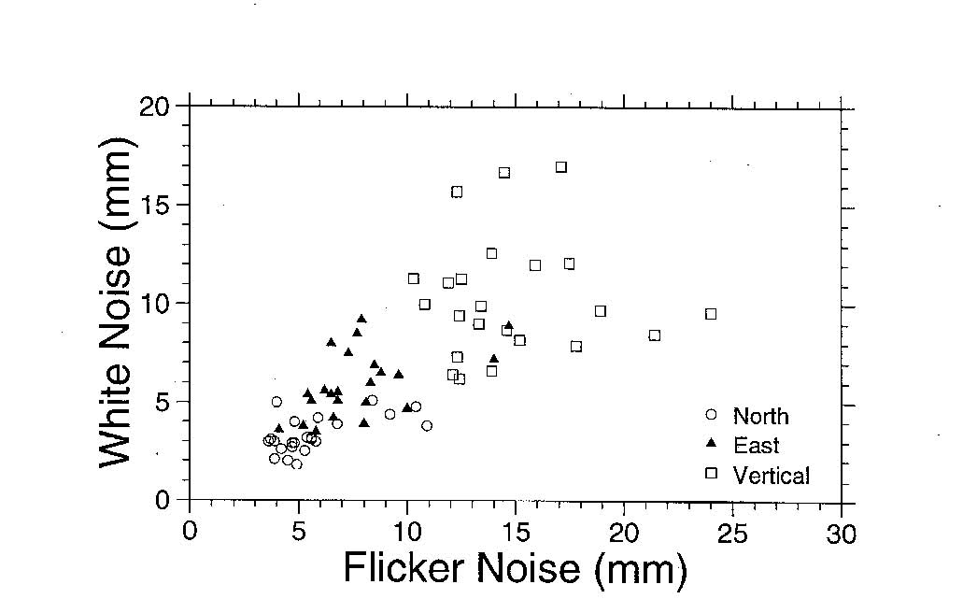
Short-cut: Use white noise statistics ( wrms) to predict the flicker noise
White noise vs flicker noise from Mao et al. [1999] spectral analysis of 23 global stations
Notes:
Since white noise can be easily computed from a short time series, and flicker noise (or RW noise) not, Mao et al. looked for correlations between the WN and FN components. And there is a useful correlation, which Mao et al. estimate as empirical constants in their Eq. 20. and which are used by Dixon et al. and Mazzotti et al. . You can make your own assessment of the uncertainty of this relationship based on the scatter in this plot. There is about a factor of 2 difference in the FN values you might infer from a given WN values.
Next let’s look at another approach to estimating the long-period noise. (“Realistic sigma” algorithm of Tom Herring.)

Slide 12
“Realistic Sigma” Algorithm for Velocity Uncertainties
Motivation: computational efficiency, handle time series with varying lengths and data gaps; obtain a model that can be used in globk
Concept: The departure from a white-noise (sqrt n) reduction in noise with averaging provides a measure of correlated noise.
Implementation:
  Fit the values of chi2 vs averaging time to the exponential function expected for a first-order Gauss-Markov (FOGM) process (amplitude, correlation time)
  Use the chi2 value for infinite averaging time predicted from this model to scale the white-noise sigma estimates from the original fit
  and/or
  Fit the values to a FOGM with infinite averaging time (i.e., random walk) and use these estimates as input to globk (mar_neu command)
Notes:
Summary of the “Realistic Sigma” algorithm. See Herring [2003].

Slide 13
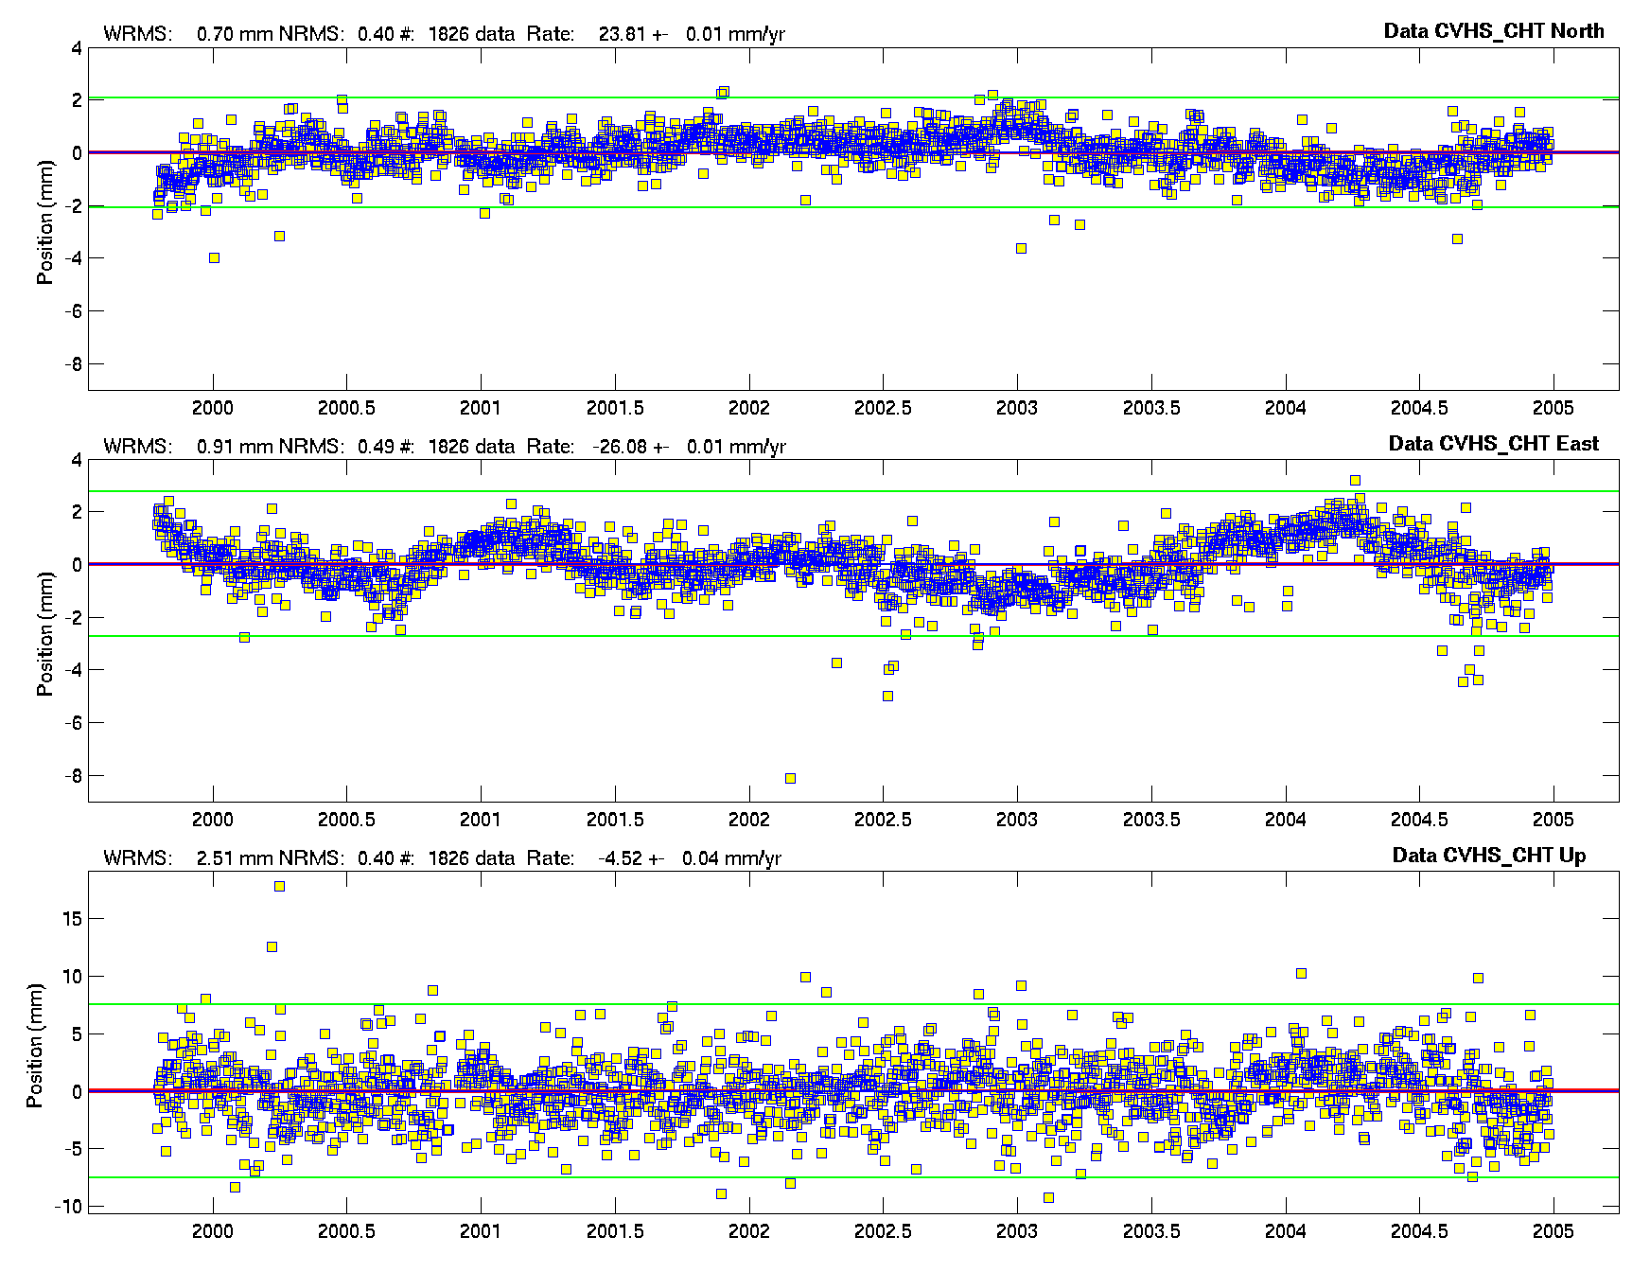
Effect of Averaging on Time-series Noise
Note the dominance of correlated errors and unrealistic rate uncertainties with a white noise assumption:
.01 mm/yr N,E
.04 mm/yr U
Yellow: Daily (raw) Blue: 7-day averages
Notes:
Southern California site with a well-behaved time series (up to 2005). WRMS < 1 mm in horizontal, 2.5 mm in vertical. Yellow squares are daily values, with NRMS of ~0.5. Blue points are 7-day averages, which you can see reduces the short-term noise considerably (as we expect, since it’s white, but not much the long-term. Suppose we keep averaging for longer and longer periods and observe what happens to the scatter: we’d expect the WRMS to go down and the NRMS to go up. If the dominant frequencies of the noise are long-period, we would expect to approach a plateau, or at least an asymptote, which we might then use to characterize the noise at infinite frequency—that is, the uncertainty in the velocity. Let’s see how this works on the E component of this time series. (While we’re here, though I’ll note that the “eye-ball” correlation time of this series is again about 100 days, implying a factor of 10 inflation of the WN uncertainty (.01 mm/yr here).

Slide 14
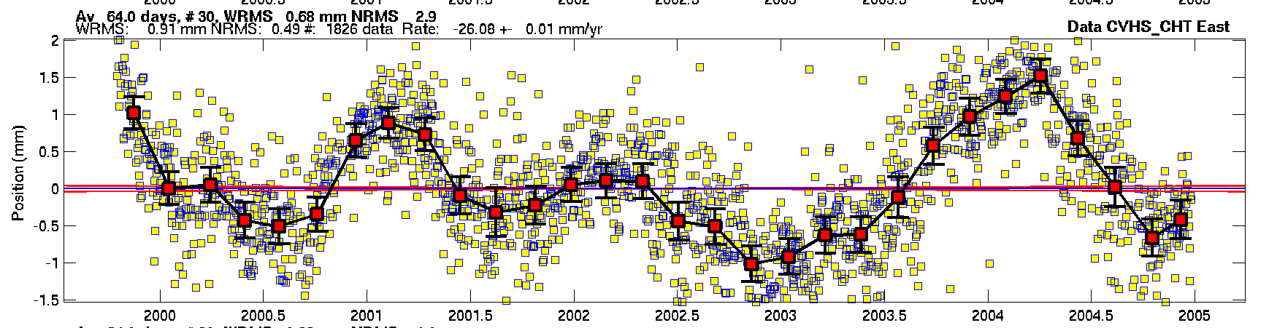
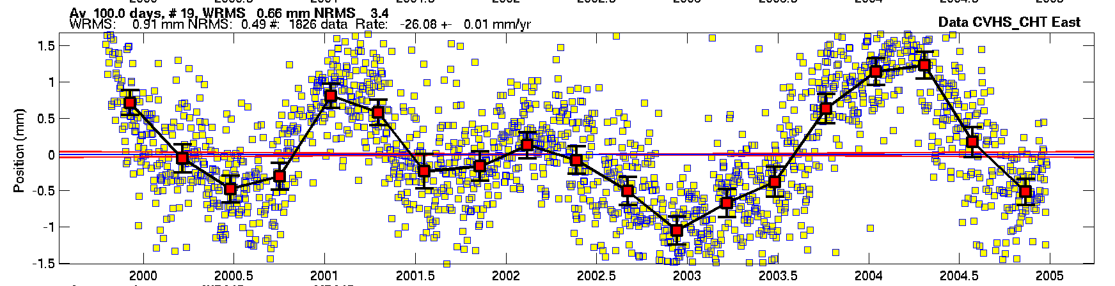
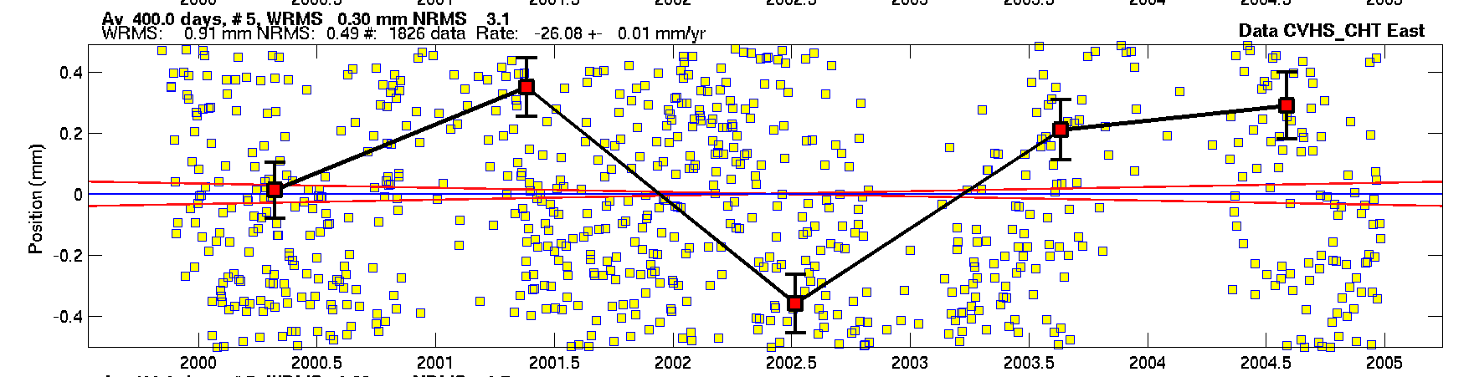
Same site, East component ( daily wrms 0.9 mm nrms 0.5 )
64-d avg
wrms 0.7 mm
nrms 2.0
100-d avg
wrms 0.6 mm
nrms 3.4
400-d avg
wrms 0.3 mm
nrms 3.1
Notes:
This plot shows the time series in East with 1-d averaging (yellow, all panels), 64d (top), 100d (middle), and 400d (bottom). The original wrms is 0.91 mm; with white noise, we would predict the 100d rms to be 0.1 mm, but in fact it’s 0.66 mm, only a 30% reduction. At 400d, it’s decreased to 0.30 mm, a factor of three, much less than the factor of 20 predicted by WN. Turned around, we see that the nrms has gone from 0.5 (1d) to about 3 for averaging of 64d or more. And you can see this visually from the behavior of the curves: that is, the dominant (only relevant) noise here has a characteristic correlation time of 100-400+ days.
The red lines here show the range of rates allowed by the WN model.

Slide 15
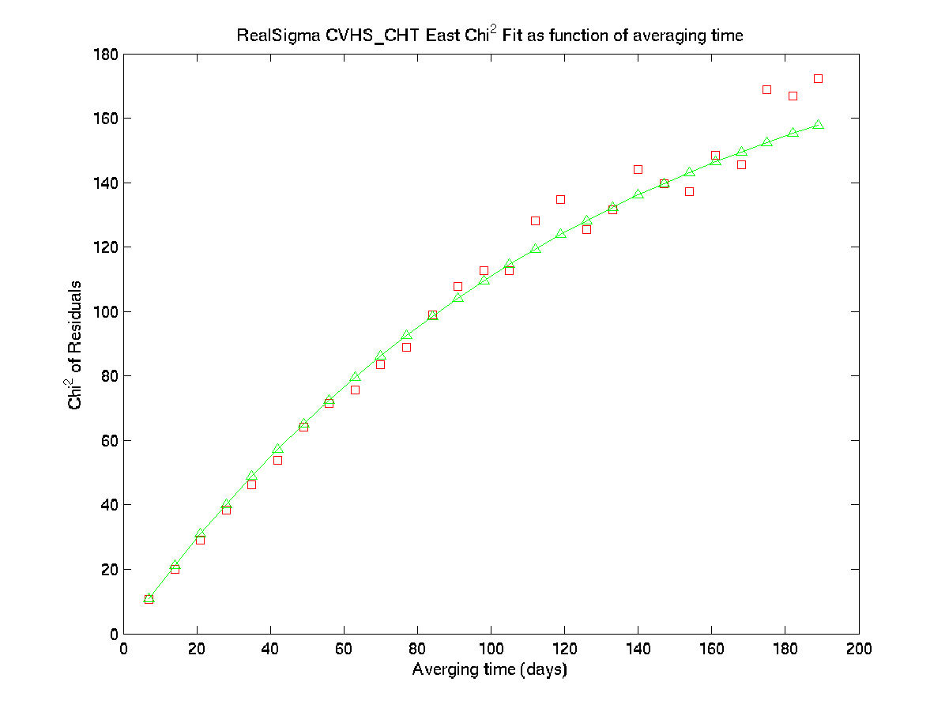
Estimating a “realistic-sigma” by fitting an exponential function to chi-square vs averaging time
Get scale factor by evaluating the function at an infinite averaging time
Notes:
Here’s what the plot of chi2 vs averaging time looks like. What the “Realistic Sigma” algorithm does is fit an exponential function these averaging samples and then calculate two numbers that can be used as a practical way of estimating the velocity uncertainty:
- one is the scale factor to be applied to the WN sigma to get the realistic sigma for a time series analysis TSVIEW or enfit
- The other is the RW coefficient to be used for a mar_neu command of GLOBK. [ sh_gen_stats ]

Slide 16
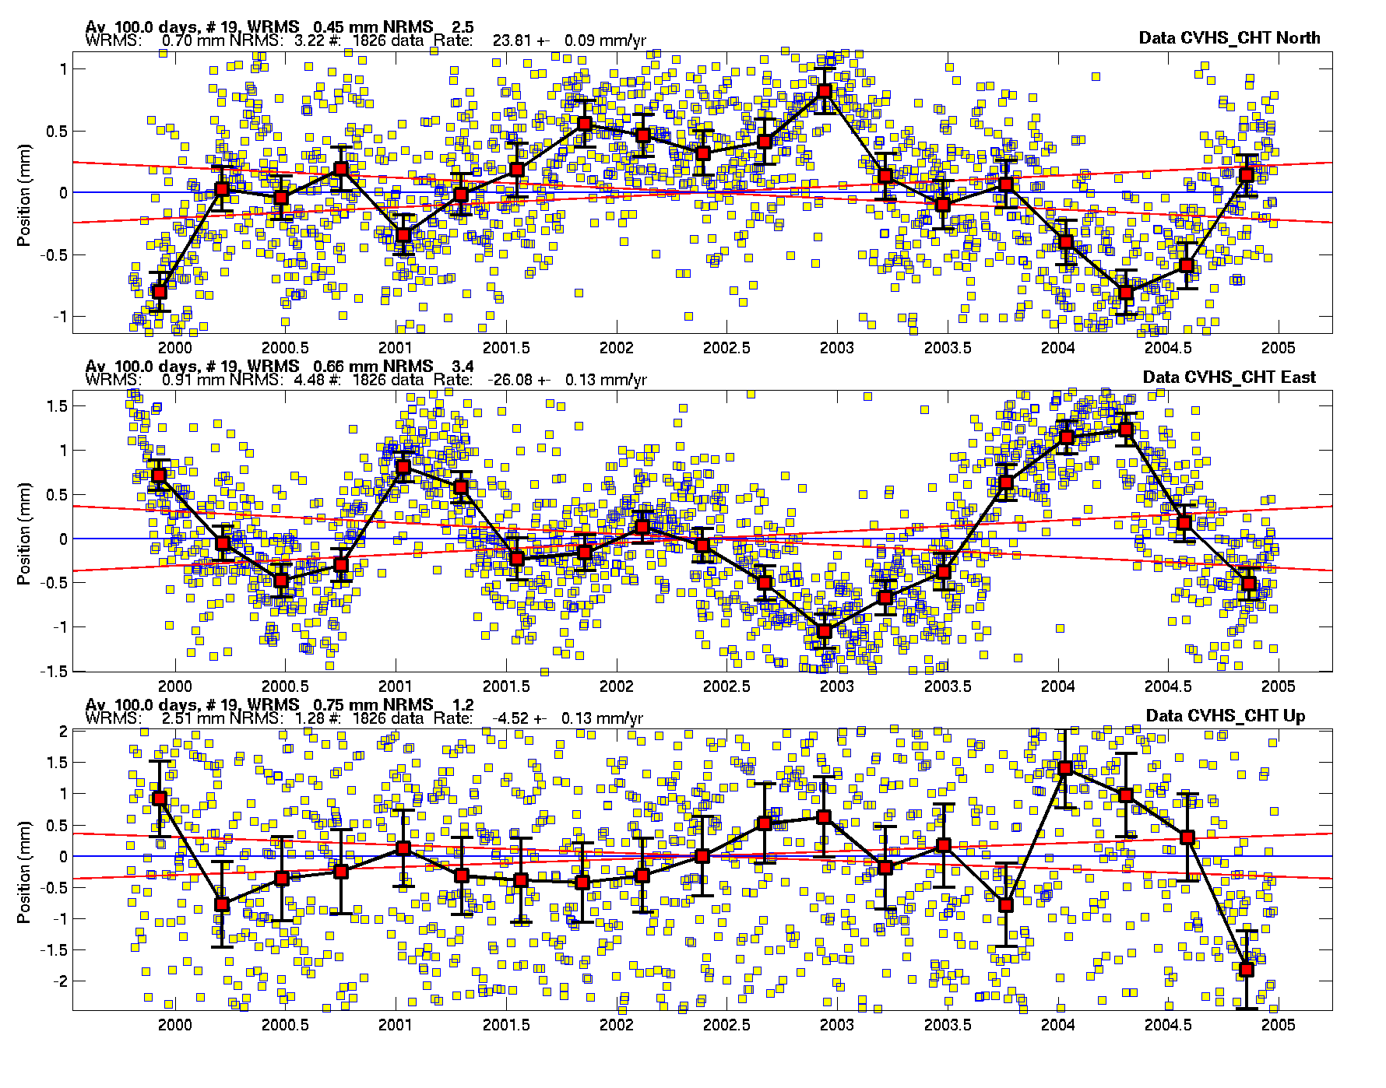
Using TSVIEW to compute and display the “realistic-sigma” results
Note rate uncertainties with the “realistic-sigma” algorithm :
0.09 mm/yr N
0.13 mm/yr E
0.13 mm/yr U
Red lines show the 68% probability bounds of the velocity based on the results of applying the algorithm.
Notes:
TSVIEW example: Here are now the N, E, and U time series, with 1d and 100d averaging. In this plot we have turned on the “realistic sigma” option of tsview, so the red lines now show the range of rates allowed by the more realistic sigmas estimated with the algorithm: 0.09 mm/yr N 0.13 E, 0.13U. (not too far from our “eyeball” estimate based on visually inspection of the original series !)

Slide 17
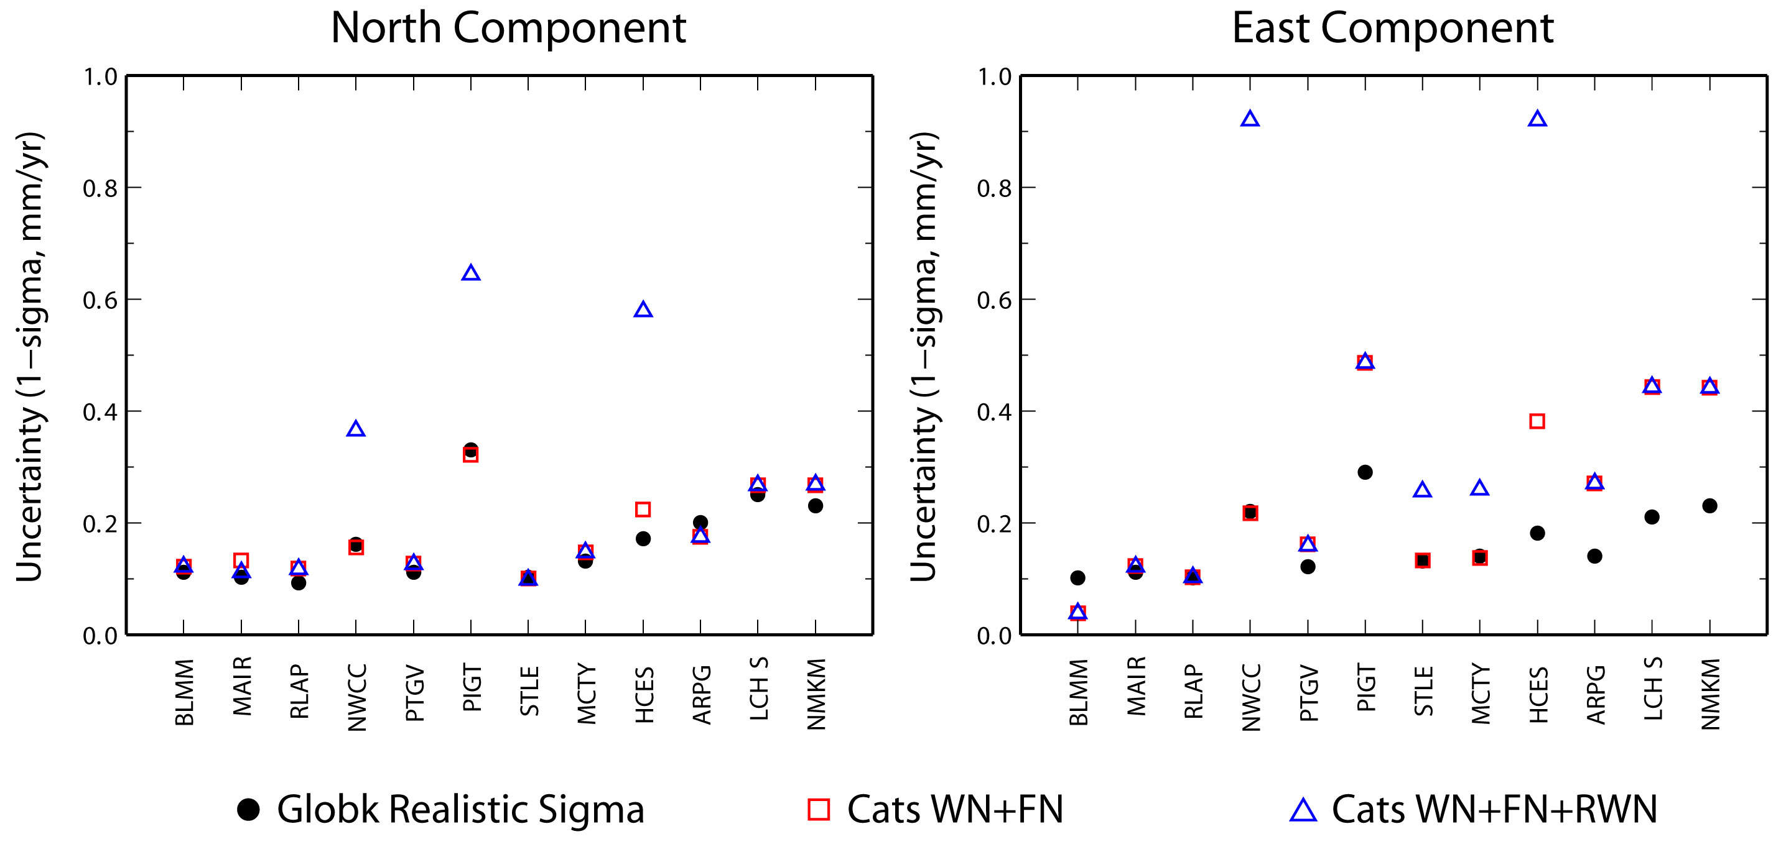
Comparison of estimated velocity uncertainties using spectral analysis (CATS*) and Gauss-Markov fitting of averages (GLOBK)
Plot courtesy E. Calias

Slide 18
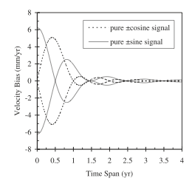
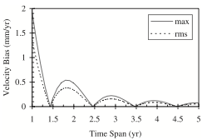
Velocity Errors due to Seasonal Signals
Annual signals from atmospheric and hydrological loading, monument translation and tilt, and antenna temperature sensitivity are common in GPS time series
Theoretical analysis of a continuous time series by Blewitt and Lavallee [2002]
Top: Bias in velocity from a 1mm sinusoidal signal in-phase and with a 90-degree lag with respect to the start of the data span
Bottom: Maximum and rms velocity bias over all phase angles
  The minimum bias is NOT obtained with continuous data spanning an even number of years
  The bias becomes small after 3.5 years of observation

Slide 19
Summary of Practical Approaches
White noise + flicker noise (+ random walk) to model the spectrum [Williams et al., 2004]
White noise as a proxy for flicker noise [Mao et al., 1999]
Random walk to model to model an exponential spectrum [Herring “realistic sigma” algorithm for velocities]
“Eyeball” white noise + random walk for non-continuous data
______________________________________
Only the last two can be applied in GLOBK for velocity estimation
All approaches require common sense and verification

Slide 20
Determining the Uncertainties of GPS Estimates of Station Velocities
Understanding the sources of error
Time series analysis to determine statistics for reweighting the data
Whatever the assumed error model and tools used to implement it, external validation is important
Notes:
Implication of Points 1 and 2 may be that we shouldn’t try to be rigorous; rather, we need to understand and account for the dominant errors at the frequencies we’re most interested in.

Slide 21
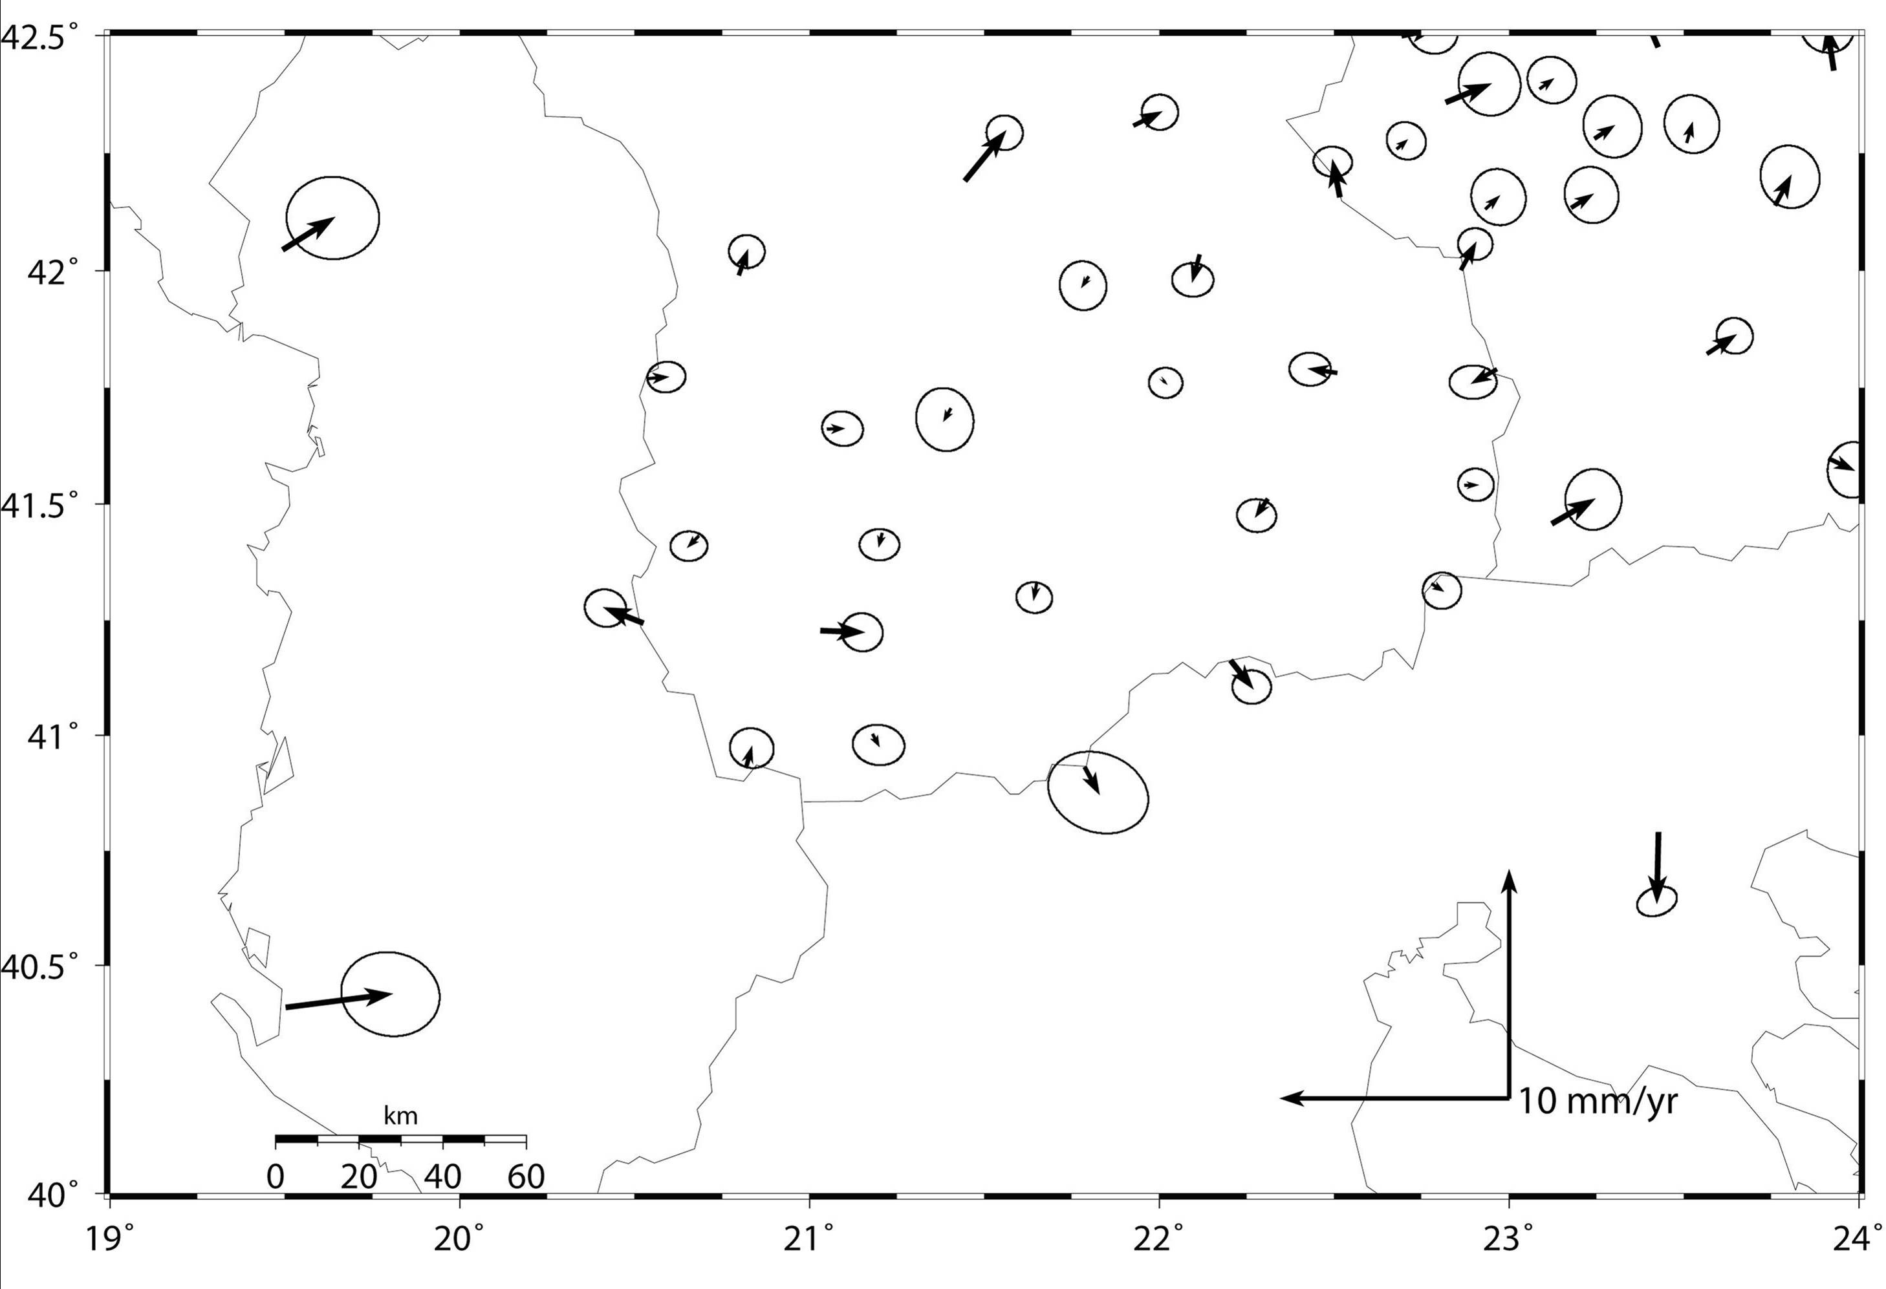
External Validation for Velocity Uncertainties
-- assume no strain within a geological rigid block
GMT plot at 70% confidence
17 sites in central Macedonia: 4-5 velocities pierce error ellipses
Notes:
Once you’ve made your best estimate of the appropriate weighting of the daily solutions, you should validate these by examining the scatter in the velocities. To do this you need to have a region that is non-deforming or well-modeled at the level of the velocity uncertainties. A relatively simple application of this approach is possible with the network shown in this slide.
The velocities for stations observed in the southern Balkans have been estimated from two or three surveys spanning 4 yrs and are displayed in a reference frame defined by the mean velocities of 20 stations in stable central Macedonia. If we plot these with GMT (sh_plotvel) with 70% error ellipses, we find that the residuals for 6 of the 20 stations in the stable region fall outside the error ellipses, approximately what we would expect if a Gaussian distribution applies.
The slide following shows the same velocity field plotted at 95% confidence, for which in this case, residuals for 2 of the stations fall outside the error ellipse.

Slide 22
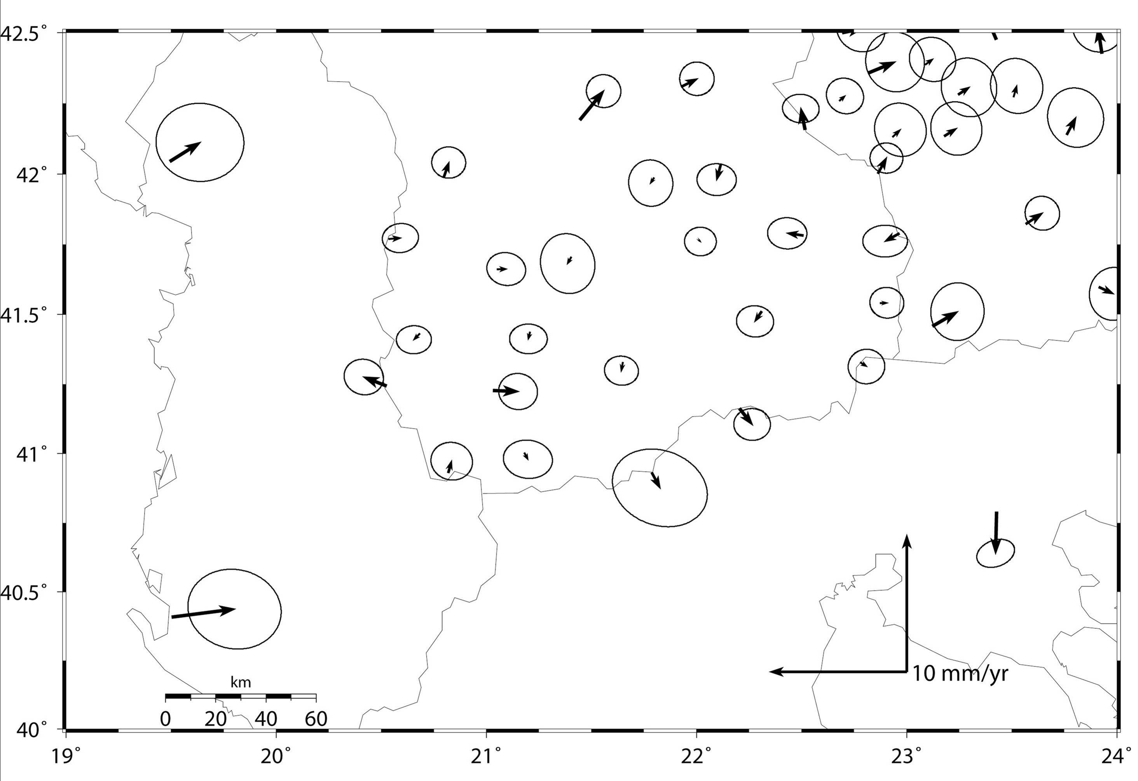
.. same solution plotted with 95% confidence ellipses
1-2 of 17 velocities pierce error ellipses

Slide 23
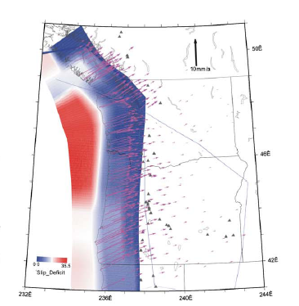
A more rigorous assessment for data from Cascadia
Colors show slipping and locked portions of the subducting slab where the surface velocities are highly sensitive to the model; area to the east is slowly deforming and insensitive to the details of the model
McCaffrey et al. 2007
Notes:
With a larger data set we can formalize this procedure—that is, we can see if the distribution of normalized velocity residuals matches a probability distribution that allows us to assign realistic odds on a velocity being “wrong”. We’ll use an example from the Pacific Northwest, for which there are over 300 stations with accurate velocities determined from survey-mode and continuous observations (next slide). Since the velocities due to the Cascadia megathrust are large along the coast, to validate the uncertainties, we’ll use only stations well inland, whose velocities are small and well-modeled. There are ~100 stations in this region E of 238 with 1-d 1-sigma uncertainties < 2 mm/yr.
Here’s a tectonic model of the region, color coded by the level of strain and with velocities shown relative to North America. In the best model for this region, the Oregon block, SW of the diagonal line, is rotating clockwise relative to NA. Note that the model effects are small and smooth for E OR and WA, which can be fit easily with a two-block model and small elastic strain from the slab, to calibrate the uncertainties in the velocity estimates.

Slide 24
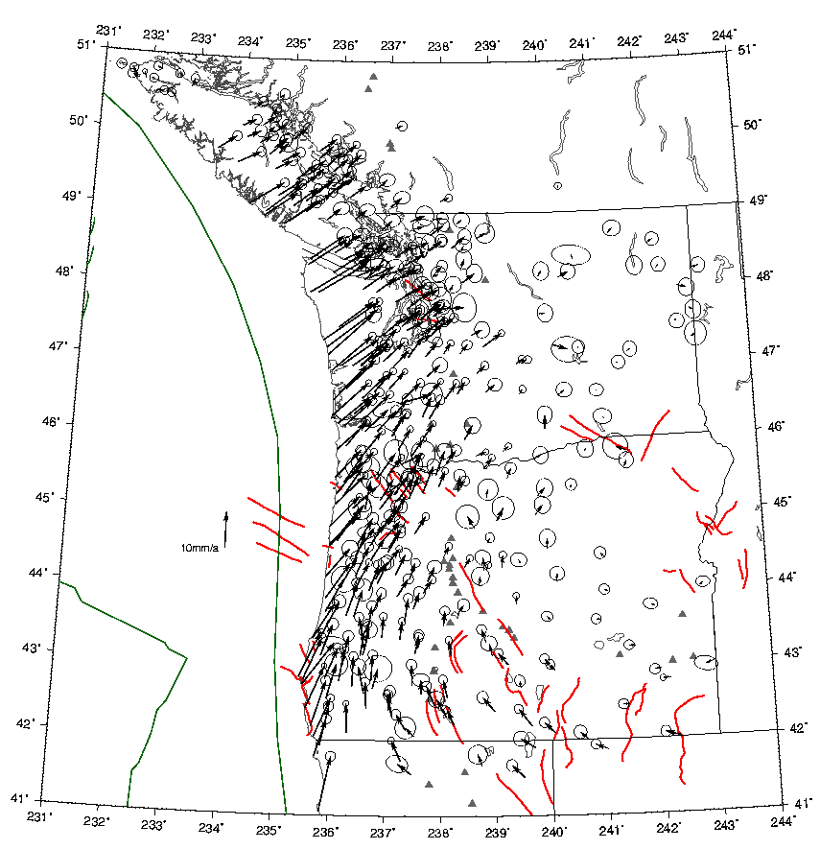
Velocities and 70% error ellipses for 300 sites observed by continuous and survey-mode GPS 1991-2004
Test area (next slide) is east of 238E
Notes:
These are the observed velocities

Slide 25
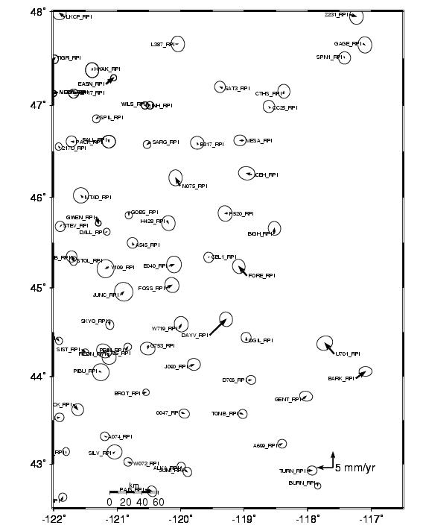
Residuals to elastic block model for 70 sites in slowly deforming region
Error ellipses are for 70% confidence:
13-17 velocities pierce their ellipse
Notes:
Look again at all of eastern Oregon to see how we might develop a statistical model for the full data set. There are about 73 stations in this area. The error ellipses are plotted for 70% confidence, so if we have applied the correct weighting to the data, we should expect about 23 of the arrows to exceed the error ellipses. If we count these visually, there are 16 clearly outside and another 7 too close to call. This approach works best when you have a region which you are sure strain is negligible compared to the data errors, but even when there is significant strain, it’s a useful calibration if you think you can model the strain in most regions to within 10-20% of the errors. If you’ve designed your network to provide sufficient spatial redundancy, you usually distinguish by patterns what is station noise and what is model noise. The most troublesome problems arise when an area seems to move coherently but the source of the motion is from spatially coherent errors—for example, if you observe all stations in a small region at the same time and they are all affected by a weather pattern or orbital error during that period. Note the one or possible two outliers, which you may choose to removed from the sample.

Slide 26
Locations of one continuous (BURN) and 3 survey-mode sites for time series shown in next slides
217U
SARG
DALL
BURN
Notes:
Next slides show time series for these 5 well-determined sites in E OR and WA. Two of them are continuous---BURN, we’ve seen before, and GOBS. The other three have been surveyed for 2-5 days every 1-2 years. The velocities shown here are with respect to a model (NAM) that removes the rotation of the Oregon block and elastic deformation along the boundary (diagonal from upper left corner to 45N 117W. The residuals of these sites and others near them are less than 1 mm/yr.
Next slide: BURN

Slide 27
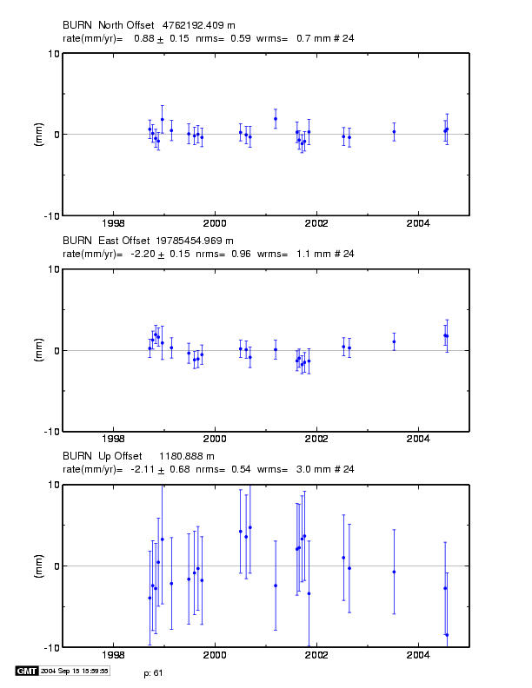
Time series of monthly position estimates for continuous site BURN
Wrms ~ 1 mm N,E
~ 3 mm U
Rate uncertainties
< 0.2 mm/yr N,E
0.7 mm/yr U
do not include random walk added for velocity estimates
Notes:
A 5-yr time series with sampling only in the summer, at the time of field surveys, from a different processing. Here the reference frame is different, so the rate differences from the previous slide cannot be considered simple data noise. Note that the formal uncertainties from yearly samples are nearly as small as from the continuous time series: 0.2 mm/yr in horizontal, 0.7 mm/yr in vertical. You could argue here that the persistent slope in the last half of the vertical time series suggests systematic errors in vertical as large as 2 mm/yr—still close to a useful result for constraining some interesting phenomena.

Slide 28
Next slide shows time series for survey-mode site 217U
Note consistency with nearby sites
217U
SARG
DALL
BURN
Notes:
Next slides show time series for these 5 well-determined sites in E OR and WA. Two of them are continuous---BURN, we’ve seen before, and GOBS. The other three have been surveyed for 2-5 days every 1-2 years. The velocities shown here are with respect to a model (NAM) that removes the rotation of the Oregon block and elastic deformation along the boundary (diagonal from upper left corner to 45N 117W. The residuals of these sites and others near them are less than 1 mm/yr.
Next slide: BURN

Slide 29
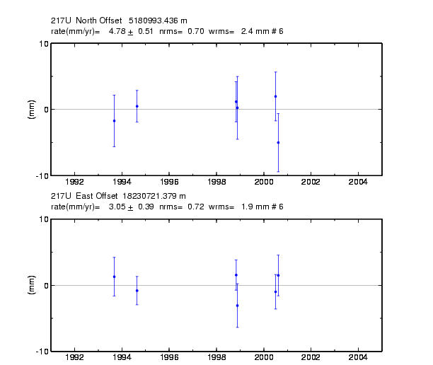
Time series for survey-mode site 217U
Position estimates based on 8-24 hr occupations
Note < 1 mm rate uncertainties due to 7-yr time span
Notes:
With the sparcity of data here, and with DALL, you can argue that the formal errors are close to the real ones. In fact, as I’ll show later from the consistency of velocities, a normalized rms of 0.6-0.8, given four or more epochs, produces a realistic one-sigma uncertainty—here 0..5 mm/yr. This is a reliable result largely because of the long time span 7-years.

Slide 30
Next slide shows time series for survey-mode site SARG
217U
SARG
DALL
BURN
Notes:
Next slides show time series for these 5 well-determined sites in E OR and WA. Two of them are continuous---BURN, we’ve seen before, and GOBS. The other three have been surveyed for 2-5 days every 1-2 years. The velocities shown here are with respect to a model (NAM) that removes the rotation of the Oregon block and elastic deformation along the boundary (diagonal from upper left corner to 45N 117W. The residuals of these sites and others near them are less than 1 mm/yr.
Next slide: BURN

Slide 31
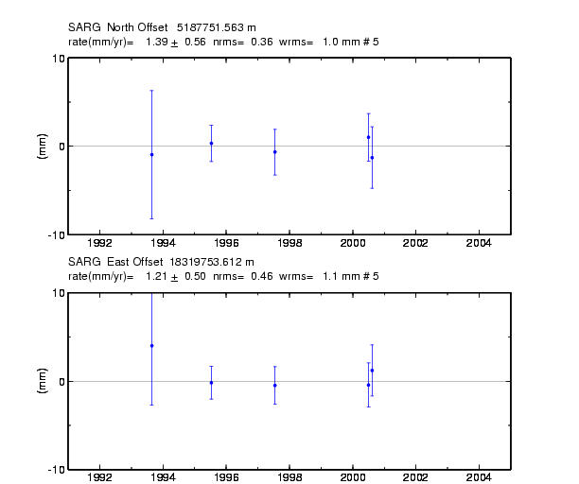
Horizontal time series for survey-mode site SARG
Position estimates based on 8-24 hr occupations
Note 1 mm wrms and
< 1 mm rate sigmas
Notes:
Another example of a field site which appears to be well behaved over 5 years, leading to realistic uncertainties in horizontal velocities less than 1 mm/yr.

Slide 32
Next slide shows time series for survey-mode site DALL
Note consistency with nearby sites except continuous site GWEN
217U
SARG
DALL
BURN
Notes:
Next slides show time series for these 5 well-determined sites in E OR and WA. Two of them are continuous---BURN, we’ve seen before, and GOBS. The other three have been surveyed for 2-5 days every 1-2 years. The velocities shown here are with respect to a model (NAM) that removes the rotation of the Oregon block and elastic deformation along the boundary (diagonal from upper left corner to 45N 117W. The residuals of these sites and others near them are less than 1 mm/yr.
Next slide: BURN

Slide 33
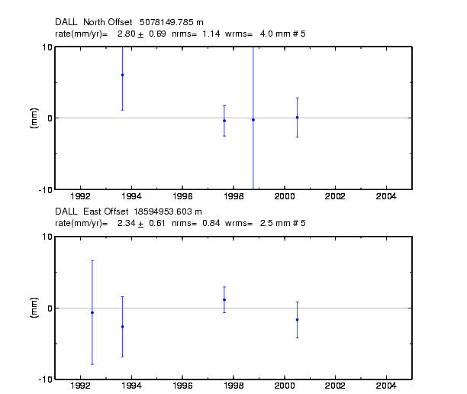
Horizontal time series for survey-mode site DALL
Position estimates based on 8-24 hr occupations
Rate sigmas < 1 mm/yr and consistent with surrounding sites even with velocities determined essentially by two occupations 3 yrs apart
Notes:
From the time series, some reason to doubt that the uncertainties are realistic. (But velocity is consistent with neighbors.)

Slide 34
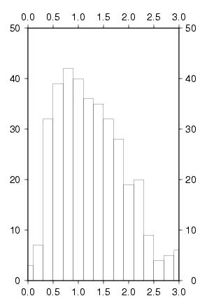
Statistics of Time Series
Distribution of normalized rms for horizontal magnitudes residuals after removing the block model
357 sites
NRMS
E, N 1.00, 1.03
NRMS
Notes:
We can be more rigorous about this by plotting histograms. My experience with this network has been that the histograms become smooth and more easily interpretable as you approach 100 stations. 60 was useful but coarse. The “V” here means the magnitude of the horizontal velocity (not ‘vertical’).

Slide 35
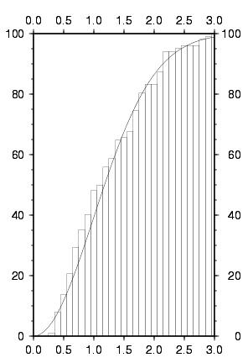
Statistics of Velocity Residuals
Cumulative histogram of normalized velocity residuals for Eastern Oregon & Washington ( 70 sites )
Noise added to position for each survey:
0.5 mm random
1.0 mm/sqrt(yr)) random walk
Solid line is theoretical for Gaussian distribution
Percent
Within
Ratio
Ratio (velocity magnitude/uncertainty)
Notes:
We can formalize the probability analysis by plotting the cumulative normalized residuals against a theoretical curve for a Gaussian distribution. For the PNW data set, I modified the formal errors by adding quadratically a random noise (here 0.5 mm) and a random-walk process (1.0 mm/sqrt-yr) F09b E238 n=102 E, N nrms 1.00, 1.08. On the next slide, you’ll see that if I decrease the random-walk component to 0.5 mm/sqrt(yr), the uncertainties are too small.

Slide 36
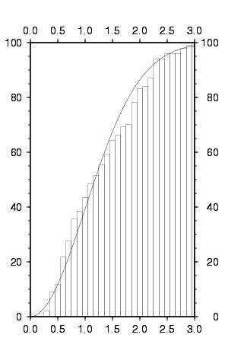
Statistics of Velocity Residuals
Percent
Within
Ratio
Same as last slide but with a smaller random-walk noise added :
0.5 mm random
0.5 mm/yr random walk
( vs 1.0 mm/sqrt(yr)) RW for ‘best’ noise model )
Note greater number of residuals in range of 1.5-2.0 sigma
Ratio (velocity magnitude/uncertainty)
Notes:
Soln a01a: Between 70 and 90% confidence, uncertainties are too small by 10-15%

Slide 37
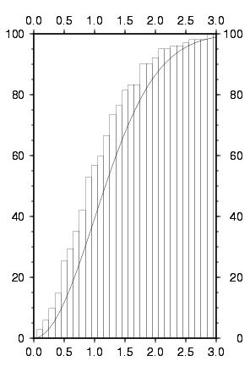
Statistics of Velocity Residuals
Same as last slide but with larger random and random-walk noise added :
2.0 mm white noise
1.5 mm/sqrt(yr)) random walk
( vs 0.5 mm WN and 1.0 mm/sqrt(yr)) RW for ‘best’ noise model )
Note smaller number of residuals in all ranges above 0.1-sigma
Percent
Within
Ratio
Ratio (velocity magnitude/uncertainty)
Notes:
Here I’ve increased the random walk to 1.5 mm/sqrt(yr) and also the random component to 2 mm at each epoch. Histogram when observations are underweighted by about 15%; e.g. with a scaling the appropriate scaling in 2-D for 70% confidence (1.6), 85% of the residuals are within the error ellipse. F12b_E238 n =102 E,N nrms 0.79, 0.94

Slide 38
Summary
All algorithms for computing estimates of standard deviations have various problems: Fundamentally, rate standard deviations are dependent on low frequency part of noise spectrum which is poorly determined.
Assumptions of stationarity are often not valid
“Realistic sigma” algorithm is a covenient and reliable appraoch to getting velocity uncertainties in globk
Velocity residuals from a model, together with their uncertainties, can be used to validate the error model

Slide 39
Tools for Error Analysis in GAMIT/GLOBK
GAMIT: AUTCLN reweight = Y (default) uses phase rms from postfit edit to reweight data with constant + elevation-dependent terms
GLOBK
  rename ( eq_file) _XPS or _XCL to remove outliers
  sig_neu adds white noise by station and span; useful for handling outliers
  mar_neu adds random-walk noise: principal method for controlling velocity uncertainties
  In the gdl files, can rescale variances of an entire h-file: useful when combining solutions from with different sampling rates or from different programs (Bernese, GIPSY)
Utilities
  Realistic sigma” algorithm implemented in tsview (MATLAB) and enfit/ensum; sh_gen_stats generates mar_neu commands for globk based on the noise estimates
  sh_plotvel (GMT) allows setting of confidence level of error ellipses
  sh_tshist and sh_velhist can be used to generate histograms of time series and velocities.

Slide 40
Summary
There are no absolute methods that ensure the correct error model can be determined for a set of data processing.
We attempt to determine with 1-sigma values, that 68% of values will be within this range due to noise; with 2-sigma, 95% of values (1-d) even when the probability distribution is not Gaussian.
The most under certain aspect is determining the nature of the temporal and spatial correlations in the results. Generally, large amounts of data are needed for this and the assumption of stationarity.

Slide 41
References
Spectral Analysis
Langbein and Johnson [J. Geophys. Res., 102, 591, 1997]
Zhang et al. [J. Geophys. Res., 102, 18035, 1997]
Mao et al. [J. Geophys. Res., 104, 2797, 1999]
Dixon et al. [Tectonics , 19, 1, 2000] Herring [GPS Solutions, 7, 194, 2003]
Williams [J. Geodesy, 76, 483, 2003]
Williams et al. [J. Geophys. Res. 109, B03412, 2004]
Langbein [J. Geophys. Res., 113, B05405, 2008]
Williams, S. [GPS Solutions, 12, 147, 2008]
Effect of seasonal terms on velocity estimates
Blewitt and Lavaellee [J. Geophys. Res. 107, 2001JB000570, 2002]
Realistic Sigma Algorithm
Herring [GPS Solutions, 7, 194, 2003]
Reilinger et al. [J. Geophys. Res., 111, B5, 2006]
Validation in velocity fields
McClusky et al. [J. Geophys. Res. 105, 5695, 2000]
McClusky et al. [Geophys. Res. Lett., 28, 3369, 2000]
Davis et al. [J. Geophys. Res. Lett. 2003GL016961, 2003]
McCaffrey et al., [Geophys J. Int., 2007.03371, 2007]

