Slide 1
Kinematic processing with track
Tutorial 3
Thomas Herring
tah@mit.edu

Slide 2
Tutorial
There are 2 tutorial folders for this exercise.
  BajaEQ
    This set of data contains 5 Hz GPS data at the time of the El Major Cucapah earthquake in April 2010.
    We demonstrate long baseline processing with these data and methods of using time-dependent process noise to improve ambiguity resolution on long baselines.
    Start with the track_shrt.cmd file in std folder.
  kineMIT
    This data set is a kinematic experiment carried out at MIT and when displayed in Google Earth it becomes clear what was being measured.
    We can process this data has a short baseline and has a long baseline using Algonquin Park in Canada has the reference station.

Slide 3
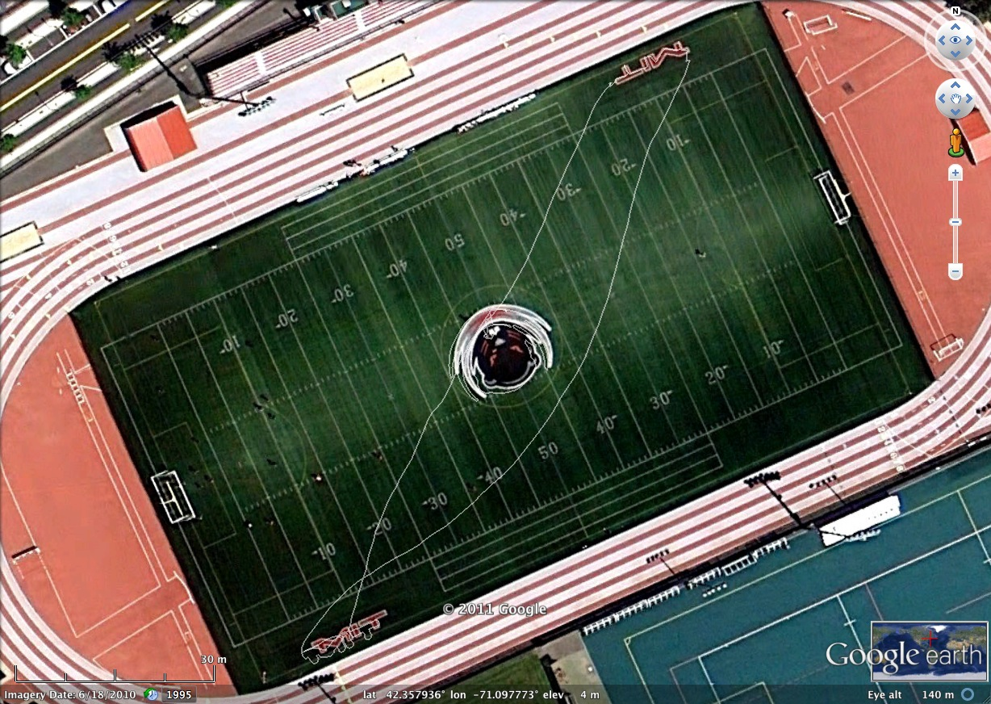
MIT track run

