Slide 1
GAMIT Modeling Aspects
Lecture 03
Thomas Herring
tah@mit.edu

Slide 2
Dominate Error Sources
  “One-sided” geometry increases vertical uncertainties relative to horizontal and makes the vertical more sensitive to session length
For geophysical measurements the atmospheric delay and signal scattering are unwanted sources of noise
For meteorological applications, the atmospheric delay due to water vapor is an important signal; the hydrostatic delay and signal scattering are sources of noise
Loading of the crust by the oceans, atmosphere, and water can be either signal or noise
Local hydrological uplift or subsidence can be either signal or noise
Changes in instrumentation are to be avoided
Notes:
Signal prop affects show up in phase residuals – motions do not.
Any of these CAN be dominant in height estimates; also can be negligible
all also show up in horizontal
Scattering and monument instability influence site selection
Atm and loading influence modeling approach.

Slide 3
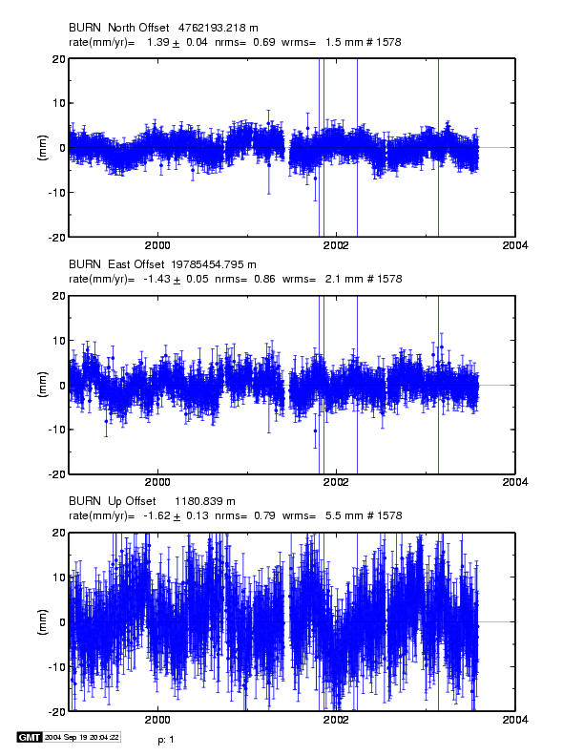
Time series for continuous station in (dry) eastern Oregon
Vertical wrms 5.5 mm, higher than the best stations. Systematics may be atmospheric or
hydrological loading,
Local hydrolology, or Instrumental effects
Notes:
Typical time series for a moderately well-behaved continuous site: eastern Oregon (low rainfaill)
2 mm horz (best are < 1 mm) 5.5 mm vertical (best are < 3 mm).
Height noise could be any combination of the four effects we’re considering .
Ignore here:
Nearly full continuous time series for BURN (4.5 yrs). Note the formal (white noise) rate uncertainties are less than 0.1 mm/yr, but the residuals are not random. We’ll compare these rates with those estimated from a 2-yr subset of the data in the next slide.

Slide 4
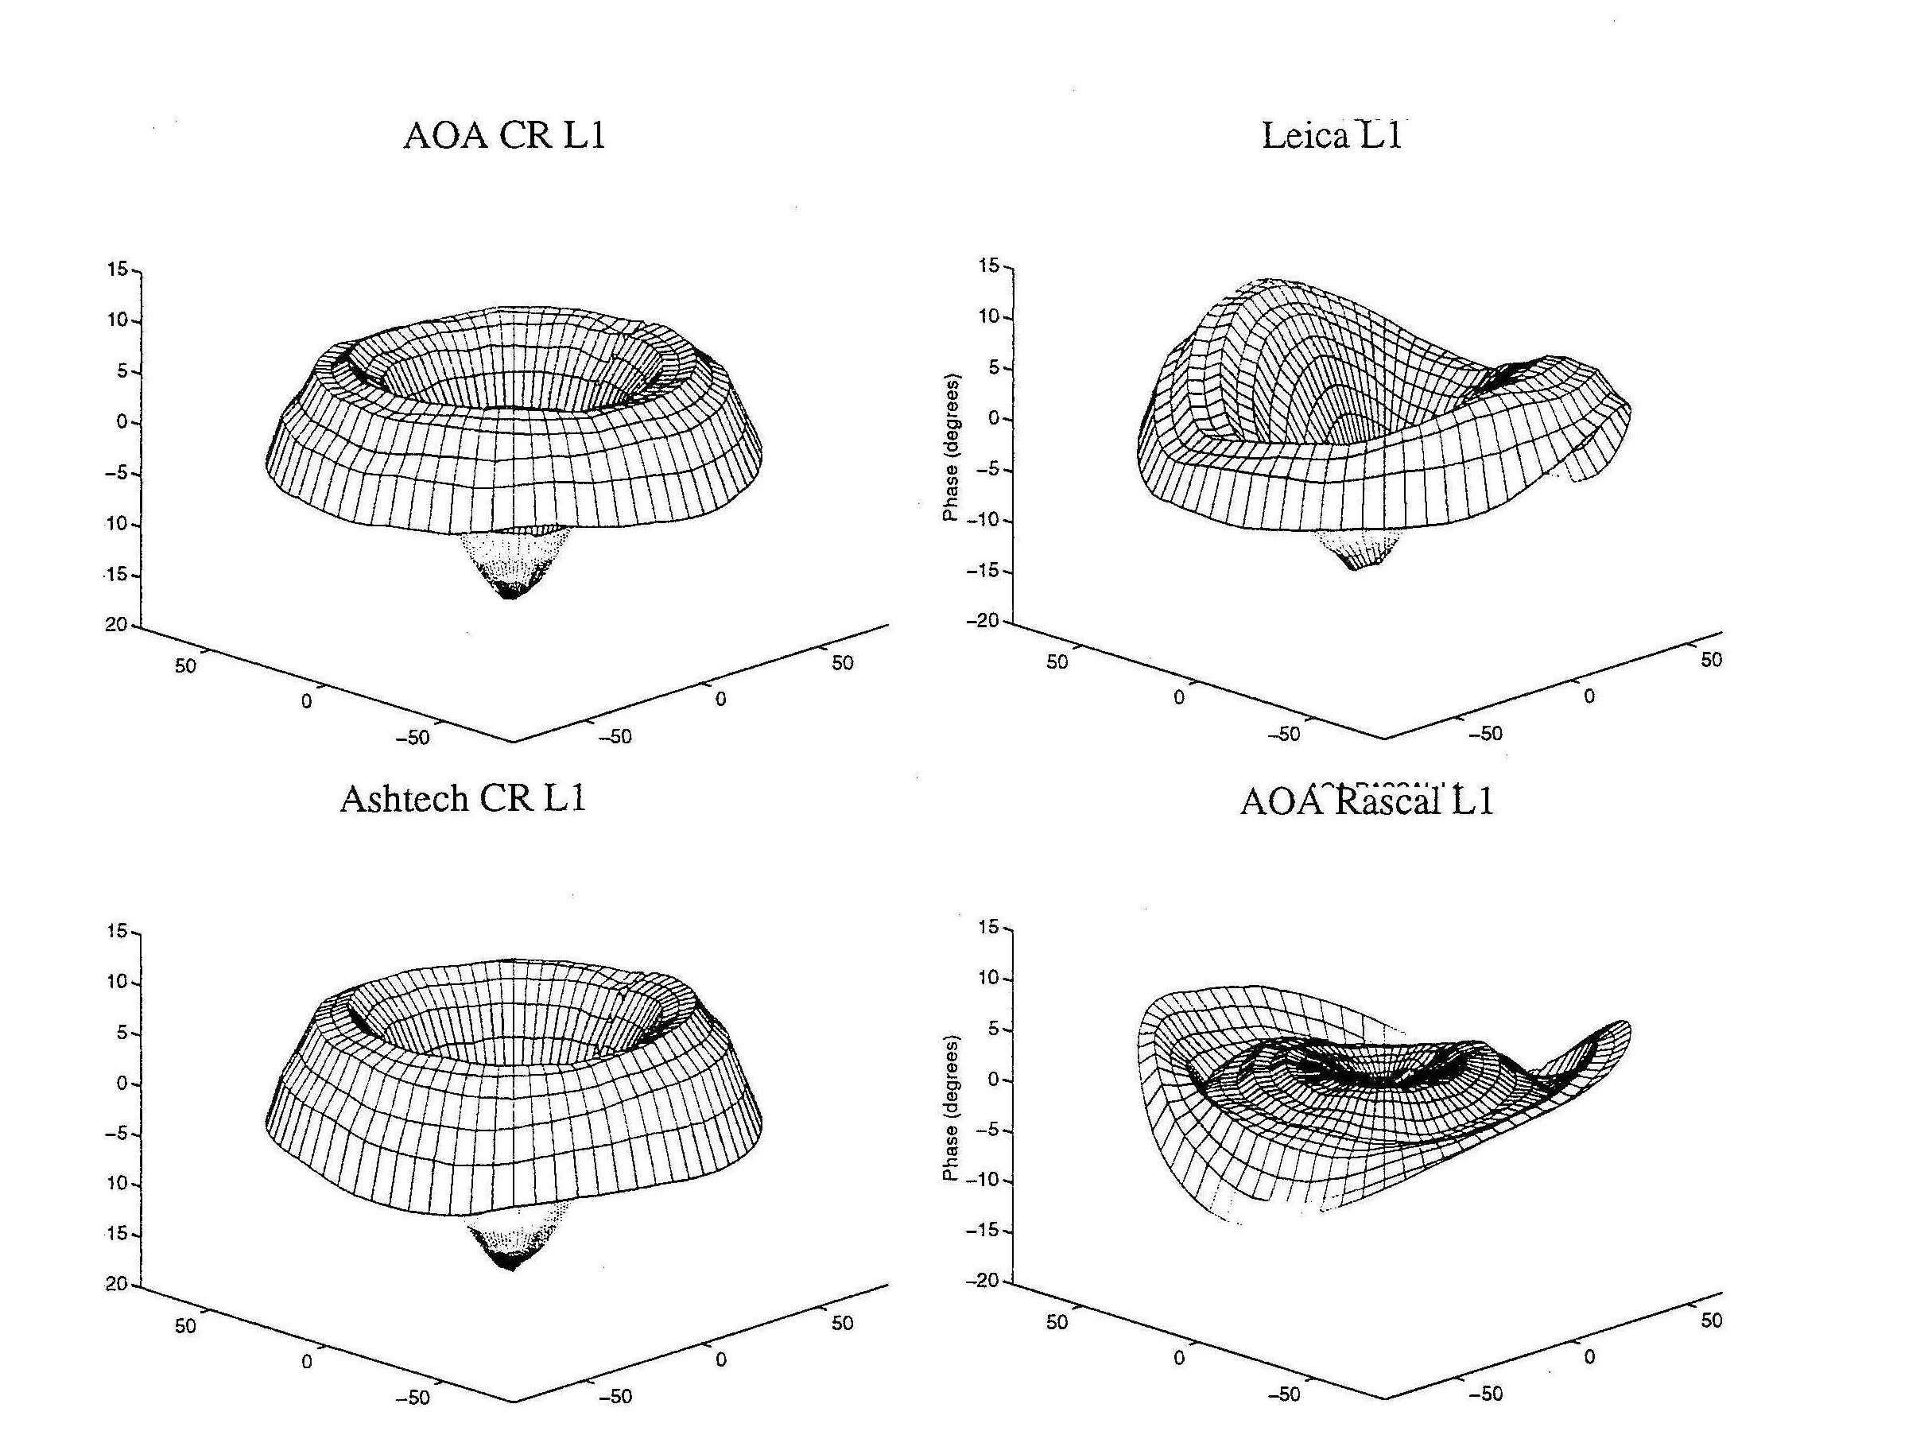
Antenna Phase Patterns
Notes:
The first problem we have is that the phase-response pattern of any physical antenna is not spherical. So the effective phase center ---the point to which you want to refer the location of the ground monument---varies as a function of elevation angle, and hence changes if you use a different minimum cutoff—which can happen when you change receivers or cables because of the change in SNR. Sometimes, the patterns also vary with azimuth, as with the Leica and Rascal antennas here, but most of the antennas used for high precision work have symmetric patterns. L1 phase variations for antennas tested by UNAVCO. Zenith values at the center and values for 10 degrees elevation at the edges. 10 deg L1 phase = 5 mm. From Rocken et a. ????

Slide 5
Modeling Antenna Phase-center Variations (PCVs)
Ground antennas
  Relative calibrations by comparison with a ‘standard’ antenna (NGS, used by the IGS prior to November 2006)
  Absolute calibrations with mechanical arm (GEO++) or anechoic chamber
  May depend on elevation angle only or elevation and azimuth
  Current models are radome-dependent
  Errors for some antennas can be several cm in height estimates
Satellite antennas (absolute)
  Estimated from global observations (T U Munich)
  Differences with evolution of SV constellation mimic scale change
  Recommendation for GAMIT: Use latest IGS absolute ANTEX file (absolute) with AZ/EL for ground antennas and ELEV (nadir angle) for SV antennas
  (MIT file augmented with NGS values for antennas missing from IGS)

Slide 6
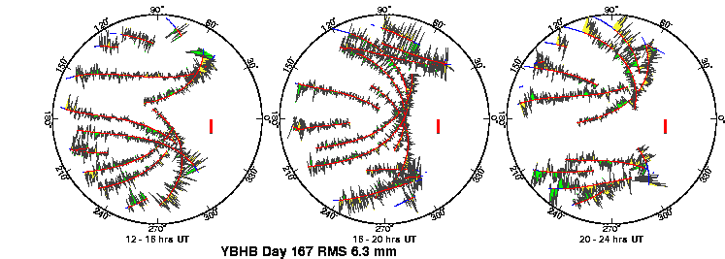
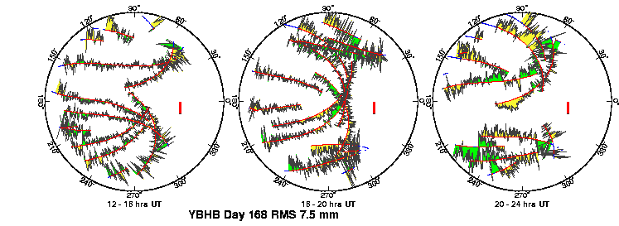
Multipath and Water Vapor Can be Seen in the Phase Residuals
Notes:
Review of sky plots: North to the right; red lines are satellite paths in the sky; green and red for positive and negative residuals (sign not important, visual aid); red bar is scale (10 mm). Plots are for the same 12-hour period on two successive days. Repeating high-frequency patterns are multipath; patterns that do not repeat are water vapor.

Slide 7
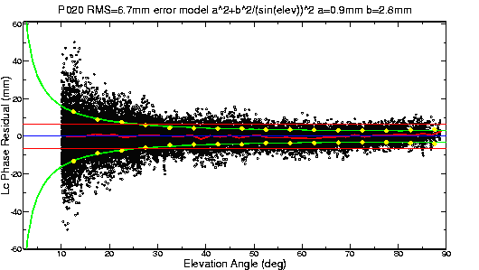
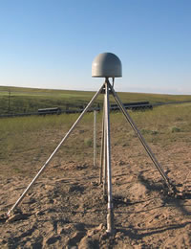
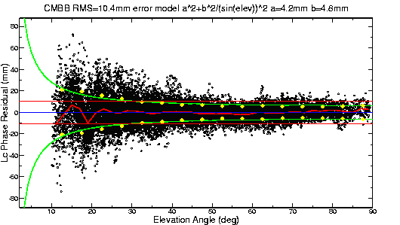
Top: PBO station near Lind, Washington.
Bottom: BARD station CMBB at Columbia College, California
Notes:
Review of phase vs elevation plots: black dots are the residuals (as in last slide) with all satellites lumped together and plotted versus height above the horizon. Red line is the mean; green lines are GAMIT’s model for weighting the observations. Mutlipath and lower-frequency signal scattering (reflections within the antenna + mount) are a function of the type of mount, height above the ground, and the reflective environment around the antenna. We now routinely create phase vs elevation plots in all of our processing. Here are two examples from continuous stations from the west US, The top one is a new PBO station in Eastern Washington. Except for the thin rods supporting the antenna, the support and the area around the antenna is “clean”, and the phase pattern quite flat. An older continuous station, mounted on a pillar. Note the low-frequency reflections at low elevation angles, indicative of higher multipath and/or an inadequate model for the antenna (+ mount) phase center variations.

Slide 8
Sky plot of phase residuals
Nature of data quality can be assessed by plots of phase residuals as a “sky plot” or as function of elevation angle.
Red line below is residuals averaged with elevation angle (used in later plots)
20 mm

Slide 9
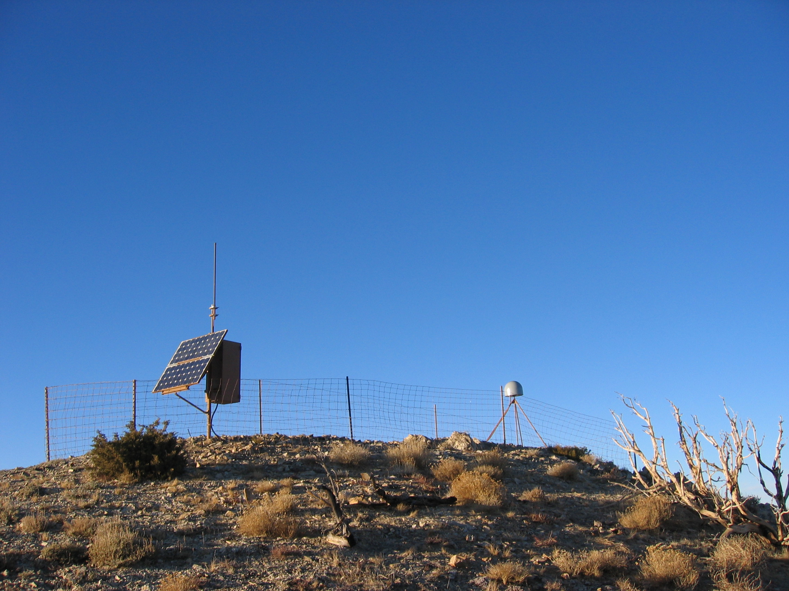
Plate Boundary Observatory (PBO) Site P099
30-days of data, different color lines
Mean shown in green
Note the ground is rough and drops away from site.
GPS antenna
+10 mm
Position RMS 0.7 mm horizontal, 2.7 mm vertical (site in Nevada).
Plot generated sh_plot_elmean
-10 to 10 mm scale, 0-90º elevation;
RMS 0.5 mm
-10 mm

Slide 10
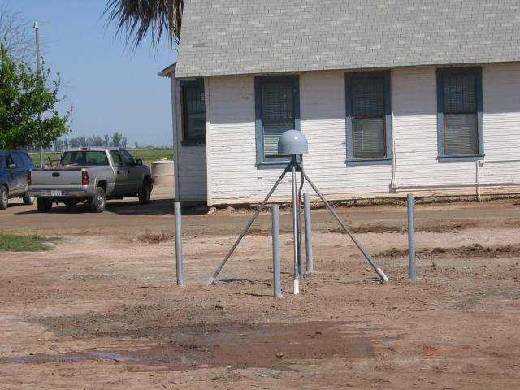
Example P501
Example of ground reflection and building
+10 mm
Color are different days; and symbols with error bars are mean.
RMS 2.7 mm (5 times worse then P099).
Ground
reflection
Building
reflection?
-10 mm
10º
80º
Elevation angle

Slide 11
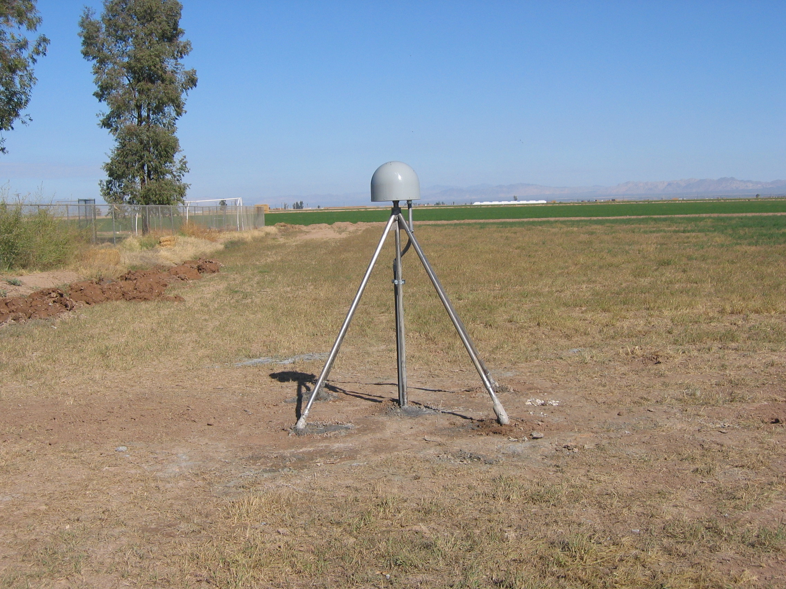
P502
Strong Ground reflection
+10 mm
Large ground reflection.
RMS 2.5 mm
Monitor to see how it changes as ground conditions change
-10 mm
10º
80º
Elevation angle

Slide 12
AB33
+10 mm
Time variable signals. Alaskan site.
Reason for time dependence not clear (maybe vehicle)
Colors span a 30-day interval. Site height changes when residuals change
-10 mm
10º
Elevation angle
80º

Slide 13
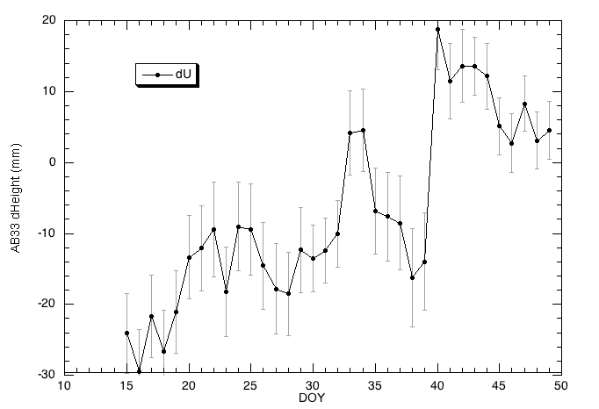
Time series and changes
Height changes correspond to residual changes
Elevation angle averaged residuals and heights have large change at day 40. AB33 in Alaska.
20 mm change

Slide 14
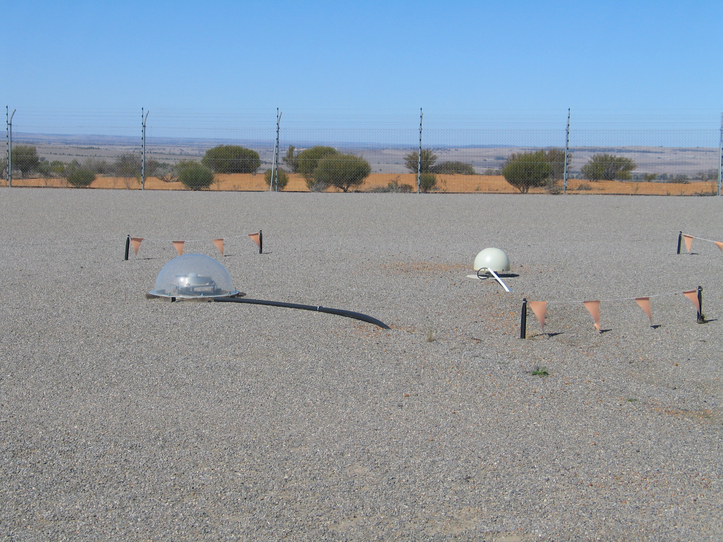
Yarragadee, Australia
YAR2: clear radome removed to test effect on position
YARR has some tracking issues during this test
YAR3: Pillar mounted site
Phase residuals global processing, radome in place
+10 mm
YAR2 YARR
YAR3 (~1.5 m pillar not shown)
-10 mm

Slide 15
Time series
Estimates
NORTH
+0.41 -0.45
± 0.07 mm
EAST
1.68 -1.74
± 0.07 mm
Up
-2.10 + 1.64
± 0.48 mm
RMS
NE 0.25 mm;
Up 1.7 mm

Slide 16
Elevation dependent phase residuals
+5 mm
+5 mm
-5 mm
-5 mm
+5 mm
Residuals from YAR2, YARR and YAR3 analysis.
High frequency from YAR3 site
RMS:
Radome 1.1 mm
No-radome 1.3 mm
With (top before, and after) and without radome
(differences right:
Loss of YARR)
-5 mm

Slide 17
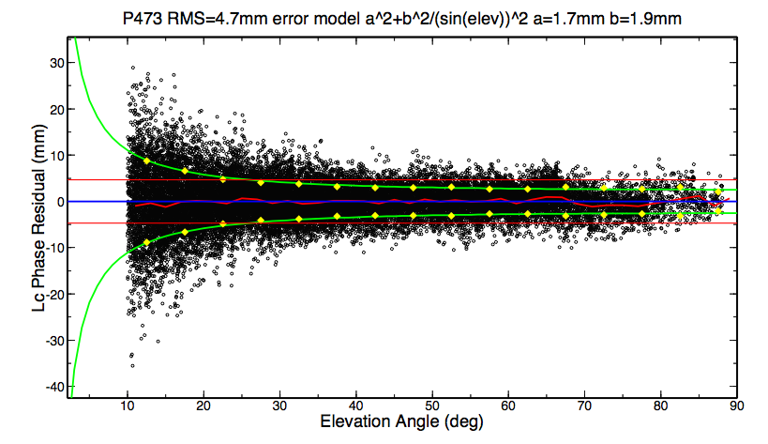
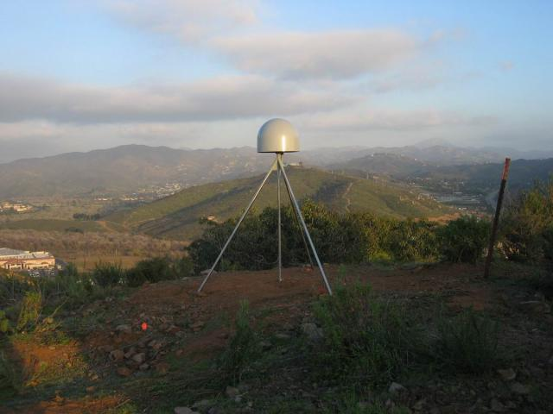
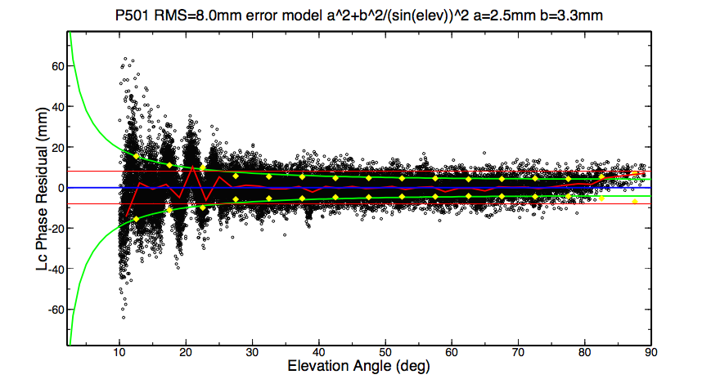
More examples
Flat, smooth ground (see web site as well)

Slide 18
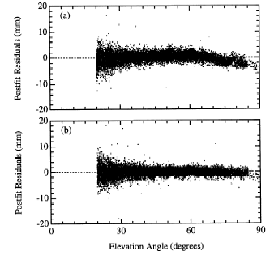
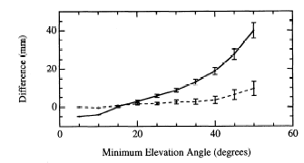
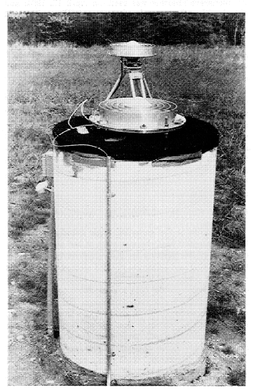
Left: Phase residuals versus elevation for Westford pillar, without (top) and with (bottom) microwave absorber.
Right: Change in height estimate as a function of minimum elevation angle of observations; solid line is with the unmodified pillar, dashed with microwave absorber added
[From Elosequi et al.,1995]
Notes:
The GPS research group at Harvard noticed that the height they estimated for the pillar at the Haystack Observatory (near Boston) was sensitive to the cutoff angle they used in their processing (upper right). The phase vs elevation plot (upper left) show swhy: notice the bend in the curve, indicative of a poor model for the antenna phase center variations. They related the pattern not the antenna itself but to the metal plate imbedded in the top of the concrete pillar. When they put microwave absorbing material beneath the antenna, the pattern flattened and the sensitivity to cutoff angle went away.

Slide 19
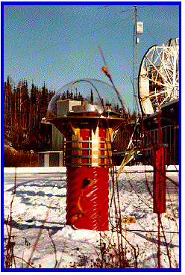
Fairbanks, Alaska
Large residuals at GPS site.
Radome removed but no large effect
+10 mm
-10 mm

Slide 20
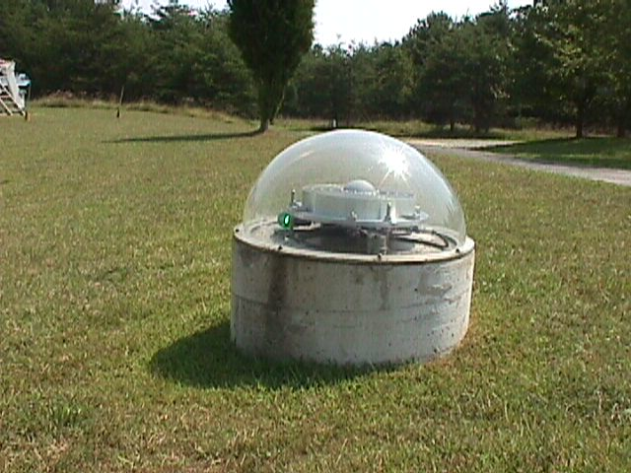
GGAO (GODE)
Again removal of radome had little effect on systematic residual pattern
+10 mm
-10 mm

Slide 21
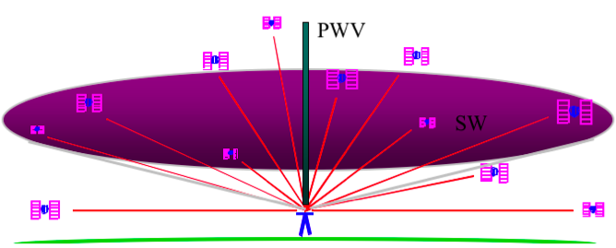
Atmospheric Delay
The signal from each GPS satellite is delayed by an amount dependent on the pressure and humidity and its elevation above the horizon. We invert the measurements to estimate the average delay at the zenith (green bar).
( Figure courtesy of COSMIC Program )

Slide 22
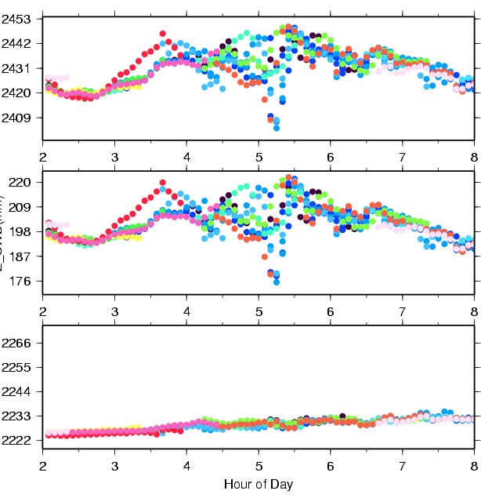
Zenith Delay from Wet and Dry Components of the Atmosphere
Colors are for different satellites
Total delay is ~2.5 meters
Variability mostly caused by wet component.
Wet delay is ~0.2 meters
Obtained by subtracting the hydrostatic (dry) delay.
Hydrostatic delay is ~2.2 meters; little variability between satellites or over time; well calibrated by surface pressure.
Plot courtesy of J. Braun, UCAR
Notes:
The three figures on the left show time series of ZHD (bottom), ZWD (middle), and ZTD (top) simulated from a MM5 3-km model simulation of a squall line. The

Slide 23
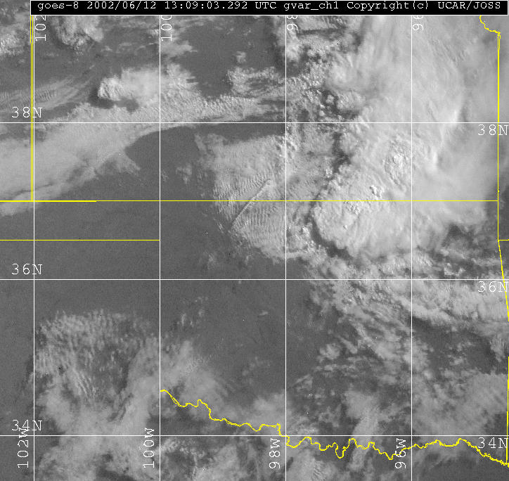
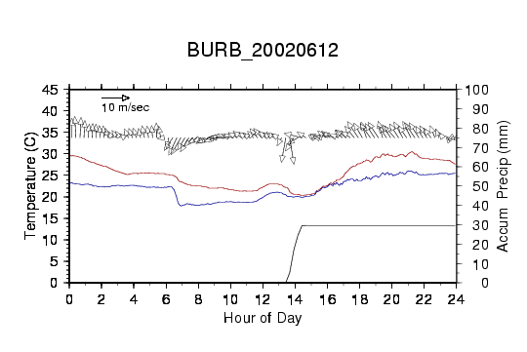
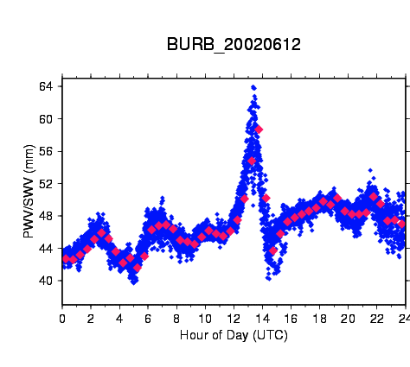
Example of GPS Water Vapor Time Series
GOES IR satellite image of central US on left with location of GPS station shown as red star.
Time series of temperature, dew point, wind speed, and accumulated rain shown in top right. GPS PW is shown in bottom right. Increase in PW of more than 20mm due to convective system shown in satellite image.
Notes:
GOES 8 image at 1309 UTC and GPS PW/SW for station BURB

Slide 24
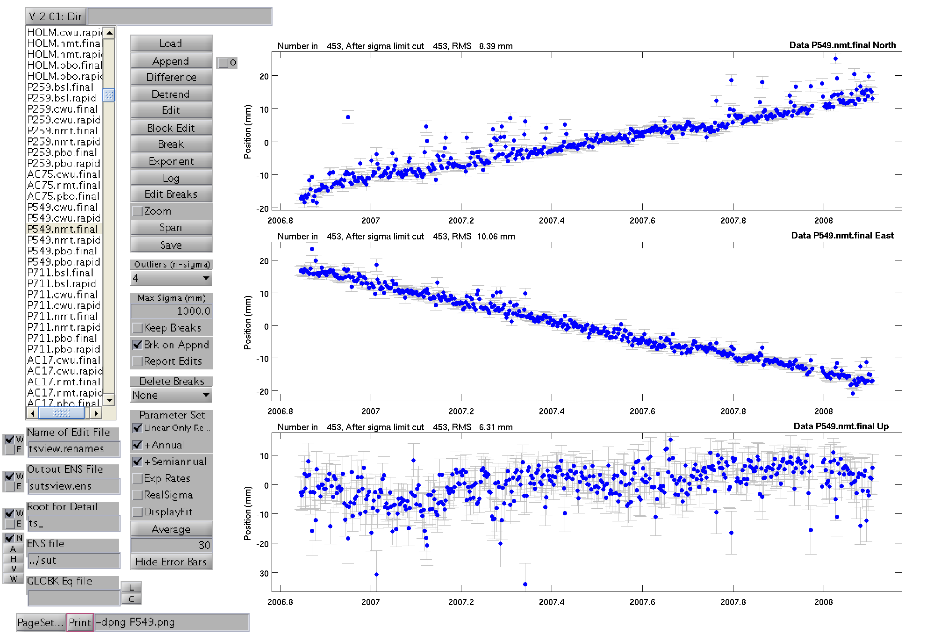
P549 Position residuals
Notes:
Example of systematic direction for residuals that may be related to local topography and weather conditions.

Slide 25
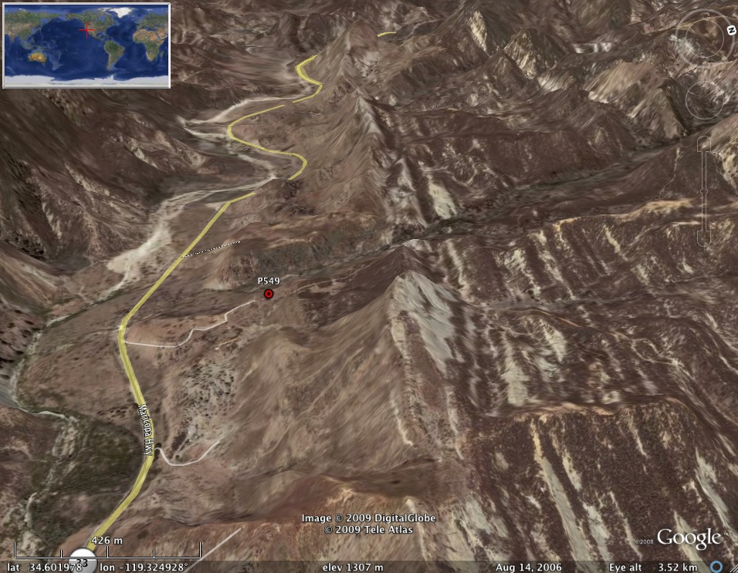
Location of P549 (Google Earth)

Slide 26
Effect of the Neutral Atmosphere on GPS Measurements
Slant delay = (Zenith Hydrostatic Delay) * (“Dry” Mapping Function) +
(Zenith Wet Delay) * (Wet Mapping Function) +
(Gradient Delay NS) ( Gradient Mapping Function) * Cos/Sin(Azimuth)
  To recover the water vapor (ZWD) for meteorological studies, you must have a very accurate measure of the hydrostatic delay (ZHD) from a barometer at the site.
  For height studies, a less accurate model for the ZHD is acceptable, but still important because the wet and dry mapping functions are different (see next slides)
  The mapping functions used can also be important for low elevation angles
  For both a priori ZHD and mapping functions, you have a choice in GAMIT of using values computed at 6-hr intervals from numerical weather models (VMF1 grids) or an analytical fit to 20-years of VMF1 values, GPT and GMF (defaults)

Slide 27
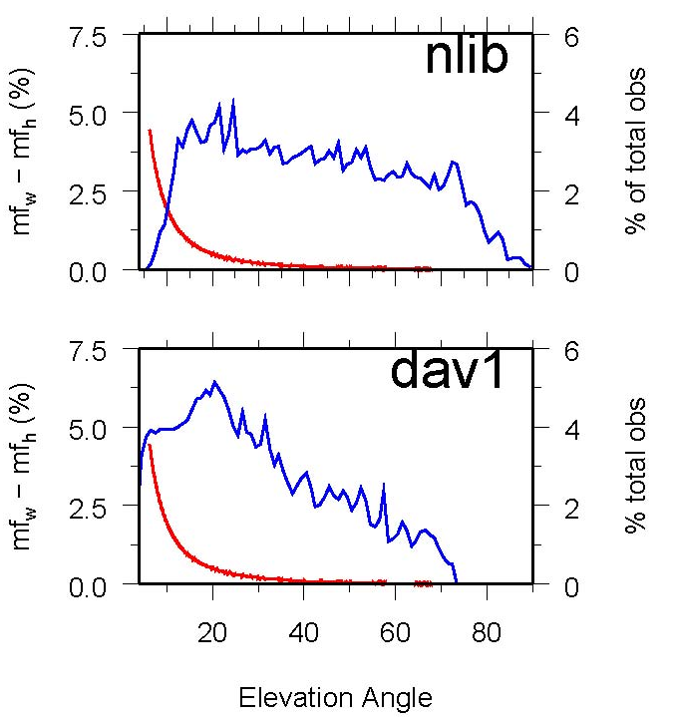
Mapping function effects
Mapping functions differ and this means hydrostatic and wet delays are coupled in the estimation.
Example: Percent difference (red) between hydrostatic and wet mapping functions for a high latitude (dav1) and mid-latitude site (nlib). Blue shows percentage of observations at each elevation angle. From Tregoning and Herring [2006].
Notes:
Problem is that the distribution of satellites on sky for different latitudes creates a bias in height estimates.

Slide 28
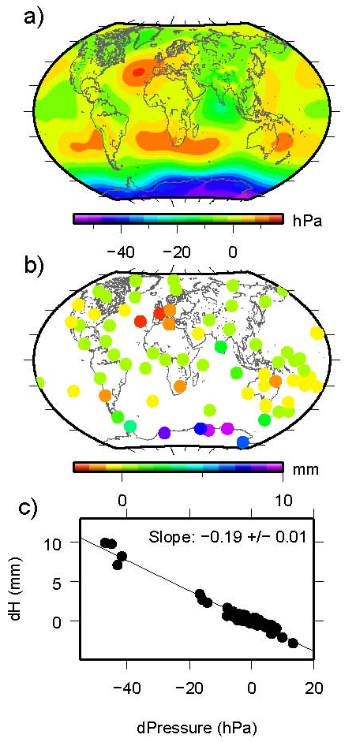
Effect of surface pressure errors
a) surface pressure derived from “standard” sea level pressure and the mean surface pressure derived from the GPT model.
b) station heights using the two sources of a priori pressure.
c) Relation between a priori pressure differences and height differences. Elevation-dependent weighting was used in the GPS analysis with a minimum elevation angle of 7 deg.

Slide 29
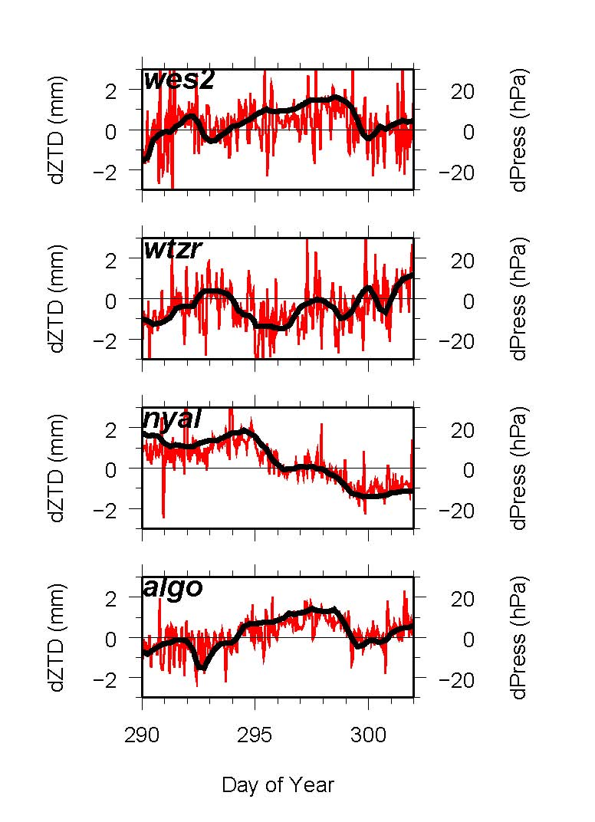
Short-period Variations in Surface Pressure not Modeled by GPT
Differences in GPS estimates of ZTD at Algonquin, Ny Alessund, Wettzell and Westford computed using static or observed surface pressure to derive the a priori. Height differences will be about twice as large. (Elevation-dependent weighting used).
Notes:
10-day span of ZD estimates from GAMIT at 4 stations, showing…
DIFFERENCES in ZTD (red) vs differences (ERROR) in pressure (black)
NOTE high correlation.

Slide 30
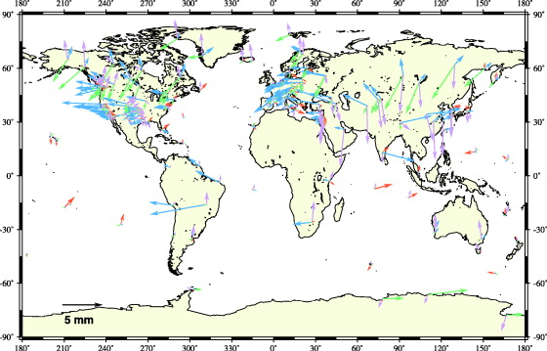
Annual Component of Vertical Loading
Atmosphere (purple)
2-5 mm
Water/snow (blue/green)
2-10 mm
Nontidal ocean (red)
2-3 mm
From Dong et al. J. Geophys. Res., 107, 2075, 2002
Notes:
The only loading effect we currently account for in our processing are those from ocean tides. For these the current models are quite good for most parts of the world, but probably inadequate for high latitudes (above the TOPEX altimeter coverage) and around some complicated shorelines. (High local tides do not mean large errors, however, because it’s the total mass of the water that matters.)
This map is taken from a paper by Danan Dong (former MIT student) and his colleagues at JPL, Scripps, and GSI in Japan. They estimated annual and semi-annual terms in vertical GPS station position and attempted to match these with predicted motions derived from a variety of sources. They could not obtain sufficient correlation overall to validate the models, but they’ve given us rough estimates of the amplitudes and geographical distribution of the induced displacements.
Tom Herring, with Tonie VanDam first detected atmospheric loading effects in VLBI data 10 years ago but neither the global pressure fields nor the data coverage were sufficient to develop and test good models. There’s now an operational program to use the NCEP and European Center analyses to compute loading corrections on a global grid and we’re planning to test these in our GPS analyses over the next few months.

Slide 31
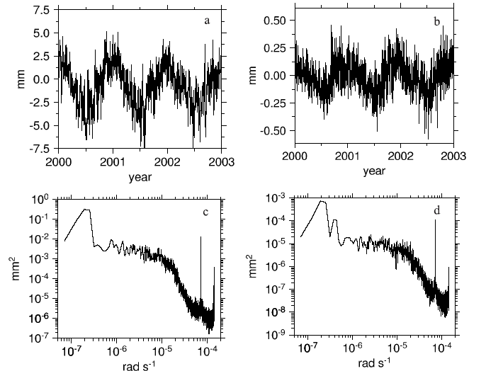
Atmospheric pressure loading near equator
Spectral peaks at diurnal and semi-diurnal frequencies are S1/S2 “tidal” loading. (Thermal “tide” effect).
Vertical (a) and north (b) displacements from pressure loading at a site in South Africa. Bottom is power spectrum. Dominant signal is annual. From Petrov and Boy (2004)
Notes:
The next three slides are from a study by Leonid Petrov and Jean-Paul Boy at Goddard to repeat the Herring and VanDam study with current pressure fields and VLBI data. This slide shows a 3-year time series and spectra for vertical and horizontal loading at low latitudes The horizontal signal is quite small, the vertical is quite detectable with GPS or VLBI measurements. The dominant signals are diurnal and semi-diurnal (narrow spikes to right), and wide-band annual and semiannual. There is relatively little power at periods below 10 days.

Slide 32
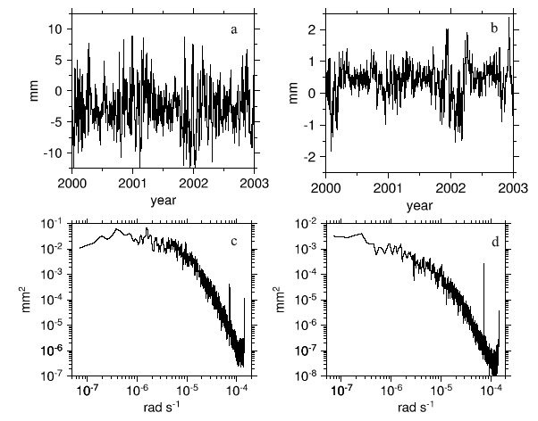
Atmospheric pressure loading at mid-latitudes
Vertical (a) and north (b) displacements from pressure loading at a site in Germany. Bottom is power spectrum. Dominant signal is short-period.
Notes:
At mid-latitudes, the circulation of low and high pressure systems with periods of 5-10 days is typical, and the annual and semiannual signal is relatively weak. (The inverted barometer assumption for the oceanic response may not be valid at these short periods.) Effect larger and the horizontal signal can be significant.

Slide 33
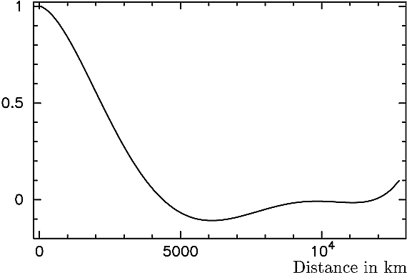
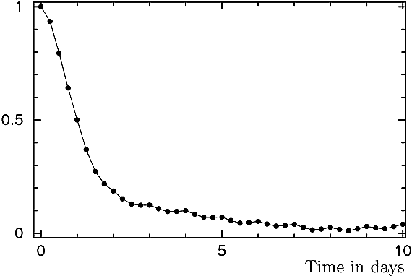
Atmospheric delay correlation
Spatial and temporal autocorrelation of atmospheric pressure loading (functions for mid-latitude site Algonquin, Canada).
From Petrov and Boy, J. Geophys. Res., 109, B03405, 2004
Notes:
The autocorrelation functions tell us a lot about what we should see in the data and how to design our measurements. We expect to get a lot of cancellation when we’re measuring regional networks of less than 1000 km. And we will expect to average out a lot of the temporal variation (at mid-latitudes) if we separate measurements of a given station by more than two days.
LAST SLIDE

Slide 34
GAMIT Options for Modeling the Troposphere and Loading
For height studies, the most accurate models for a priori ZHD and mapping functions are the VMF1 grids computed from numerical weather models at 6-hr intervals.
For most applications it is sufficient to use the analytical models for a priori ZHD (GPT) and mapping functions (GMF) fit to 20 years of VMF1.
For meteorological studies, you need to use surface pressure measured at the site to compute the wet delay, but this can be applied after the data processing (sh_met_util), and it is sufficient to use GPT in the GAMIT processing
For height studies, atmospheric loading from numerical weather models (ATML grids) should also be applied. (ZHD and ATML are correlated, so don’t use one set of grids without the other)

Slide 35
Summary
For individual locations in regional network, atmospheric delay modeling, multipath and the stability of monumentation are usually the largest error contributors
For survey mode measurements, set-up errors can also be large
The other largest uncertainty and the way results are viewed can arise from the reference frame realization.

