Slide 1
EPOS GAMIT/GLOBK/Track Workshop
Introduction
Thomas Herring, MIT
tah@mit.edu

Slide 2
Workshop Overview
Web site
http://geoweb.mit.edu/~simon/gtgk/Thessalonki12/
Lectures and Tutorials: Day 1:
  Advanced modeling and diagnostic in GAMIT daily processing GAMIT Lecture: Overview of standard processing in GAMIT; daily session processing
  Advanced processing methods in GLOBK
  Tutorial session: Salton Sea data analysis around time of Magnitude 5.8 aftershock to El Major Cucapah April 4, 2010 Mw 7.2 earthquake. Demonstrates short session and globk combined processing.

Slide 3
Workshop Overview
Lectures and Tutorials Day 2
  Basics of kinematic processing with module track
  Advanced tuning and diagnostics in track (some discussion of trackRT (real-time version) if interest)
  Tutorial: Kinematic data processing data set collected at MIT (display in Google Earth). Individual data sets can be processed here as well.
  Tutorial: Processing of El Mayo Cucapah earthquake April 2010 5-Hz data. Students may bring their own data for processing in this session if desired.

Slide 4
Workshop Overview
Asking questions during the workshop is critical for getting the most from this course.
Each participant can either ask or submit questions/issues in email to tah@mit.edu and these will be addressed during the tutorial session.
Questions so far?
General question: Interest in real-time data processing?

Slide 5
GPS overview
For GPS processing, the critical information needed is range and phase data from a receiver collecting data from multiple GPS satellites and information about the orbits of the satellites (earth-fixed frame) and some information about clocks in satellites.
In GAMIT, only crude clock information needed due to double-differencing.
To integrate GPS orbits, information needed about rotation between earth-fixed and inertial space.
For the most accurate GPS results, other ancillary information needed (e.g., atmospheric models, ocean tides, antenna and receiver biases).
Program track (kinematic processing) can use just RINEX data files and SP3 GPS orbit files but GAMIT needs a full suite of additional files (track also can use some of these file). The main GAMIT processing script sh_gamit handles getting all these files.

Slide 6
GPS overview
GAMIT processes GPS phase and range data files (RINEX format) usually for 24-hour sessions of data. For newer data collection (post 1996), orbits do not need to be estimated because IGS has very good combined orbits available.
GLOBK combines together results from daily GPS processing and is used to generate velocity estimates and time-series products.
In this workshop, basic familiarity with GAMIT/GLOBK processing is assumed and more advanced/subtle aspects of data processing will be addressed.

Slide 7
Observables in Data Processing
Fundamental observations
L1 phase = f1 x range (19 cm) L2 phase = f2 x range (24 cm)
C1 or P1 pseudorange used separately to get receiver clock offset (time). There are “Differential Code Biases” (DCB) between C1 and P1 and so the track method is important when receiver types are mixed>
To estimate parameters use doubly differenced
LC = 2.55 L1 - 1.98 L2 “Ionosphere-free phase combination” L1-cycles
PC = 2.55 P1 - 1.55 P2 “Ionosphere-free range combination” Meters
Double differencing (DD) removes clock fluctuations; LC removes almost all of ionosphere. Both DD and LC amplify noise (use L1, L2 directly for baselines < 1 km)
Notes:
MW-WL needs Data-Code bias (DCB) corrections that are receiver type and satellite dependent.

Slide 8
Observables
Auxiliary combinations for data editing and ambiguity resolution
“Geometry-free combination (LG)” or “Extra wide-lane” (EX-WL)
LG = L2 - f2/f1 L1 used in GAMIT (displayed in cview)
EX-WL = L1 - f1/f2 L2 used in TRACK
Removes all frequency-independent effects (geometric & atmosphere) but not multipath or ionosphere
Melbourne-Wubbena wide-Lane (MW-WL): phase/pseudorange combination that removes geometry and ionosphere; dominated by pseudorange noise
MW-WL = N1-N2=(L1-L2)-(ΔF/ΣF)(P1+P2) = (L1-L2)-0.12 (P1+P2)

Slide 9
Modeling the observations
I. Conceptual/Quantitative
Motion of the satellites
  Earth’s gravity field ( flattening 10 km; higher harmonics 100 m )
  Attraction of Moon and Sun ( 100 m )
  Solar radiation pressure ( 20 m )
Motion of the Earth
  Irregular rotation of the Earth ( 5 m )
  Luni-solar solid-Earth tides ( 30 cm )
  Loading due to the oceans, atmosphere, and surface water and ice ( 10 mm)
Propagation of the signal
  Neutral atmosphere ( dry 6 m; wet 1 m )
  Ionosphere ( 10 m but LC corrects to a few mm most of the time )
  Variations in the phase centers of the ground and satellite antennas ( 10 cm)
  * incompletely modeled

Slide 10
Modeling the observations
II. Software structure
Satellite orbit
  IGS tabulated ephemeris (Earth-fixed SP3 file) [ track ]
  GAMIT tabulated ephemeris ( t-file ): numerical integration by arc in inertial space, fit to SP3 file, may be represented by its initial conditions (ICs) and radiation-pressure parameters; requires tabulated positions of Sun and Moon
Motion of the Earth in inertial space [model or track ]
  Analytical models for precession and nutation (tabulated); IERS observed values for pole position (wobble), and axial rotation (UT1)
  Analytical model of solid-Earth tides; global grids of ocean and atmospheric tidal loading
Propagation of the signal [model or track ]
  Zenith hydrostatic (dry) delay (ZHD) from pressure ( met-file, VMF1, or GPT )
  Zenith wet delay (ZWD) [crudely modeled and estimated in solve or track ]
  ZHD and ZWD mapped to line-of-sight with mapping functions (VMF1 grid or GMT)
  Variations in the phase centers of the ground and satellite antennas (ANTEX file)

Slide 11
Parameter Estimation
Phase observations [ solve or track ]
  Form double difference LC combination of L1 and L2 to cancel clocks & ionosphere
  Apply a priori constraints
  Estimate the coordinates, ZTD, and real-valued ambiguities
  Form M-W WL and/or phase WL with ionospheric constraints to estimate and resolve the WL (L2-L1) integer ambiguities [ autcln, solve, track ]
  Estimate and resolve the narrow-lane (NL) ambiguities
  Estimate the coordinates and ZTD with WL and NL ambiguities fixed
  --- Estimation can be batch least squares [ solve ] or sequential (Kalman filter [ track ]
Quasi-observations from phase solution (h-file) [ globk ]
  Sequential (Kalman filter)
  Epoch-by-epoch test of compatibility (chi2 increment) but batch output

Slide 12
Limits of GPS Accuracy
Signal propagation effects
  Signal scattering ( antenna phase center / multipath )
  Atmospheric delay (mainly water vapor)
  Ionospheric effects
  Receiver noise
Unmodeled motions of the station
  Monument instability
  Loading of the crust by atmosphere, oceans, and surface water
Unmodeled motions of the satellites
Reference frame
Notes:
The four catagories I’ve listed here is a useful way to think about errors in GPS measurements. For studying global phenomena they are all potentially important, but I’m going to concentrate today on measurements on continental scale. For these intersite distances, we now know the orbits of the satellites well enough that their contribution is usually small. So we’ll look at effects in signal propagation and uninteresting motions of the receiving antenna. In signal propagation, first order ionospheric effects are removed in all high precision work by combining signals at the two GPS frequencies. And for modern observations, receiver noise is nearly negligible. So we’re left with scattering effects and the atmosphere.

Slide 13
Limits of GPS Accuracy
Signal propagation effects
  Signal scattering ( antenna phase center / multipath )
  Atmospheric delay (mainly water vapor)
  Ionospheric effects
  Receiver noise
Unmodeled motions of the station
  Monument instability
  Loading of the crust by atmosphere, oceans, and surface water
Unmodeled motions of the satellites
Reference frame
Notes:
The four catagories I’ve listed here is a useful way to think about errors in GPS measurements. For studying global phenomena they are all potentially important, but I’m going to concentrate today on measurements on continental scale. For these intersite distances, we now know the orbits of the satellites well enough that their contribution is usually small. So we’ll look at effects in signal propagation and uninteresting motions of the receiving antenna. In signal propagation, first order ionospheric effects are removed in all high precision work by combining signals at the two GPS frequencies. And for modern observations, receiver noise is nearly negligible. So we’re left with scattering effects and the atmosphere.

Slide 14
Multipath is interference between the direct and a far-field reflected signal (geometric optics apply)
To mitigate the effects:
Avoid Reflective Surfaces
Use a Ground Plane Antenna
Use Multipath Rejection Receiver
Observe for many hours
Remove with average from many days
Reflected Signal
Direct Signal
Reflected Signal

Slide 15
Station Characterization
New output in autcln that summaries the elevation angle dependence of phase residuals. One line per site, average elevation angle in 1-degree bins (99.9 used if no data).
Automatically written into autcln.post.sum and can be illustrative of problems.
Shell script: sh_plot_elmean used
Examples:

Slide 16
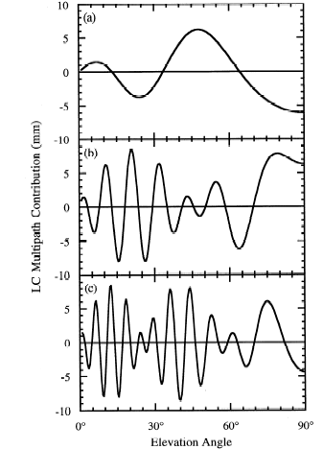
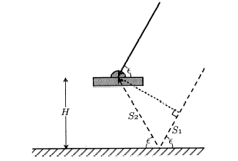
Antenna Ht
0.15 m
0.6 m
Simple geometry for incidence of a direct and reflected signal
1 m
Multipath contributions to observed phase for three different antenna heights [From Elosegui et al, 1995]
Notes:
RIGHT SIDE is predicted variations for three heights.
The most common and dominant source of high-frequency multipath is reflection from the horizontal surface beneath the antenna. If this surface is far enough away from the antenna (1-2 m) to be outside the fresnel zone (no interaction with the antenna itself), then geometric optics allows us to model the signal well enough to predict the frequency. For an antenna mounted 1-2 m above the surface, the variations will be of the order of minutes, and tend to have low, though still significant correlatations with the signature of the station’s coordinates and the atmospheric delay. Once you get within a half-meter, though, the longer period variations are a real problem. And this is even without taking into account the interaction with the antenna structure.

Slide 17
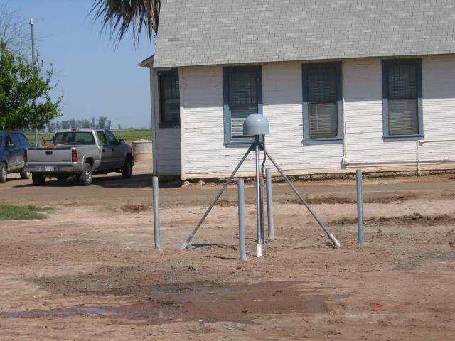
Example P501
Example of ground reflection and building
Color are different days; and symbols with error bars are mean.
Building
reflection?
Ground
reflection

Slide 18
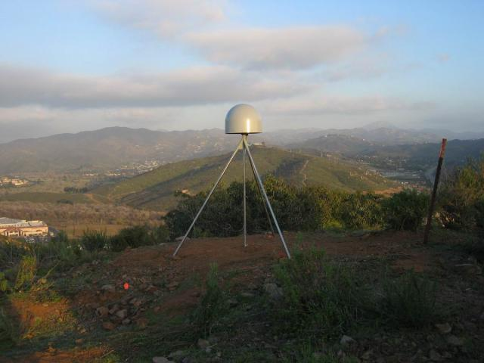
P473
Example with little ground reflection

Slide 19
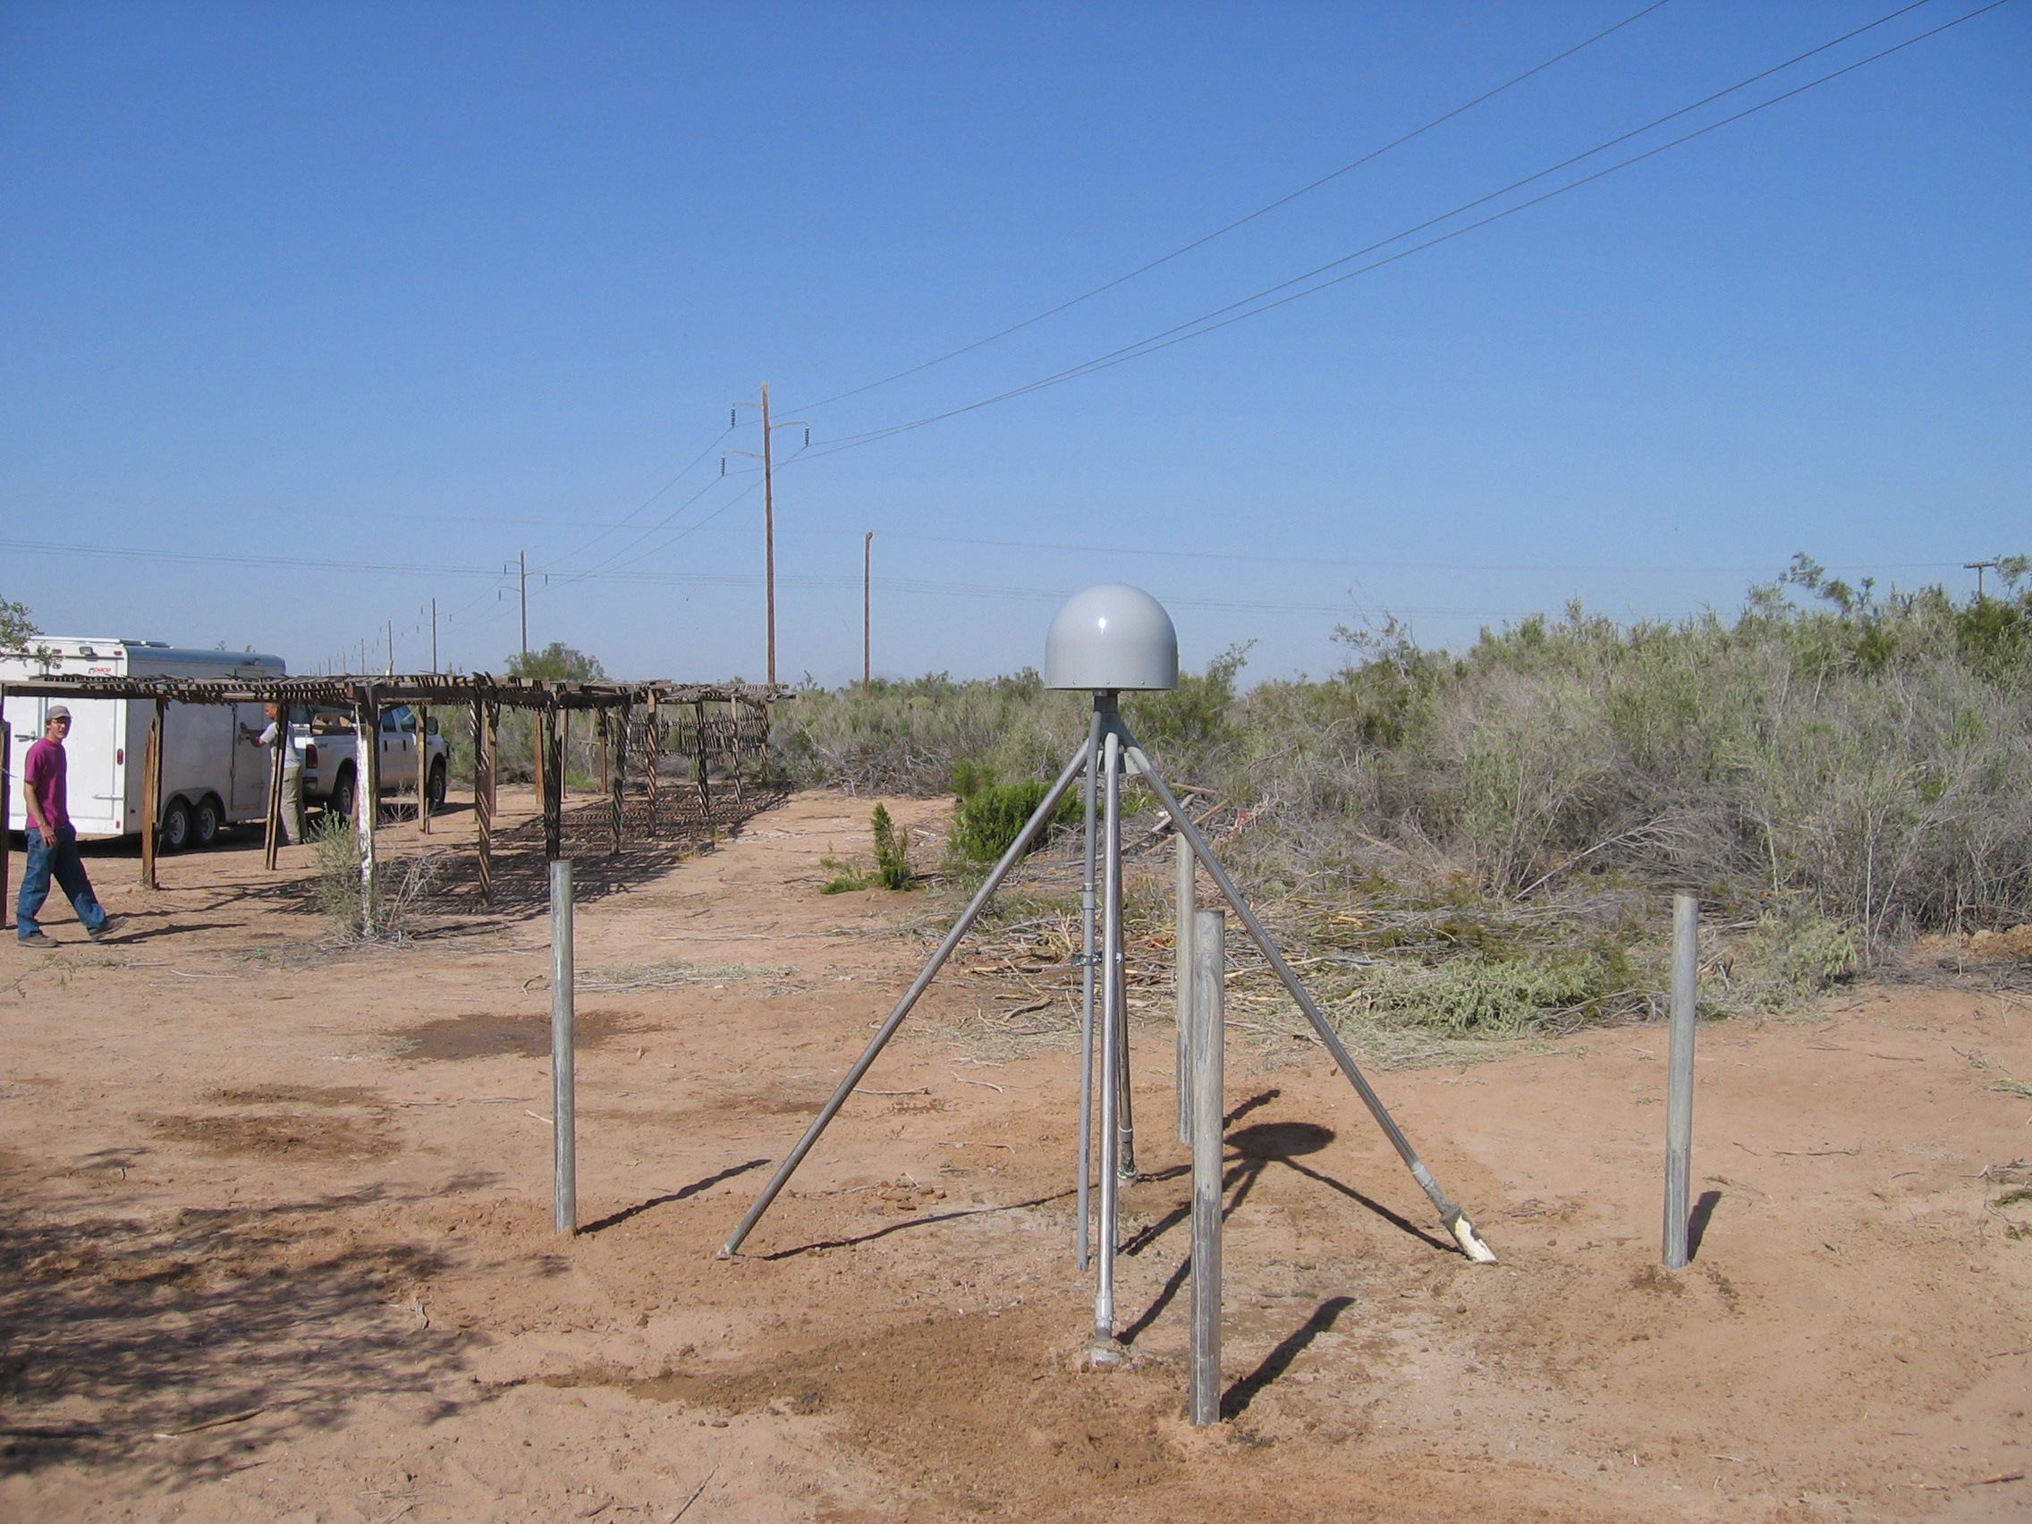
P500
Large ground reflection; flat surface

Slide 20
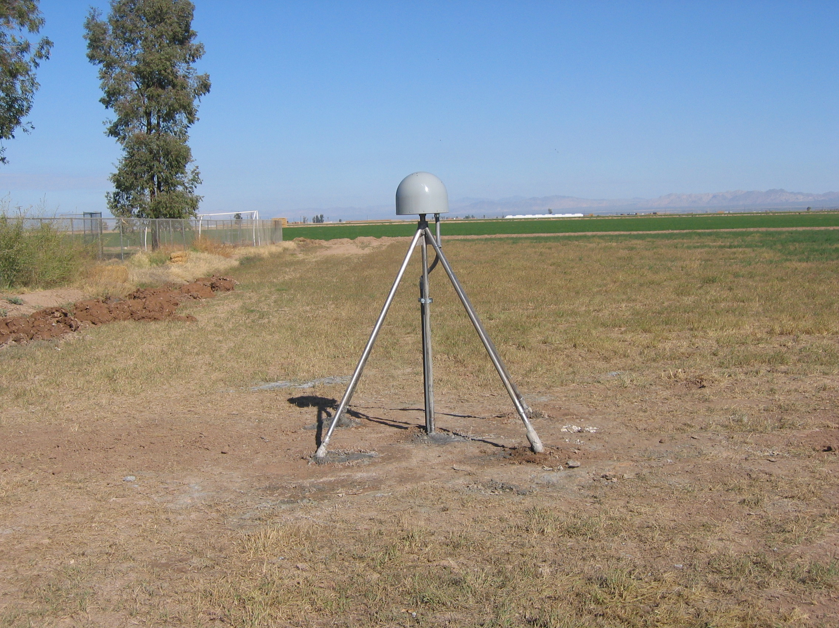
P502
Strong Ground reflection
Site will be monitored to see how it changes as ground conditions change

Slide 21
AB33
Time variable signals. Alaskan site with snow accumulation and melting (believed)
Colors span a 30-day interval. Site height changes when residuals change

Slide 22
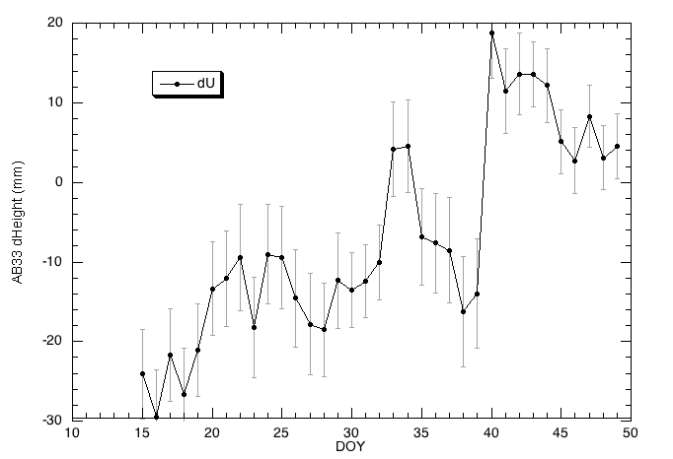
Time series and changes
Height changes correspond to residual changes
Residuals and heights have large change at day 40.

Slide 23
Limits of GPS Accuracy
Signal propagation effects
  Signal scattering ( antenna phase center / multipath )
  Atmospheric delay (mainly water vapor)
  Ionospheric effects
  Receiver noise
Unmodeled motions of the station
  Monument instability
  Loading of the crust by atmosphere, oceans, and surface water
Unmodeled motions of the satellites
Reference frame
Notes:
The four catagories I’ve listed here is a useful way to think about errors in GPS measurements. For studying global phenomena they are all potentially important, but I’m going to concentrate today on measurements on continental scale. For these intersite distances, we now know the orbits of the satellites well enough that their contribution is usually small. So we’ll look at effects in signal propagation and uninteresting motions of the receiving antenna. In signal propagation, first order ionospheric effects are removed in all high precision work by combining signals at the two GPS frequencies. And for modern observations, receiver noise is nearly negligible. So we’re left with scattering effects and the atmosphere.

Slide 24
Loading use in GAMIT
Atmospheric loading: This is still an area of active research and the optimum approach in terms of SNR of the loading calculations is not clear yet.
There are three basic issues:
  Short period tidally driven atmospheric loading signal. These are at the S1 and S2 tidal frequencies
  Short period (sub-daily) non-tidal signals. Here the debate is on signal-to-noise ratio. If these are important, then need to be applied at the observational level.
  Reference frame: Center of mass versus center of figure for corrections

Slide 25
Loading in GAMIT
In sestbl. set
  Use atl.grid = Y ! This turns of the tidal loading
  Use atml.grid = Y ! Turns on 6-hrs gridded loading
When these options are set; sh_gamit will link the day directory files to the ../tables directory for:
  atl.grid This file normally links back to main tables directory because it is time independent
  atml.grid in day directory is linked to atml.grid in local tables. In sh_links.tables (called from sh_setup) the atml.grid in tables is linked to ~/gg/tables/atml.grid.yyyy (if files already exist in local tables they are not updated).

Slide 26
Loading setup
The loading files are available from ftp to everest.mit.edu in the GRIDS directory (they are large). The file names reflect the type of file:
  184674852 Jan 19 2011 atmdisp_ce.2010
  184674852 Jan 19 2011 atmdisp_cf.2010
  184674852 Jan 19 2011 atmdisp_cm.2010
  184800996 Feb 23 2011 atmfilt_ce.2010
  184800996 Feb 23 2011 atmfilt_cf.2010
  184800996 Feb 23 2011 atmfilt_cm.2010
  231626292 Feb 22 2011 vmf1grd.2010
This year (as of 03/30/2012
  34941924 Mar 13 13:46 atmdisp_ce.2012_069
  34941924 Mar 13 13:46 atmdisp_cf.2012_069
  34941924 Mar 13 13:46 atmdisp_cm.2012_069
  28887012 Mar 13 13:57 atmfilt_ce.2012_057
  28887012 Mar 13 13:57 atmfilt_cf.2012_057
  28887012 Mar 13 14:02 atmfilt_cm.2012_057
  231626292 Mar 30 10:00 vmf1grd.2012_084
Each of the yearly grid files is 185Mbytes so they are not small (also shown are the VMF1 grids if this option is used in processing.

Slide 27
Which load files to use?
The CE, CF and CM are for different origins of the terrestrial reference frame. For orbit determination, the CM frame should be used and this would also be the case for using IGS orbits
The filt (filtered) files should be used with the tide model but the debate is if the filtered series looses too much at sub-daily frequencies. The disp raw files should not be used with the tide model and the debate here is: is the 6hr spacing too coarse to capture the tides (and is the noise level too high).
Future releases of globk will be able to add and remove daily averaged load signal (release summer 2012)
Program atmtoasc can be used to generate values at specific locations. Experiment and see what happens.

Slide 28
Files you need to worry about
RINEX files – local plus list in sites.defaults
Control files
process.defaults – minor edits for each survey
sites.defaults – sites to include/omit; source of metadata
sestbl. – unchanged for most processing
sittbl. – sites constrained for ambiguity resolution
globk_comb.cmd – use_site, apr_neu, apr_svs, apr_wob, apr_ut1, sig_neu, mar_neu
glorg_comb.cmd – apr_file, pos_org, stab_site
A priori coordinates ( apr-file, l-file )
Meta-data (station.info)
Differential code biases (dcb.dat) – download current values 1/month
Satellite characteristics (svnav.dat) – download current w/ each new launch
Notes:
Templates for these files are in the study notes. pp 5-11, and the individual entries are discussed in Chapter 2 of the Introduction to GAMIT/GLOBK and Chapter 3 of the GAMIT Reference Manual.

Slide 29
Files provided or created automatically
Satellite orbits
IGS sp3-files (tabular) and/or g-files (ICs for GAMIT)
ARC integrates to get t-files (tabular)
Earth Orientation Parameters ( ut1., wob.) - downloaded if needed for current day
Leap-second file -- linked to gg/tables (update ~yearly or when leap second)
Satellite clock (j-) files – from RINEX navigation (brdc) file
Rcvr/ant characteristics (rcvant.dat, hi.dat) – linked to gg/tables
Differential code biases (dcb.dat)—update ~monthly
Antenna phase center models (antmod.dat) – linked to gg/tables (also needs to be updated when new antennas added).
Luni-solar ephemerides and nutation (soltab., luntab., nutabl.) linked to gg/tables (need to update yearly)
Ocean tide grid (optional) – linked to gg/tables
Atmospheric loading grid (optional) – need to update yearly unless running near-real-time.
Mapping function grid (optional) – need to update yearly unless running near-real-time.
Notes:
ftp chandler.mit.edu and get files from source/incremental_updates/tables directory.

Slide 30
Summary
High precision GPS (mm and better positioning) requires external information in additional to just the data and orbit information.
Here we focused in new residual output and how to include loading in gamit solutions.
Review of files that need to be kept up to date.
The next lecture examines GLOBK. The tutorial session this afternoon will look at earthquake effected data set.

