Slide 1
Kinematic processing with track
Tutorial 03 and 04
Thomas Herring
tah@mit.edu

Slide 2
Tutorial
There are 2 tutorial folders for this exercise.
  BajaEQ
    This set of data contains 5 Hz GPS data at the time of the El Major Cucapah earthquake in April 2010.
    We demonstrate long baseline processing with these data and methods of using time-dependent process noise to improve ambiguity resolution on long baselines.
    Start with the track_shrt.cmd file in std folder.
  kineMIT
    This data set is a kinematic experiment carried out at MIT and when displayed in Google Earth it becomes clear what was being measured.
    We can process this data has a short baseline and has a long baseline using Algonquin Park in Canada has the reference station.

Slide 3
Some results
Examine the short/long baseline MIT results: Look at this example in more detail later
April 4, 2010 El-Mayor Cucapah earthquake in Baja California: 5-Hz results. Look later at long baseline processing for these sites.

Slide 4
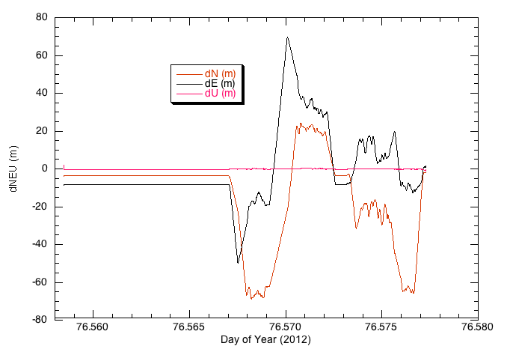
MIT long baseline Example
Analysis with LC data type: Base 685 km away

Slide 5
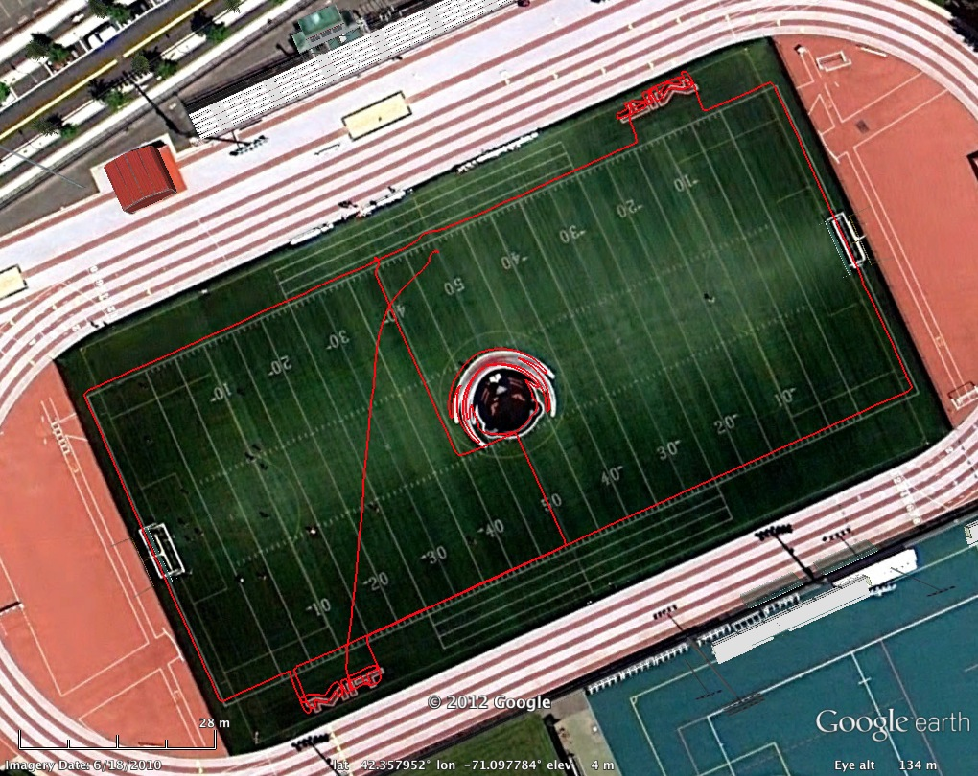
MIT track run

Slide 6
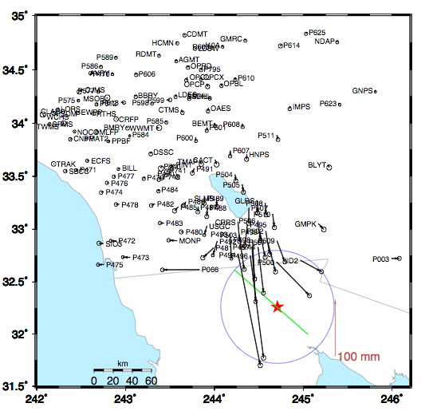
Coseismic offsets
Offsets based on 2-days before and after earthquake.
Two days used is reduce leakage of postseismic motions.
Red Star is epicenter; blue circle is 60 km (15-20 seconds surface wave speed)

Slide 7
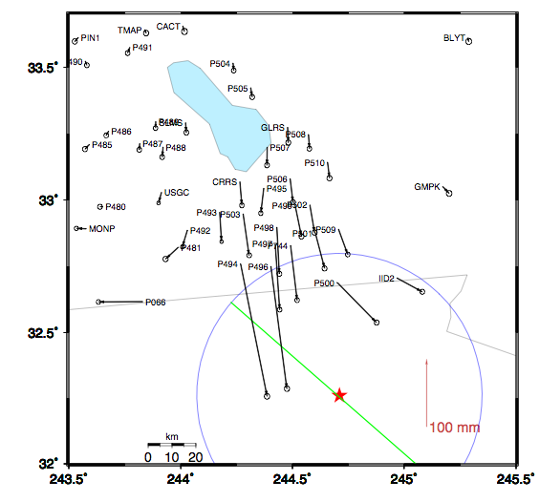
Zoom around border
Sites near the epicenter.
Blue circle is 60 km radius
Displacements
P494 200 mm
P496 182 mm
P497 97 mm
…
P491 9 mm

Slide 8
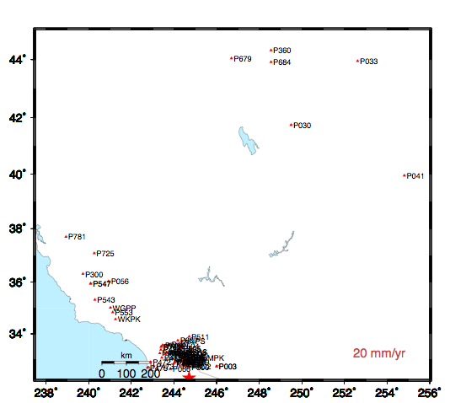
High-rate GPS site download
1Hz reference site
High rate data from these sites downloaded after event.
Most sites are 5-Hz; more distant sites are 1-Hz.
Reference site for high rate positioning

Slide 9
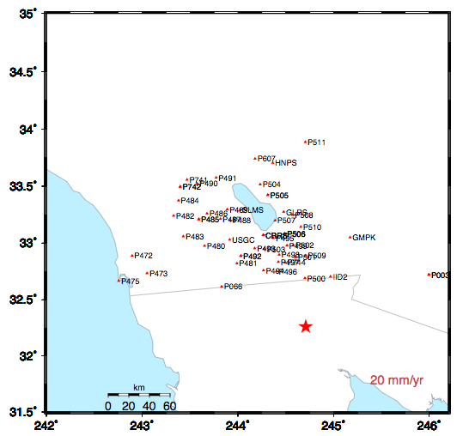
Sites in coseismic region
Sites shown have 5-Hz data for 3-days before and after the earthquake
Examine sequence of sites along US/Mexico border and North
Notes:
P494, P496 P500 P066 P473 P472 sequence in next slides.

Slide 10
P494

Slide 11
P496

Slide 12
P500

Slide 13
P066

Slide 14
P473
Notes:
Note that this and the next site are similar distances from the epicenter but P742 is along the San Andreas. Also point out the 220-sec arrival

Slide 15
P742

Slide 16
Surface wave arrival at P725
P725 is ~600 km from epicenter. This signal common to sites is the arrival at the “reference site”
Notes:
Low rate data from distance reference site (with sign flipped)

